Slide 1
OpenDSS Tutorial and Cases
ECpE Department
GRA: Fankun Bu
Advisor: Dr. Zhaoyu Wang
Department of Electrical and Computer Engineering
Iowa State University
Reference:
R. C. Dugan, The Open Distribution System Simulator (OpenDSS),
Electric Power Research Institute, Palo Alto, CA, USA, 2019.

Slide 2
Part I: OpenDSS Tutorial
ECpE Department

Slide 3
Outline
Introduction
  What is OpenDSS?
  What can OpenDSS do?
  OpenDSS Resources
Installation
User Interface
Workflow of developing a project
  Define a circuit
  Set up the circuit options
  Solve the circuit
  Perform analysis
ECpE Department

Slide 4

Introduction
What is OpenDSS?
The Open Distribution System Simulator (OpenDSS, or simply, DSS) is a comprehensive electrical system simulation tool for electric utility distribution systems.
Open → Open Source
DSS → Distribution System Simulator
The Development of OpenDSS began in April 1997. Roger Dugan is the principal author of the software.
In 2004, the DSS had been acquired by EPRI Solutions.
In 2008, EPRI released the software under an open-source license to cooperate with other grid modernization efforts.
ECpE Department

Slide 5
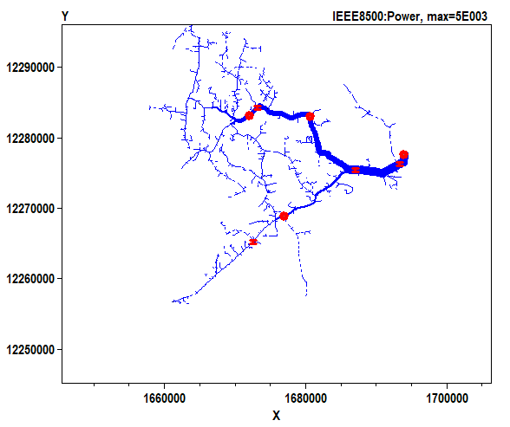
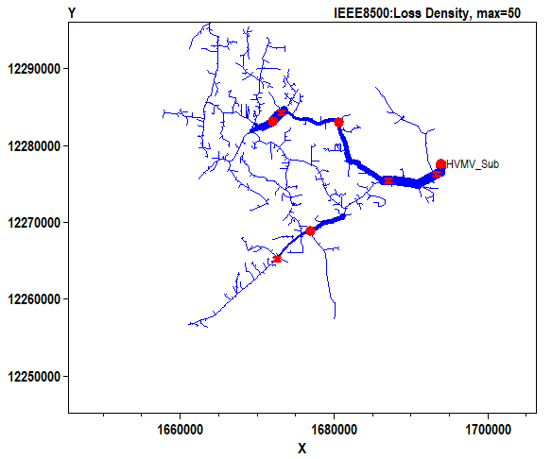
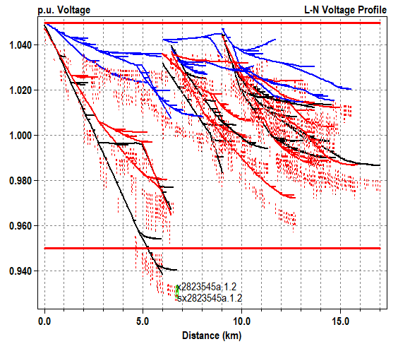
Introduction
What can OpenDSS do?
Power flow analysis
When a power flow is completed, the losses, nodal voltages, currents and power flows are available for the total system, each component, and certain defined areas.
  OpenDSS can handle both radial distribution (MV) circuits and network (meshed) systems.
  It can also be used to solve small‐ to medium‐sized networks with a transmission‐style power flow.
  The power flow executes in numerous solution modes including the standard single Snapshot mode, and Daily mode, etc.
Black -- phase 1
Blue -- phase 3
Red -- phase 2
Solid – Primary
Dotted – Secondary
ECpE Department

Slide 6
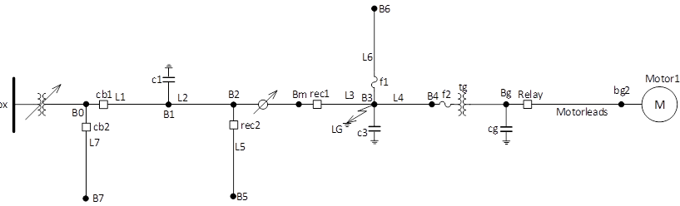
Introduction
What can OpenDSS do?
Fault study
Fault study can give us the short-circuit currents and voltages, which can further be used for selecting circuit breakers, setting relays or reclosers, and analyzing the stability of system operation.
  OpenDSS can perform fault study for all buses, reporting currents and voltages on all phases for all types of faults, including 3‐phase faults, SLG faults on each phase, LL and L‐L‐G faults.
ECpE Department

Slide 7
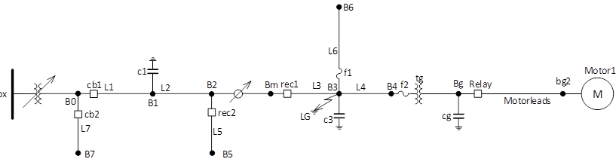
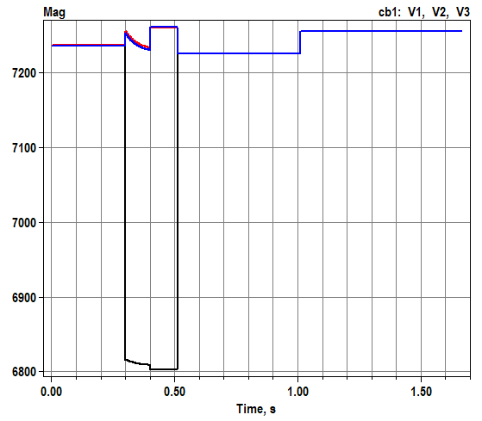
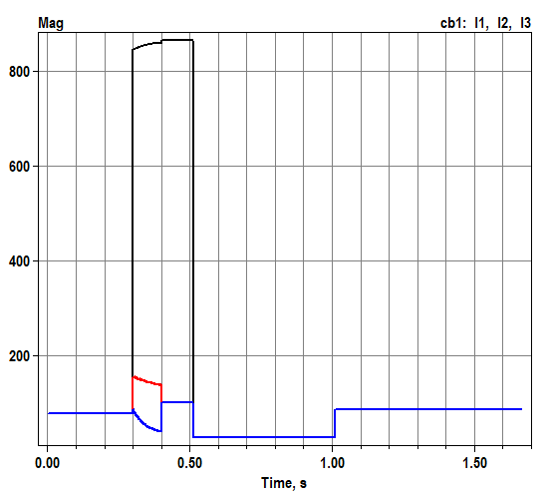
Introduction
What can OpenDSS do?
Fault study
Black -- phase 1
Red -- phase 2
Blue -- phase 3
ECpE Department

Slide 8
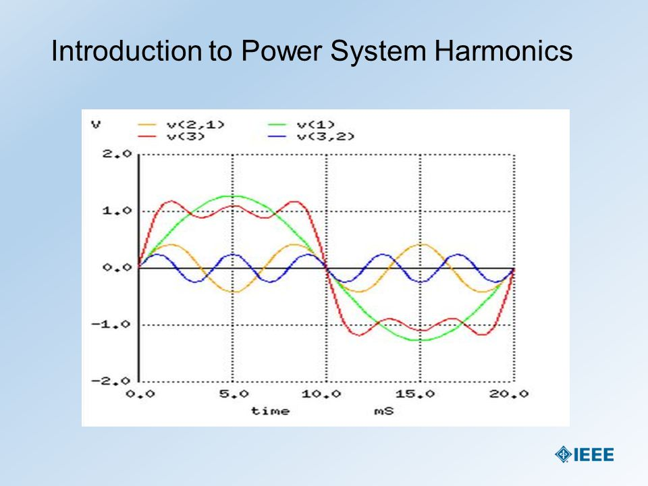
Introduction
What can OpenDSS do?
Harmonic flow analysis
It can give us power flow results corresponding to each frequency. The user defines various harmonic spectra to represent harmonic sources of interest. The spectra are connected to Load, Generator, voltage source, current source objects and a few other power conversion elements as desired.
https://slideplayer.com/slide/4397909/
ECpE Department

Slide 9
Introduction
What can OpenDSS do?
Dynamics
The OpenDSS can perform basic electromechanical transient, or dynamic simulations.
Black -- phase 1
Red -- phase 2
Blue -- phase 3
ECpE Department

Slide 10
Introduction
What can OpenDSS do?
Specific Applications
Distribution Planning and Analysis
General Multi‐phase AC Circuit Analysis
Analysis of Distributed Generation Interconnections
Annual Load and Generation Simulations
Risk‐based Distribution Planning Studies
Probabilistic Planning Studies
Solar PV System Simulation
Wind Plant Simulations
Nuclear Plant Station Auxiliary Transformer Modeling
Distribution Automation Control Assessment
Protection System Simulation
Storage Modeling
Distribution Feeder Simulation with AMI Data
Distribution State Estimation
Ground Voltage Rise on Transmission Systems
Geomagnetically‐Induced Currents (GIC)
EV Impacts Simulations
Co‐simulation of Power and Communications Networks
Analysis of Unusual Transformer Configurations
Harmonic and Interharmonic Distortion Analysis
Neutral‐to‐earth Voltage Simulations
Development of IEEE Test feeder cases
Phase Shifter Simulation
Arc Furnace Simulation
Impulse Loads (car crushers, etc.)
And more ….
ECpE Department

Slide 11
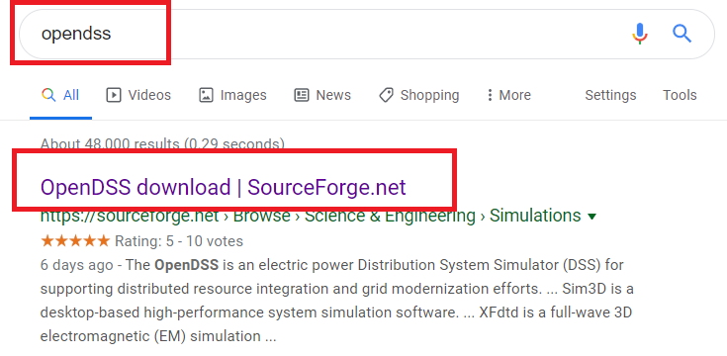
Introduction
Where to download and learn OpenDSS?
ECpE Department

Slide 12
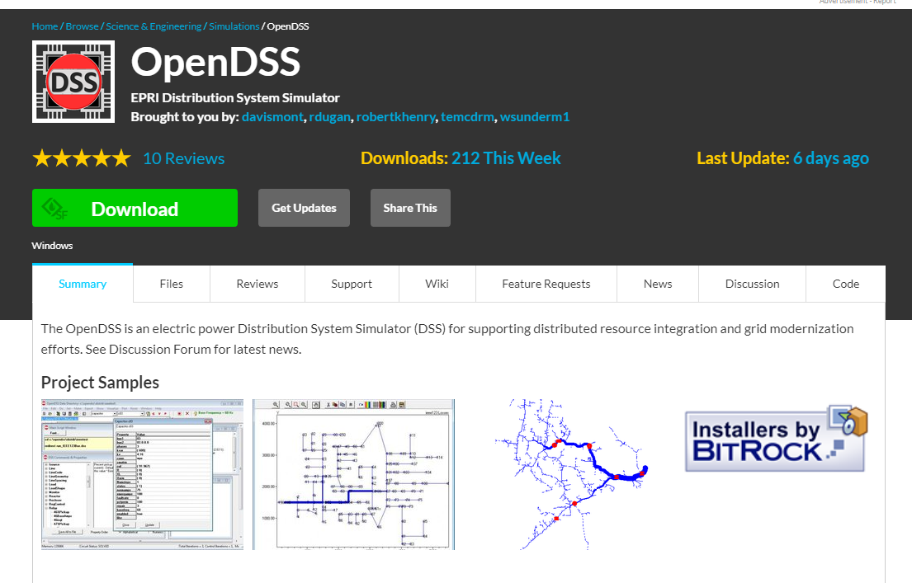
Introduction
Where to download and learn OpenDSS?
ECpE Department

Slide 13
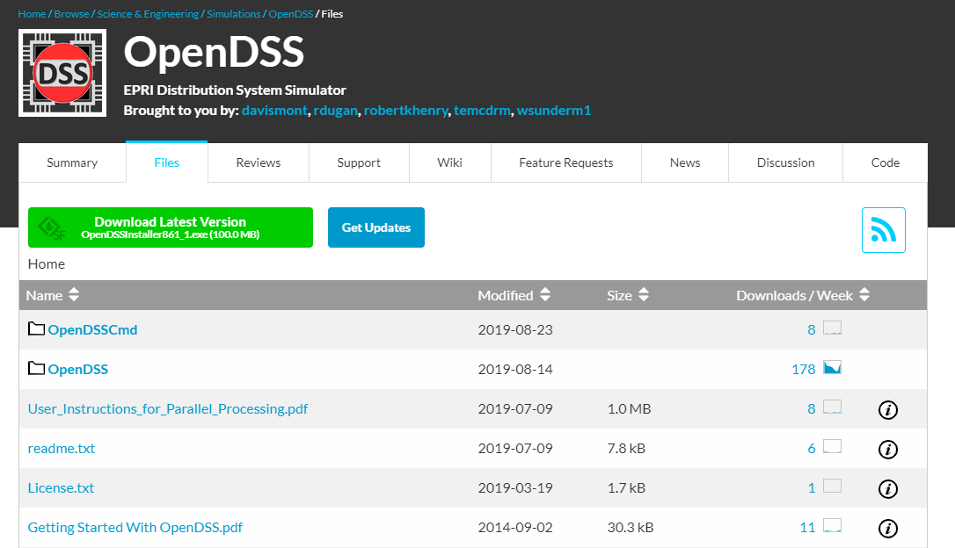
Introduction
Where to download and learn OpenDSS?
ECpE Department

Slide 14
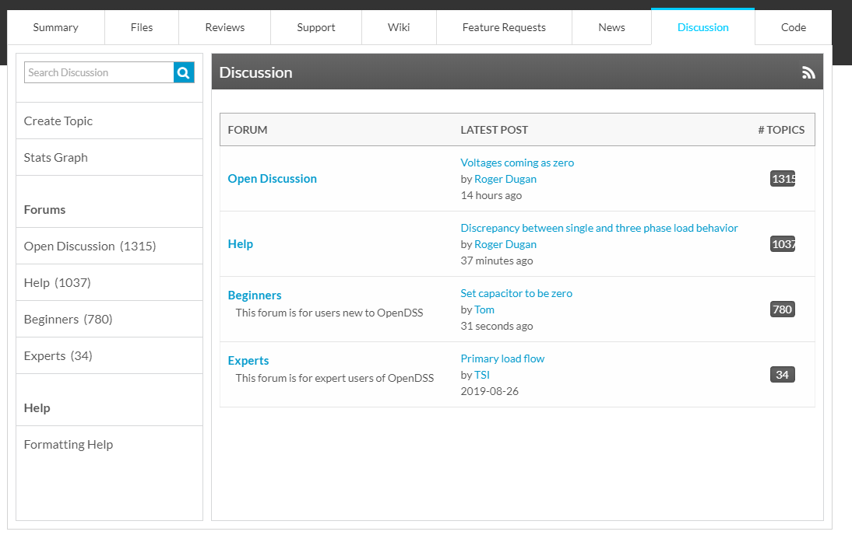
Introduction
OpenDSS Forum
ECpE Department

Slide 15
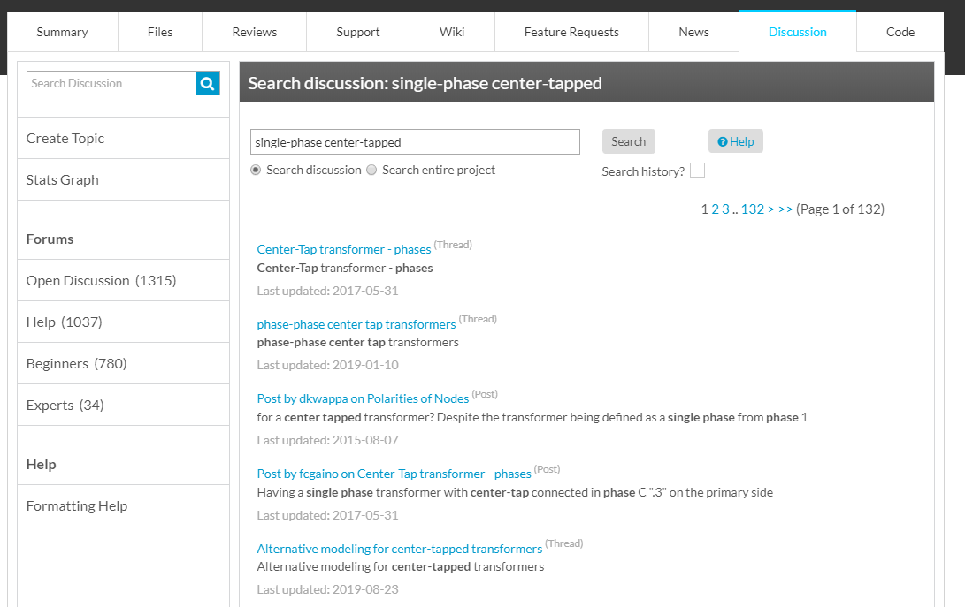
Introduction
OpenDSS Forum
ECpE Department

Slide 16
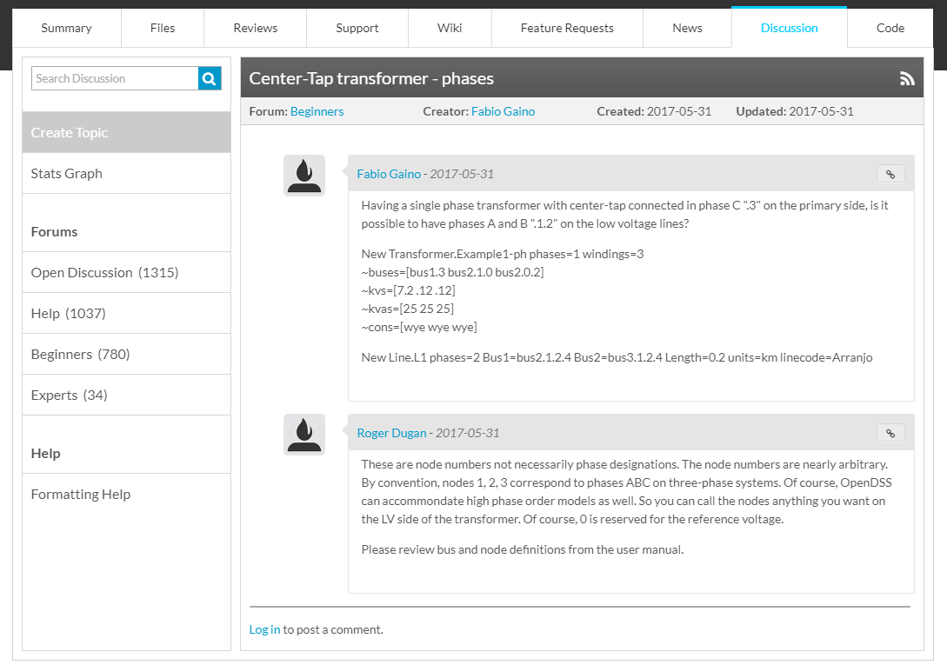
Introduction
OpenDSS Forum
ECpE Department

Slide 17
Introduction
Tutorial Videos
Introduction: https://www.youtube.com/watch?v=RGbfIfhGcRg&list=PLcOap2oqW_gEMEVH9dg2HoXJ4NvydfsZM
Line: https://www.youtube.com/watch?v=jUSWAC0jNDU&list=PLcOap2oqW_gEMEVH9dg2HoXJ4NvydfsZM&index=7
Linecode: https://www.youtube.com/watch?v=k8l3Lo10dgk&list=PLcOap2oqW_gEMEVH9dg2HoXJ4NvydfsZM&index=8
Transformer: https://www.youtube.com/watch?v=z9EbQCmaWBo&list=PLcOap2oqW_gEMEVH9dg2HoXJ4NvydfsZM&index=12
Capacitor: https://www.youtube.com/watch?v=cggpjOixWUI&list=PLcOap2oqW_gEMEVH9dg2HoXJ4NvydfsZM&index=11
Load: https://www.youtube.com/watch?v=FANmMQPnDPY&list=PLcOap2oqW_gEMEVH9dg2HoXJ4NvydfsZM&index=10
ECpE Department

Slide 18

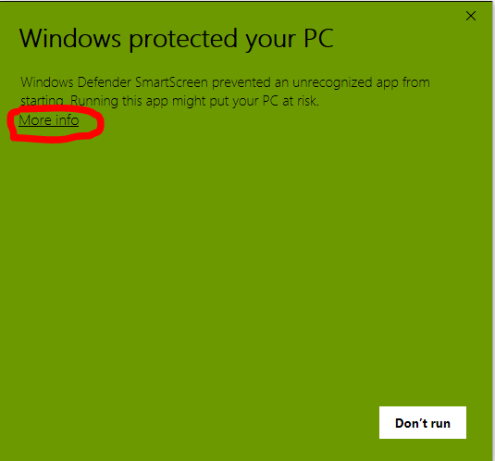
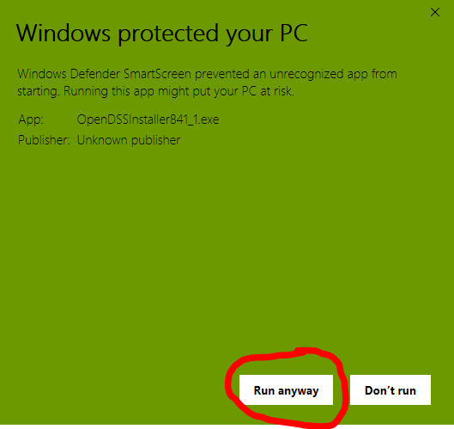
Installation
Enter the link https://sourceforge.net/projects/electricdss/ in your internet browser.
Click “Download” button in the figure below, the software will be downloaded automatically.
Open the downloaded OpenDSSInstaller.
(If your PC displays the reminder as below, click “more info”, then click “Run anyway”.)
ECpE Department

Slide 19
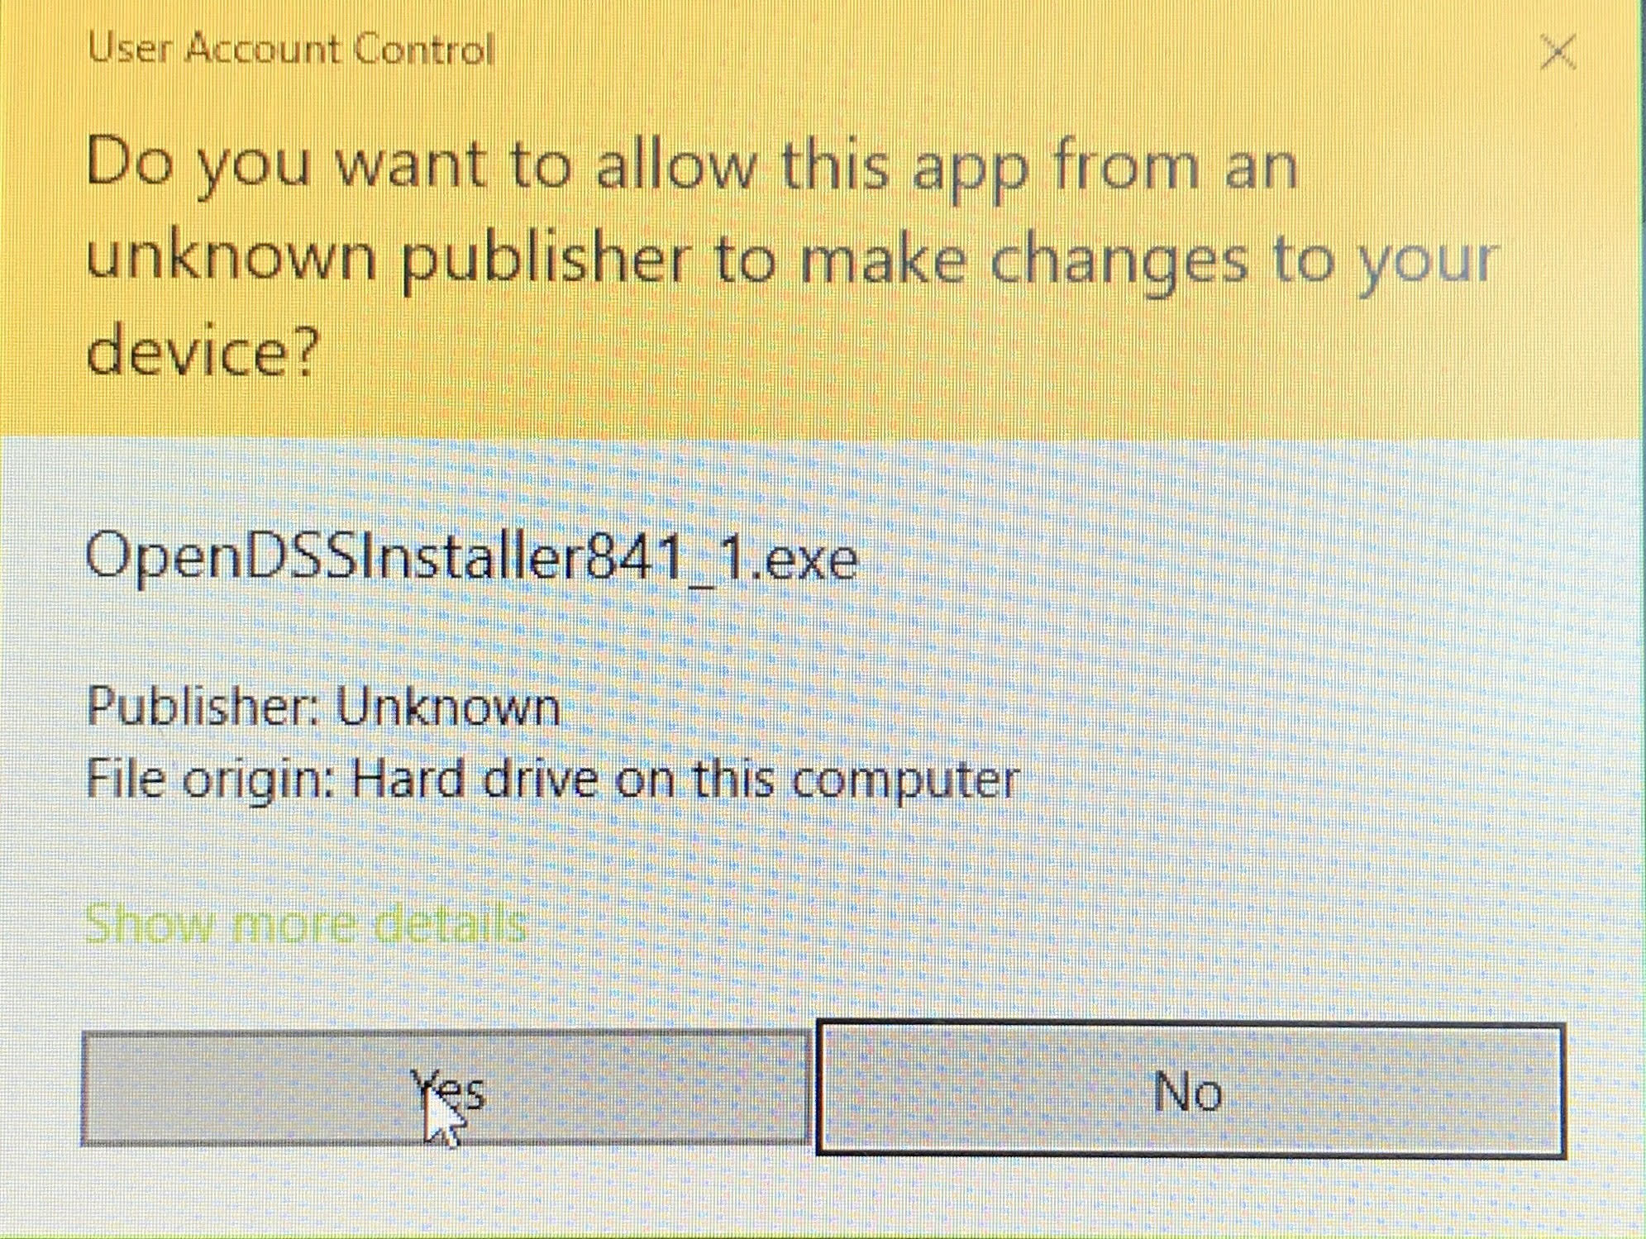
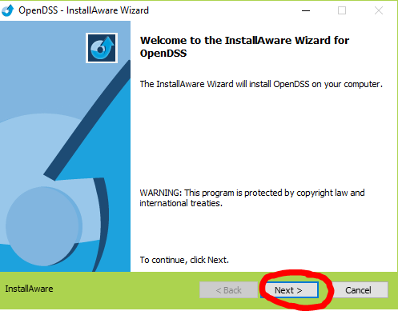
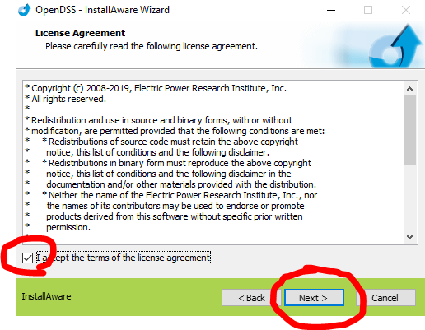
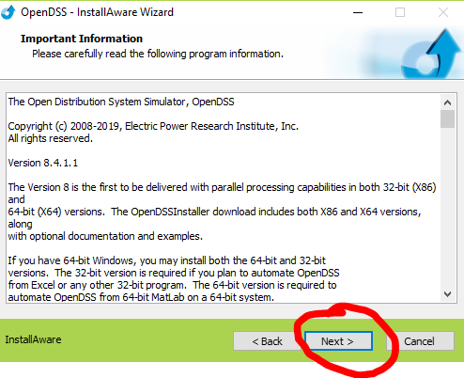
Installation
Click “Yes” in the popup dialog box.
Click “Next” button.
Select “I accept the terms of the license agreement” and click “Next”.
Click “Next”.
ECpE Department

Slide 20
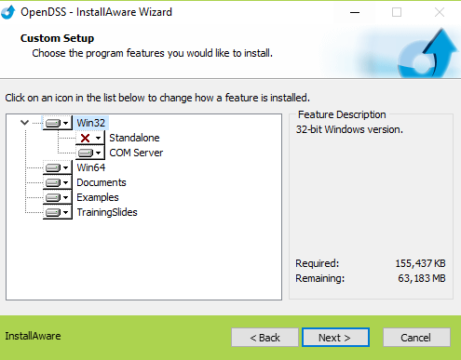
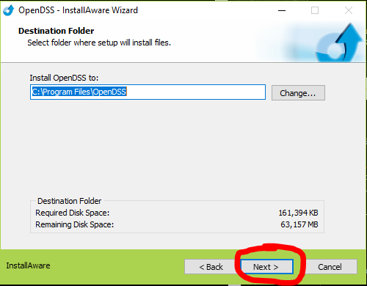
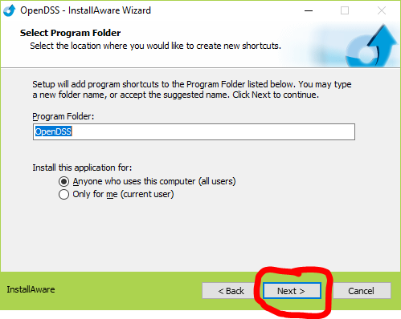
Installation
Then, a dialog box like the picture on the left will appear. Click the red cross and select “Will be installed on local hard drive”.
Choose the directory where you want to install and click “Next”.
Click “Next”.
ECpE Department

Slide 21
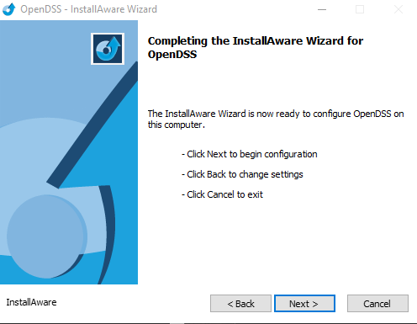
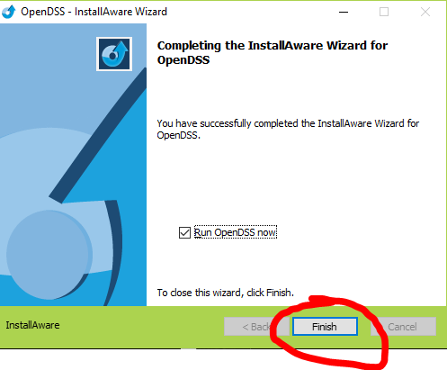
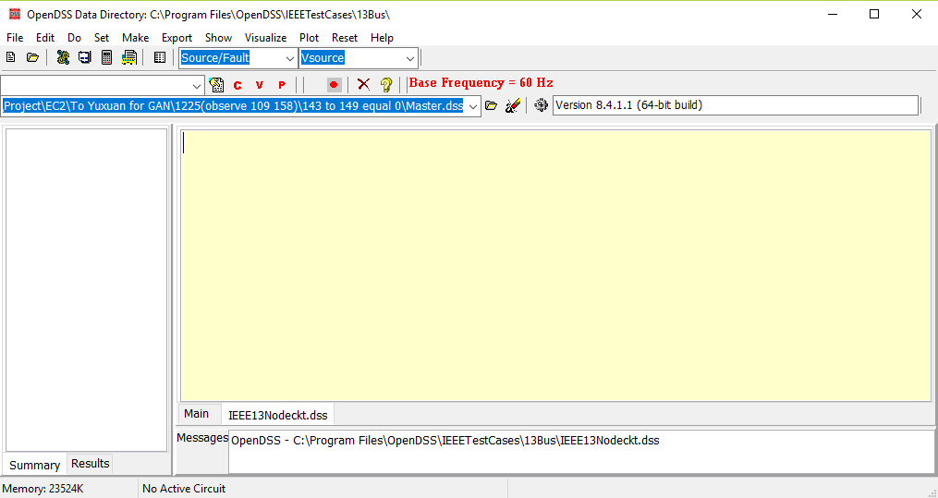
Installation
Click “Next”.
Click “Finish” and check if the software has been successfully installed.
If successful, an interface like below will appear.
ECpE Department

Slide 22
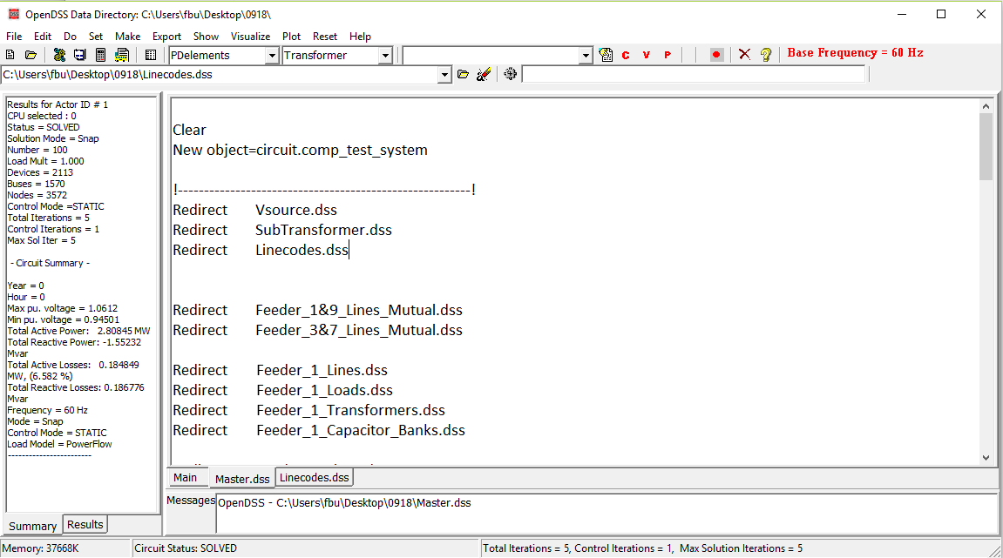
User Interface
Menus
Help button
Result bar
[1]
[8]
Toolbar
[2]
[3]
[4]
[5]
Script tools
Element tools
[6]
Summary window
[7]
Script windows
ECpE Department

Slide 23
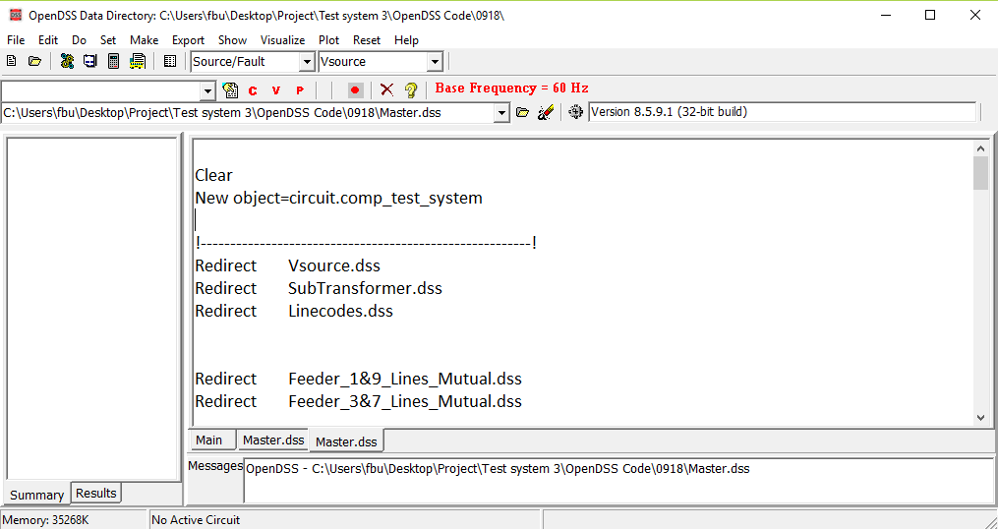
User Interface
[1] Menus: drive most of the workflow in OpenDSS.
Note that all these menus can be executed via writing alternative commands.
ECpE Department

Slide 24
User Interface
[1] Menus
-- File and Edit: create, open, save and edit project files.
ECpE Department

Slide 25
User Interface
[1] Menus
-- Do: contains the commands which are used for executing OpenDSS text strings.
The command “Selected Line(s)” is commonly used, it is like the general command “Run” .
ECpE Department

Slide 26
User Interface
[1] Menus
-- Set: allows us to set any solution parameters that can be set via the option scripting commands.
ECpE Department

Slide 27
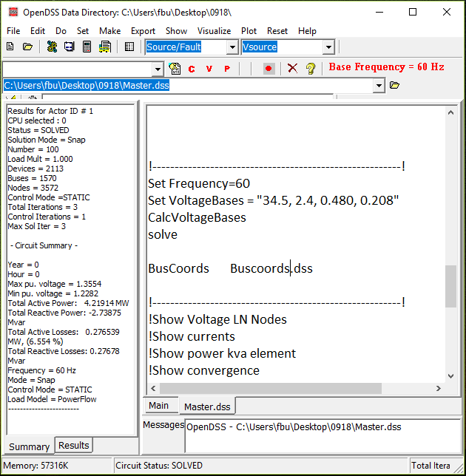
User Interface
[1] Menus
-- Set
Equivalent
ECpE Department

Slide 28
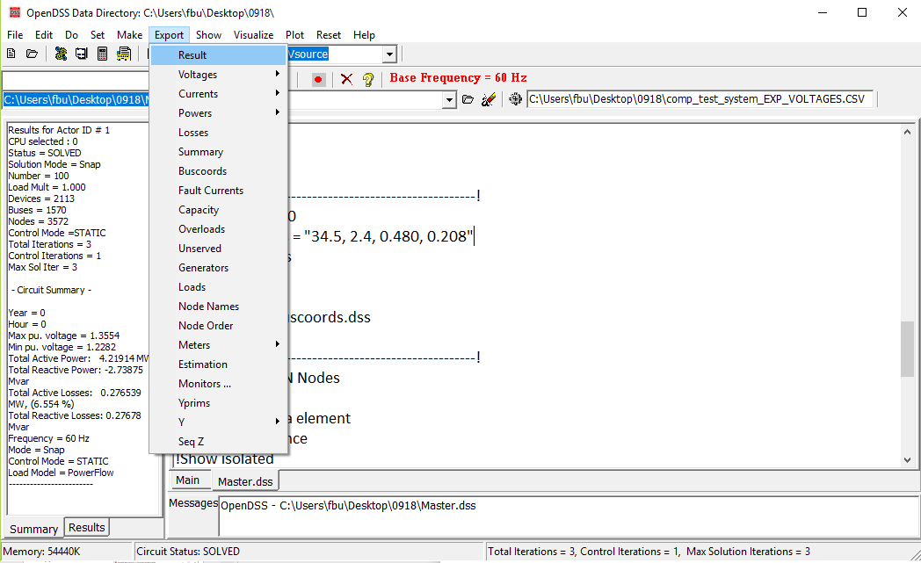
User Interface
[1] Menus
-- Export: allows us to save various reports to csv files.
ECpE Department

Slide 29
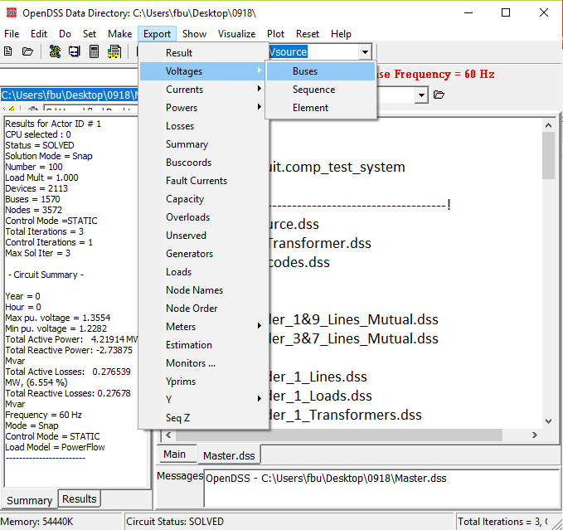
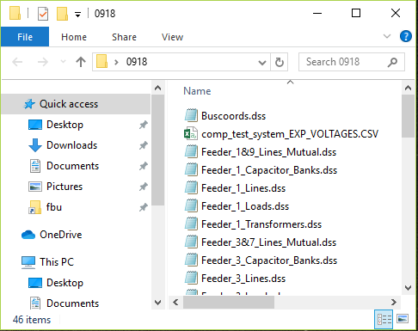
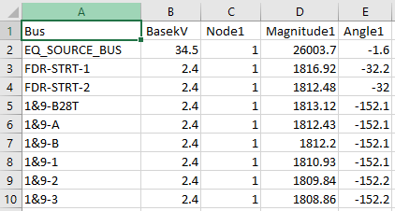
User Interface
[1] Menus
-- Export
ECpE Department

Slide 30
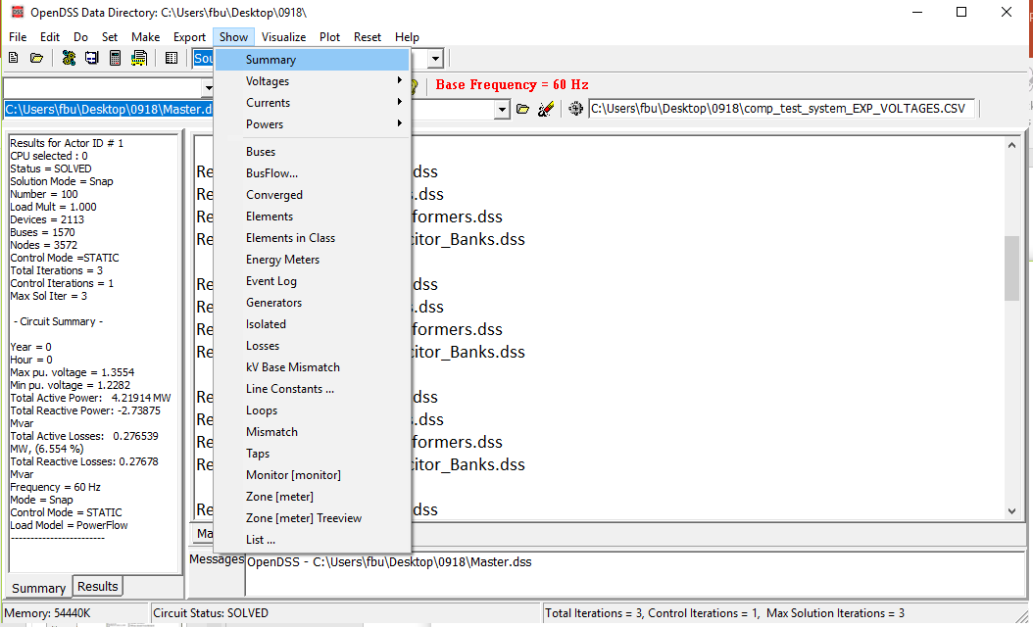
User Interface
[1] Menus
-- Show: contains much of the same information as the exported reports using the Export menu, but displays them directly in the GUI.
ECpE Department

Slide 31
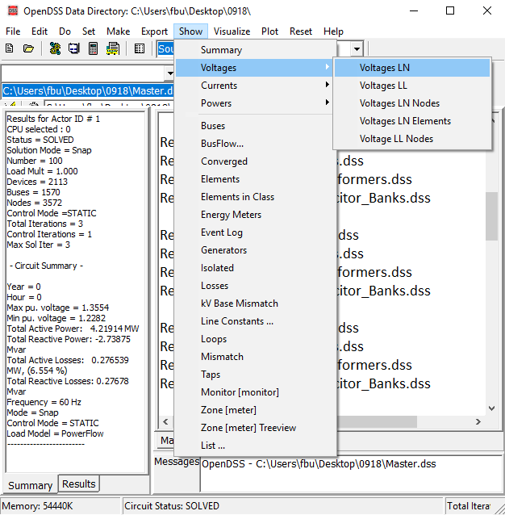
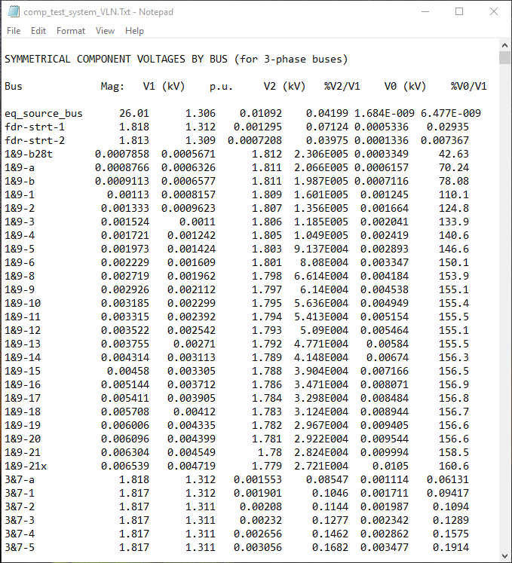
User Interface
[1] Menus
-- Show
popup
ECpE Department

Slide 32
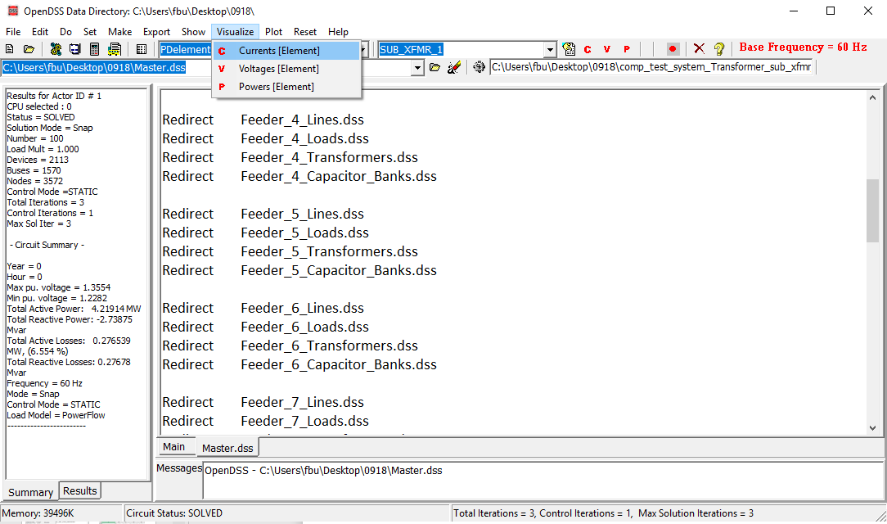
User Interface
[1] Menus
-- Visualize: provides a graphical output of the device selected via the element selector.
ECpE Department

Slide 33
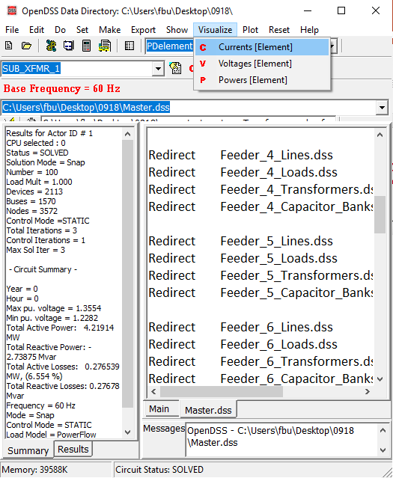
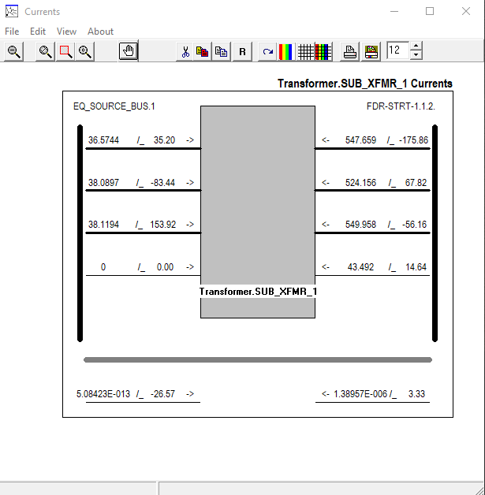
User Interface
[1] Menus
-- Visualize
popup
ECpE Department

Slide 34
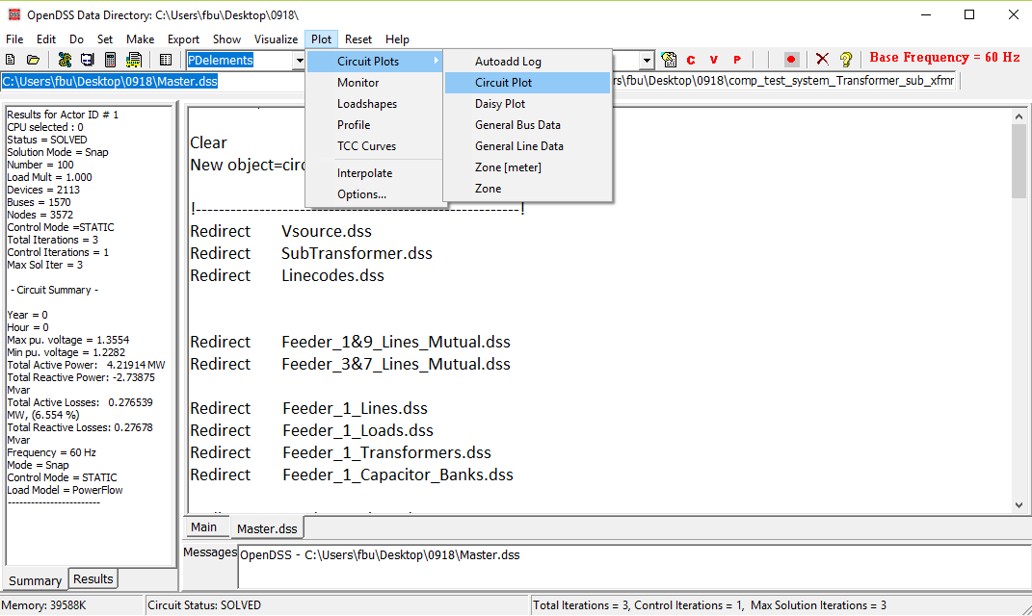
User Interface
[1] Menus
-- Plot: provides graphical output relevant to the whole system.
ECpE Department

Slide 35
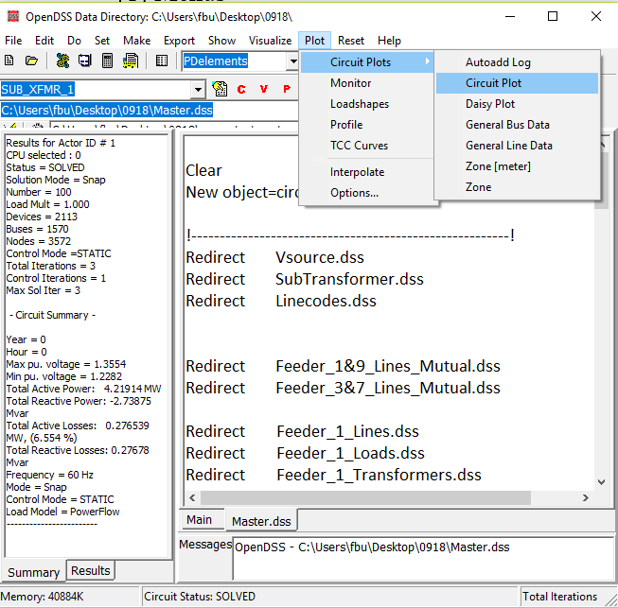
User Interface
[1] Menus
-- Plot
popup
ECpE Department

Slide 36
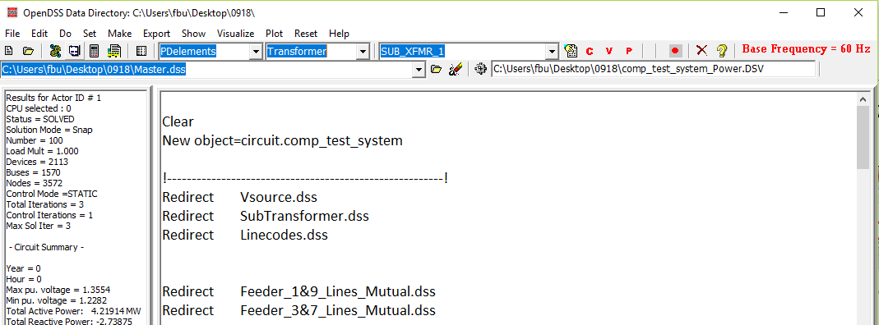
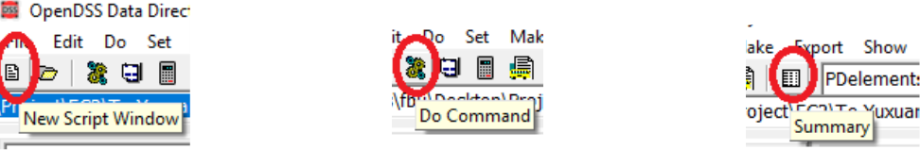
User Interface
[2] Toolbar: provides direct access to many commonly used OpenDSS commands such as “Solve,” “Summary,” and “Do Command”.
ECpE Department

Slide 37
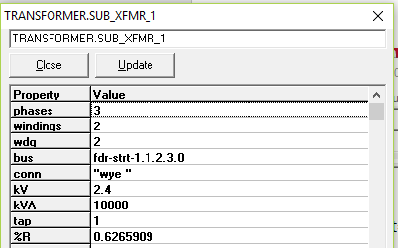
User Interface
[3] Element tools: allow the user to select which circuit element (by type) to edit or display visualizations for.
Edit parameter of the selected element.
Current
Voltage
Name of selected element
Power
ECpE Department

Slide 38
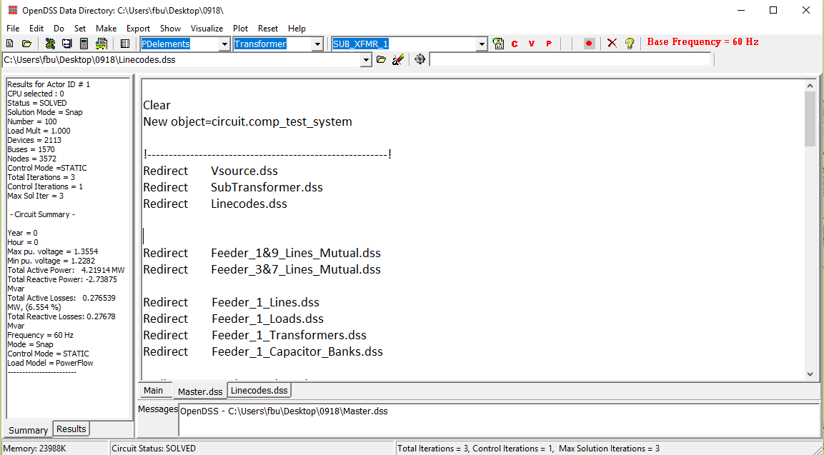
User Interface
[4] Script tools: allow us to select which of the current opened scripts to run.
ECpE Department

Slide 39
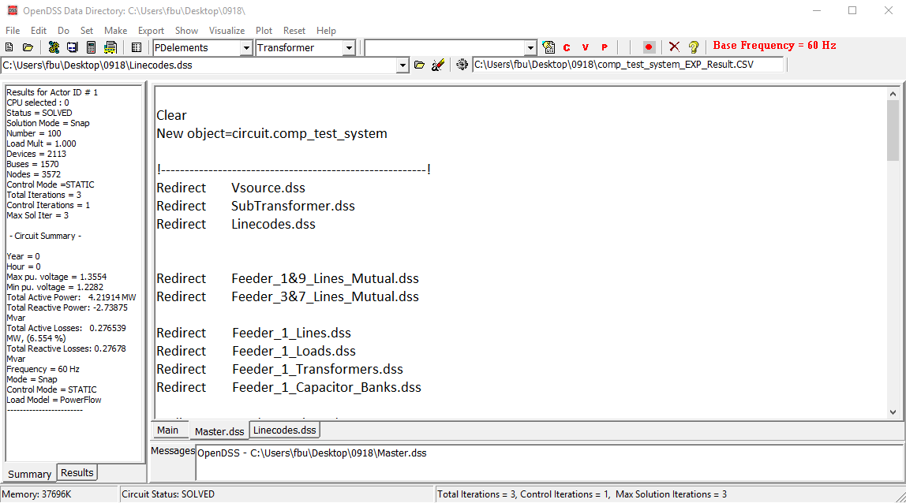
User Interface
[5] Results bar: provides a condensed version of the results.
ECpE Department

Slide 40
User Interface
[6] Script Windows: allow us to directly edit various *.dss files.
ECpE Department

Slide 41
User Interface
[7] Summary Window: provides us the brief summary of solutions.
ECpE Department

Slide 42
User Interface
[8] Help button: brings up the OpenDSS Command and Element Property Reference which gives a tree‐view guide to the various script commands in OpenDSS.
ECpE Department

Slide 43
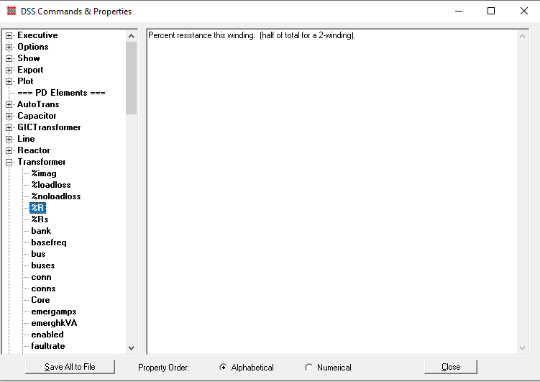
User Interface
[8] Help button
ECpE Department

Slide 44
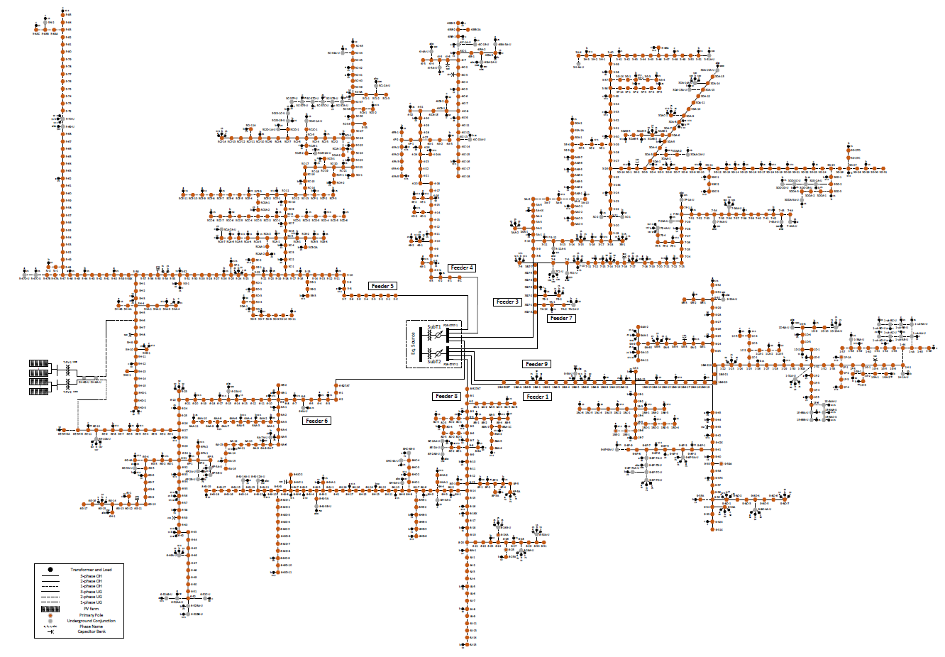
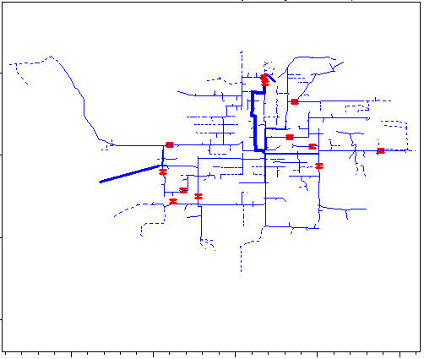
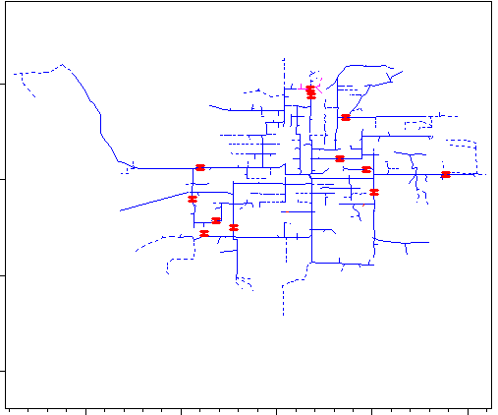



Workflow
4 steps to develop a project:
Define the circuit
Perform analysis
Set up the
circuit options
Solve
ECpE Department

Slide 45
Define A Circuit – Overall Concept
Define the circuit
Overall circuit model;
Bus and terminal models;
Power delivery elements;
Power conversion elements;
Putting it all together.
ECpE Department

Slide 46

Define A Circuit – Overall Concept
Overall Circuit Model
The OpenDSS consists of a model of the electrical power distribution system in the rms steady state, overlaid with a communication network that interconnects controls on power delivery elements and on power conversion elements.
Compared with the communication network, the electric power distribution system is more commonly used for simulating real systems.
ECpE Department

Slide 47

Define A Circuit – Overall Concept
Bus Definition
A bus is a circuit element having multiple ([1..N]) nodes. Buses are the connection point for all other circuit elements. In other words, bus is a connecting place with 1 or more nodes for connecting individual phases and other conductors.
Node 0 of each bus is implicitly connected to the voltage reference (i.e., the node's voltage is always 0 and is never explicitly included in the Y matrix).
In many other power system analysis programs, “bus” and “node” are nearly synonymous, but they are distinctively different in OpenDSS. Bus is the container of Node objects. That is to say, a Bus has Nodes.
ECpE Department

Slide 48

Define A Circuit – Overall Concept
Bus Definition
Bus naming:
Bus name can include letters and numbers, and can contain some symbols. It is better to avoid containing blanks, tabs, or other “white space”.
Example1:
ECpE Department

Slide 49

Define A Circuit – Overall Concept
Terminal Definition
Each electrical element in the power system has one or more terminals. Each terminal has one or more conductors.
△-grounded Y
Each conductor conceptually contains a disconnect switch and a TCC (fuse) curve. However, in general, we define external fuses or switches, instead of using the built-in fuses or switches. The conductors are numbered [1, 2, 3,…].
ECpE Department

Slide 50
Define A Circuit – Overall Concept
Terminal Definition
If the terminal is connected to an n‐phase device, the first n conductors are orderly assumed to correspond to the phases. The remaining conductors are frequently neutrals or other non‐power conductors.
phases
neutral
Note that Phase 1, 2, 3 do not necessarily correspond to Phase A, B, C, respectively.
ECpE Department

Slide 51

Define A Circuit – Overall Concept
Power delivery elements
Power delivery elements usually consist of two or more multiphase terminals.
Their basic function is to transport energy from one point to another.
In the power systems, the most common power delivery elements are lines and transformers.
ECpE Department

Slide 52

Define A Circuit – Overall Concept
Power conversion elements
Power conversion elements convert power from electrical form to some other forms, or vice-versa.
Most of the power conversion elements have only one connection to the power system and, therefore, only one multiphase terminal.
In the power systems, the most common power delivery elements are load and generator.
ECpE Department

Slide 53

Define A Circuit – DSS Command
DSS command contains three sections:
DSS command language syntax;
DSS command reference;
Option reference.
DSS commands specify the rules of writing .dss files
ECpE Department

Slide 54
Define A Circuit – DSS Command
Command syntax
The command language is of the following form:
Command parm1, parm2 parm3 parm 4 ….
Parameters (parm1, etc) may be separated by commas (,) or white spaces (blank, tab).
Parameters may be positional or named (tagged). If named, an "=" sign is expected.
Example:
New Object="Line.First Line" Bus1=b1240 Bus2=32 LineCode=336ACSR,
…
New “Line.First Line”, b1240 32 336ACSR, …
The first example uses named parameters, which are shown in the default order. The second example simply gives the values of the parameters and the parser assumes that they are in the default order. Note that the name of the object contains a blank, which is a standard DSS delimiter character. Therefore, it is enclosed in quotes or parentheses, etc.
ECpE Department

Slide 55
Define A Circuit – DSS Command
Command reference
Currently, there are 98 commands in OpenDSS. Newer builds of the DSS may have additional properties and commands. You can execute the Help command while running the DSS to view the present commands available in your version.
// (comment) and ! (inline comment)
The appearance of “//” in the command position indicates that this statement is a comment line. It is ignored by the DSS. If you wish to place an in‐line comment at the end of a command line, use the “!” character. The parser ignores all characters following the ! character.
// This is a comment line
New line.line4 linecode=336acsr length=2.0 ! this is an in‐line comment
ECpE Department
Notes:
Double slash, Exclamation mark

Slide 56
Define A Circuit – DSS Command
Command reference
/* … */ Block Comments
This block comment symbol is used to comment out whole sections (whole lines of script). The block comment must begin with /* in the FIRST column of the line. The block comment terminates after the appearance of */ anywhere in a line or with the end of a script file or selection in a script window. Example:
Compile "C:\Users\prdu001\DSSData\CDR\Master3.DSS"
New Monitor.Line1-PQ Line.LINE1 1 mode=1 ppolar=no
New Monitor.Line1-VI Line.LINE1 1 mode=0 VIpolar=Yes
/* comment out the next two monitors
New Monitor.Source-PQ Vsource.source 1 mode=1 ppolar=no
New Monitor.source-VI Vsource.source 1 mode=0 VIpolar=Yes
****/ End of block comment
New Monitor.Tran2-VI Transformer.PHAB 2 mod=0 VIPolar=no
New Monitor.Tran3-VI Transformer.PHAB 3 mod=0 VIPolar=no
Solve
ECpE Department

Slide 57
Define A Circuit – DSS Command
Command reference
Customizing Solution Processes
The next seven commands, all beginning with an underscore (‘_’) character, allow you to script your own solution process by providing access to the different steps of the solution process.
_DoControlActions
For step control of solution process: Pops control actions off the control queue according to the present control mode rules. Dispatches contol actions to proper control element "DoPendingAction" handlers.
_InitSnap
For step control of solution process: Initialize iteration counters, etc. that normally occurs at the start of a snapshot solution process.
_SampleControls
For step control of solution process: Sample the control elements, which push control action requests onto the control queue.
…
ECpE Department

Slide 58
Define A Circuit – DSS Command
Command reference
Customizing Solution Processes
…
_ShowControlQueue
For step control of solution process: Show the present control queue contents.
_SolveDirect
For step control of solution process: Invoke direct solution function in DSS. Non‐iterative solution of Y matrix and active sources only.
_SolveNoControl
For step control of solution process: Solves the circuit in present state but does not check for control actions.
_SolvePFlow
For step control of solution process: Invoke iterative power flow solution function of DSS directly.
ECpE Department

Slide 59
Define A Circuit – DSS Command
Command reference
AddBusMarker
Add a marker to a bus in a circuit plot. Markers must be added before issuing the Plot command. The effect is persistent until circuit is cleared or the ClearBusMarkers command is issued. Example:
ClearBusMarkers !...Clears any previous bus markers
AddBusMarker Bus=Mybusname1 code=5 color=Red size=3
AddBusMarker Bus=Mybusname2 code=5 color=Red size=3
...
For the color, you can use any of the standard color names or RGB numbers.
To clear the present definitions of bus markers, issue the ClearBusMarkers command. If you specify a busname that doesn’t exist, it is simply ignored.
ECpE Department

Slide 60
Define A Circuit – DSS Command
Command reference
AllocateLoads
Estimates the allocation factors for loads that are defined using the XFKVA property. Requires that energymeter objects be defined with the PEAKCURRENT property set. Loads that are not in the zone of an energymeter cannot be allocated. This command adjusts the allocation factors for the appropriate loads until the best match possible to the meter values is achieved. Loads are adjusted by phase. Therefore all single‐phase loads on the same phase will end up with the same allocation factors.
If loads are not defined with the XKVA property, they are ignored by this command.
BusCoords
It defines x,y coordinates for buses. It is executed after executing Solve or MakeBusList command, so that bus lists are defined. You can read coordinates from a CSV file with records of the following form:
busname, x, y.
You may use spaces and tabs as well as commas for value separators. Example:
BusCoords [file=]xxxx.csv
ECpE Department

Slide 61
Define A Circuit – DSS Command
Command reference
CalcVoltageBases
It estimates the voltage base for each bus based on the array of voltage bases defined with a "SetVoltagebases=..." command. To calculate voltage bases, first, OpenDSS performs a zero‐current power flow considering only the series power‐delivery elements of the system. No loads, generators, or other shunt elements are included in the solution. The voltage base for each bus is then set to the nearest voltage base specified in the voltage base array.
Alternatively, you may use the SetkVBase command to set the voltage base for each bus, individually. Note that the OpenDSS does not need the voltage base for most calculations, but uses it for reporting.
It is useful to show the bus voltages after the execution of this command. This will help confirm that everything in the circuit is connected as it should be. It is especially useful for devices with unusual connections.
ECpE Department

Slide 62
Define A Circuit – DSS Command
Command reference
CktLosses
Returns the total losses for the active circuit in the Result string in kW, kvar.
Clear
Clears all circuit element definitions from the DSS. This statement is recommended at the beginning of all Master files for defining DSS circuits.
ClearBusMarkers
Clears all bus markers created with the AddBusMarker command.
Currents
Returns the currents for each conductor of ALL terminals of the active circuit element in the Result string. (See Select command.) Returned as comma‐separated magnitude and angle.
ECpE Department

Slide 63
Define A Circuit – DSS Command
Command reference
Disable [Object]
Disables object in active circuit. All objects are Enabled when first defined. Use this command if you wish to temporarily remove an object from the active circuit, for example, for a contingency case.
Edit [Object] [Edit String]
Edits the specified object. When editing, the object Class and Name fields are required and you must designate a valid object (previously instantiated by a New command) in the problem. Otherwise, nothing is done and an error is posted.
The edit string is passed on to the object named to process. The DSS main program does not attempt to interpret property values for circuit element classes. These can and do change periodically.
ECpE Department

Slide 64
Define A Circuit – DSS Command
Command reference
Enable [Object]
Cancels a previous Disable command. All objects are automatically Enabled when first defined. Therefore, the use of this command is unnecessary until an object has been first disabled. (Also see Open, Close commands.)
Export <Quantity> [Filename or switch]
Writes a text file (.CSV) of the specified quantity for the most recent solution. Defaults to exporting voltages. The purpose of this command is to produce a file that is readily readable by other programs such as MATLAB (use csvread), spreadsheet programs, or database programs.
The first record is a header record providing the names of the fields. The remaining records are for data. For example, the voltage export looks like this:
…
ECpE Department

Slide 65
Define A Circuit – DSS Command
Command reference
Export <Quantity> [Filename or switch]
…
Bus, Node Ref., Node, Magnitude, Angle, p.u., Base kV
sourcebus , 1, 1, 6.6395E+0004, 0.0, 1.000, 115.00
sourcebus , 2, 2, 6.6395E+0004, -120.0, 1.000, 115.00
sourcebus , 3, 3, 6.6395E+0004, 120.0, 1.000, 115.00
subbus , 4, 1, 7.1996E+0003, 30.0, 1.000, 12.47
subbus , 5, 2, 7.1996E+0003, -90.0, 1.000, 12.47
subbus , 6, 3, 7.1996E+0003, 150.0, 1.000, 12.47
This format is common for many spreadsheets and databases, although databases may require field types and sizes for direct import. The columns are aligned for better readability.
Valid syntax for the command can be one of the following statement prototypes in bold. If the Filename is omitted, the file name defaults to the name shown in italics in parentheses.
…
ECpE Department

Slide 66
Define A Circuit – DSS Command
Command reference
Export <Quantity> [Filename or switch]
…
Export Voltages [Filename] (EXP_VOLTAGES.CSV). Exports voltages for every bus and active node in the circuit. (Magnitude and angle format).
Export SeqVoltages [Filename] (EXP_SEQVOLTAGES.CSV) Exports the sequence voltage magnitudes and the percent of negative‐ and zero‐sequence to positive sequence.
Export Currents [Filename] (EXP_CURRENTS.CSV) Exports currents in magnitude and angle for each phase of each terminal of each device.
Export Overloads [Filename] EXP_OVERLOADS.CSV) Exports positive sequence current for each device and the percent of overload for each power delivery element that is overloaded.
Export SeqCurrents [Filename] (EXP_SEQCURRENTS.CSV) Exports the sequence currents for each terminal of each element of the circuit.
…
ECpE Department

Slide 67
Define A Circuit – DSS Command
Command reference
Export <Quantity> [Filename or switch]
…
Export Powers [MVA] [Filename] (EXP_POWERS.CSV). Exports the powers for each terminal of each element of the circuit. If the MVA switch is specified, the result are specified in MVA. Otherwise, the results are in kVA units.
Export Faultstudy [Filename] (EXP_FAULTS.CSV) Exports a simple report of the 3‐ phase, 1‐phase and max L‐L fault at each bus.
Export Loads [Filename] (EXP_LOADS.CSV) Exports the follow data for each load object in the circuit: Connected KVA, Allocation Factor, Phases, kW, kvar, PF, Model.
Export Monitors monitorname (file name is assigned) Automatically creates a separate filename for each monitor. Exports the monitor record corresponding the monitor's mode. This will vary for different modes.
…
ECpE Department

Slide 68
Define A Circuit – DSS Command
Command reference
Export <Quantity> [Filename or switch]
…
Export Meters [Filename | /multiple ] (EXP_METERS.CSV)
Export Generators [Filename | /multiple ] (EXP_GENMETERS.CSV)
EnergyMeter and Generator object exports are similar. Both export the time and the values of the energy registers in the two classes of objects. In contrast to the other Export options, each invocation of these export commands appends a record to the file.
For Energymeter and Generator, specifying the switch "/multiple" (or /m) for the file name will cause a separate file to be written for each meter or generator. The default is for a single file containing all meter or generator elements.
Export Yprims [Filename] (EXP_Yprims.CSV). Exports all primitive Y matrices for the present circuit to a CSV file.
…
ECpE Department

Slide 69
Define A Circuit – DSS Command
Command reference
Export <Quantity> [Filename or switch]
…
Export Y [Filename] (EXP_Y.CSV). Exports the present system Y matrix to a CSV file. Useful for importing into another application. Note: This file can be HUGE!
Export SeqZ [Filename] (EXP_SEQZ.CSV). Exports the equivalent sequence short circuit impedances at each bus. Should be preceded by a successful “Solve Mode=Faultstudy” command. This will initialize the short circuit impedance matrices at each bus.
ECpE Department

Slide 70
Define A Circuit – DSS Command
Command reference
Get [Opt1] [opt2] etc.
Basically, it is the opposite of the SET command. It returns DSS property values for options set, using the Set command. Result is returned in the Result property of the Text interface.
VBA Example:
DSSText.Command = "Get mode"
Answer = DSSText.Result
Note that multiple properties may be requested on one get. The results are appended and the individual values are separated by commas. Array values are returned separated by commas.
ECpE Department

Slide 71
Define A Circuit – DSS Command
Command reference
LatLongCoords
It defines x,y coordinates for buses using Latitude and Longitude values (decimal numbers). Similar to BusCoords command, it is executed after executing Solve command or MakeBusList command, so that bus lists are defined. You can read coordinates from a CSV file with records of the follwing form:
busname, Latitude, Longitude.
Example:
LatLongCoords [file=]xxxx.csv
Note: Longitude is mapped to x coordinate and Latitude is mapped to y coordinate.
Losses
Returns the total losses for the active circuit element in the Result string, in kW, kvar.
ECpE Department

Slide 72
Define A Circuit – DSS Command
Command reference
MakeBusList
Updates the buslist, if needed, using the currently enabled circuit elements. (This happens automatically for Solve command.) See ReprocessBuses.
New [Object] [Edit String]
It adds an element which is described on the remainder of the line to the active circuit. The first parameter (Object=…) is required for the New command.
All circuit objects are instantiated with a reasonable set of values, so that they can likely be included in the circuit and solved without modification. Therefore, the Edit String needs only to include definitions for property values that are different than the defaults.
…
ECpE Department

Slide 73
Define A Circuit – DSS Command
Command reference
New [Object] [Edit String]
…
Examples:
New Object=Line.Lin2 ! Min required
New Line.Lin2 ! Same, sans object= …
!Line from Bs1 to Bs2
New Line.Lin2 Bs1 Bs2 R1=.01 X1=.5 Length=1.3
The Edit String does not have to be complete at the time of issuing the New command. The object instantiated may be edited again at any later time by invoking the Edit command or by continuing with the next command line (see More or ~). The ‘later time’ does not have to occur immediately after definition. One can make up a script later that edits one or more object properties.
…
ECpE Department

Slide 74
Define A Circuit – DSS Command
Command reference
New [Object] [Edit String]
…
Immediately after issuing the New command, the instantiated object remains the active object, and the Edit command does not have to be given to select the object for further editing. You can simply issue the More command, or one of its abbreviations (~), and continue to send editing instructions. Actually, the DSS command interpreter defaults to editing mode and you may simply issue the following command
Property=value …(and other editing statements)
The "=" is required when using this format. When the DSS parser sees this, it will assume you wish to continue editing and are not issuing a separate DSS Command.
To avoid ambiguity, which is always recommended for readability, you may specify the element completely:
Class.ElementName.Property = Value
…
ECpE Department

Slide 75
Define A Circuit – DSS Command
Command reference
New [Object] [Edit String]
…
More than one property may be set on the same command, just as if you had issued the New or Edit commands.
Class.ElementName.Property1 = Value1 property2=value2 …
Note that all DSS objects have a Like property inherited from the base class. When another element of the same class is very similar to a new one being created, use the Like parameter to start the definition then change only the parameters that differ. Therefore, you should issue the Like=nnnn property first. Example:
New Line.Lin3 like=Lin2 Length=1.7
While all devices have a Like property, for Line objects and Transformer objects, users generally prefer to use the Linecode and Xfmrcode properties instead when objects have the same properties.
ECpE Department

Slide 76
Define A Circuit – DSS Command
Command reference
[Object Property Name] = value
This syntax permits the setting of any published property value of a DSS circuit element. Simply specify the complete element and property name, “=”, and a value. For example,
Monitor.mon1.mode=48
In this example, this method simply invokes the Monitor object’s editor and sets the value. If there is more text on the string, the editor continues editing. For example,
Line.line1.R1=.05 .12 .1 .4
will set the R1, X1, R0, X0 properties of Line.line1 in sequence using positional property rules.
This is a convenient syntax to use to change properties in circuit elements that have already been defined.
ECpE Department

Slide 77
Define A Circuit – DSS Command
Command reference
Open [Object] [Term] [Cond]
It opens a specified terminal conductor switch.
All conductors in the terminals of all circuit elements have an inherent switch. This command can be used to open one or more conductors in a specified terminal.
If the 'Cond=' field is 0 or omitted, all phase conductors are opened. Otherwise, open one conductor at a time (one per command). For example:
Open object=line.linxx term=1 ! opens all phase conductors of
terminal 1 of linxx
Open line.linxx 2 3 ! opens 3rd conductor of 2nd terminal of linxx
No action is taken if either the terminal or conductor specifications are invalid. Note, this action disconnects the terminal from the node to which it is normally connected. The node remains in the problem. If it becomes isolated, a tiny conductance is attached to it and the voltage computes to zero.
ECpE Department

Slide 78
Define A Circuit – DSS Command
Command reference
PhaseLosses
Returns the losses for the active circuit element (see Select command) for each PHASE in the Result string in comma‐separated kW, kvar pairs.
Plot (options …)
Plot is a rather complex command that displays a variety of results in a variety of manners on graphs.
You can use the control panel to execute the plot command with the recorder on to see examples of how to construct the plot command. Implemented options include (in order):
…
ECpE Department

Slide 79
Define A Circuit – DSS Command
Command reference
Plot (options …)
…
Type = {Circuit | Monitor | Daisy | Zones | AutoAdd | General (bus data) | Loadshape | Tshape | Priceshape |Profile}. A Circuit plot requires that the bus coordinates should be defined. By default the thickness of the circuit lines is drawn proportional to power. The Monitor plot plots one or more channels from a Monitor element. A Daisy plot is a special circuit plot that shows a unique symbol for generators. (When there are many generators at the same bus, the plot resembles a daisy.) The Zones plot draws the energymeter zones. Autoadd plot shows autoadded elements on the circuit plot. General plot expects a CSV file of bus data with bus name and a number of values. Specify which value to plot in Quantity= property. Bus colors are interpolated based on the specification of C1, C2, and C3. Loadshape, Tshape and Priceshape plots show the time-varying load, temperature and price curves, respectively. Profile plot expects voltage curves.
…
ECpE Department

Slide 80
Define A Circuit – DSS Command
Command reference
Plot (options …)
…
Quantity = {Voltage | Current | Power | Losses | Capacity | (Value Index for General, AutoAdd, or Circuit[w/ file]) } Specifies which quantity or value index to be plotted.
Max = {0 | value corresponding to max scale or line thickness}
Dots = {Y | N} It specifies turning on/off the dot symbol for bus locations on the circuit plot.
Labels = {Y | N} Turns on/off the bus labels on the circuit plot Object = [metername for Zone plot | Monitor name | File Name for General bus data or Circuit branch data | Loadshape name]. Specifies what object to plot: meter zones, monitor or CSV file, or previously defined Loadshape.
…
ECpE Department

Slide 81
Define A Circuit – DSS Command
Command reference
Plot (options …)
…
ShowLoops = {Y | N} (default=N). Shows the loops in meter zone in red. Note that the DSS has no problem solving loops; This is to help detect unintentional loops in radial circuits.
R3 = pu value for tri‐color plot max range [0.85] (Color C3)
R2 = pu value for tri‐color plot mid range [0.50] (Color C2)
C1, C2, C3 = {RGB color number}. Three color variables used for various plots.
Channels = (array of channel numbers for monitor plot). Specifies which monitor channels to be plotted on the same graph. Ex: Channels=[1, 3, 5]
Bases = (array of base values for each channel for monitor plot). Default is 1.0 for each. This will per‐unitize the plot to the specified bases. Set Bases=[ … ] after defining channels.
Subs = {Y | N} (default=N) Specifies whether to show substations or not.
…
ECpE Department

Slide 82
Define A Circuit – DSS Command
Command reference
Plot (options …)
…
Thickness = max thickness allowed for lines in circuit plots (default=7). Useful for controlling aesthetics on circuit plots.
Buslist = {Array of Bus Names | File=filename } This is for the Daisy plot.
Plot daisy power max=5000 dots=N Buslist=[file=MyBusList.txt]
A "daisy" marker is plotted for each bus in the list. Bus names may be repeated, which results in multiple markers distributed in a circle around the bus location. This gives the appearance of a daisy if there are several symbols at a bus. Not needed for plotting active generators.
Phases = {default* | ALL | PRIMARY | LL3ph | LLALL | LLPRIMARY | (phase number)} For Profile plot. Specify which phases you want plotted.
  default = plot only nodes 1‐3 at 3‐phase buses (default)
  ALL = plot all nodes
…
ECpE Department

Slide 83
Define A Circuit – DSS Command
Command reference
Plot (options …)
…
PRIMARY = plot all nodes ‐‐ primary only (voltage > 1kV)
LL3ph = 3‐ph buses only ‐‐ L‐L voltages)
LLALL = plot all nodes ‐‐ L‐L voltages)
LLPRIMARY = plot all nodes ‐‐ L‐L voltages primary only)
(phase number) = plot all nodes on selected phase
Note: Only nodes downline from an energy meter are plotted.
For Loadshapes, they may be plotted from the control panel of the user interface.
For Power and Losses, they are specified in kW. C1 is used for default color. C2, C3 are used for gradients, tricolor plots. Scale is determined automatically of Max = 0 or not specified. Some examples:
…
ECpE Department

Slide 84
Define A Circuit – DSS Command
Command reference
Plot (options …)
…
Plot circuit quantity=7 Max=.010 dots=Y Object=branchdata.csv
Plot General Quantity=2 Object=valuefile.csv
Plot type=circuit quantity=power
Plot Circuit Losses 1phlinestyle=3
Plot Circuit quantity=3 object=mybranchdata.csv
Plot daisy power 5000 dots=N
Plot daisy power max=5000 dots=N Buslist=[file=MyBusList.txt]
Plot General quantity=1 object=mybusdata.csv
Plot Loadshape object=myloadshape
Plot Tshape object=mytemperatureshape
Plot Priceshape object=mypriceshape
Plot Profile
Plot Profile Phases=Primary
ECpE Department

Slide 85
Define A Circuit – DSS Command
Command reference
Powers
Returns the powers (complex) going into each conductors of ALL terminals of the active circuit element. The powers are returned as comma‐separated kW and kvar.
Sample
Force all monitors and Energymeters to take a sample for the most recent solution. Keep in mind that Energymeters will perform integration each time they take a sample.
SeqCurrents
Returns the sequence currents going into all terminals of the active circuit element. The sequence currents are returned as comma‐separated magnitude only values. Order of returned values: 0, 1, 2 (for each terminal).
ECpE Department

Slide 86
Define A Circuit – DSS Command
Command reference
SeqPowers
Returns the sequence powers going into all terminals of the active circuit element. The sequence powers are returned as comma‐separated kw, kvar pairs. Order of returned values: 0, 1, 2 (for each terminal).
SeqVoltages
Returns the sequence voltages at all terminals of the active circuit element. The sequence voltages are returned as comma‐separated magnitude only values. Order of returned values: 0, 1, 2 (for each terminal).
Set [option1=value1] [option2=value2] (Options)
The Set command sets various global variables and options having to do with solution modes, user interface issues, and the like. It works like the Edit command except that you don't specify object type and name.
ECpE Department

Slide 87
Define A Circuit – DSS Command
Command reference
SetkVBase [bus=…] [kvll=..]
It explicitly sets the base voltage for a specified bus.
For SetkVBase command, bus must be previously defined. And also, it will override the definitions determined by “Set Voltagebases” .
Since we already have the “Set Voltagebases” command, why do we need the SetkVBase command? The reason is as follows: When there are only a few voltage bases in the circuit, and they are very distinct, the “Set Voltagebases” command can work well nearly every time, since the voltage base for each bus is set to the nearest voltage base specified in the voltage base array. However, problems arise if there are two voltage bases that are close together, such as 12.47 kV and 13.2 kV. Therefore, we can use the SetkVBase commands to remove this ambiguity.
kV base is normally given in line‐to‐line kV (phase‐phase). However, it may also be specified by line‐to‐neutral kV. The following examples are equivalent:
  setkvbase Bus=B9654 kVLL=13.2
  setkvbase B9654 13.2
  setkvbase B9654 kvln=7.62
ECpE Department

Slide 88
Define A Circuit – DSS Command
Command reference
Show <Quantity>
The Show command generally writes a text file report of the specified quantity for the most recent solution, and opens a viewer to display the file.
Note that the Show command is updated frequently, often making the tutorial or document out of date. You can see the Help on the latest version.
It defaults to Show Voltages -- so if you mistype the name of the quantity you want, you will get the sequence voltages.
Quantity can be one of:
Currents ‐ Shows the currents going into each device terminal.
Monitor <monitor name> ‐ Shows a text (CSV) file with the voltages and currents presently stored in the specified monitor.
Faults ‐ Shows results of Faultstudy mode solution: all‐phase, one‐phase, and adjacent 2‐phase fault currents at each bus.
…
ECpE Department

Slide 89
Define A Circuit – DSS Command
Command reference
Show <Quantity>
…
Elements ‐ Shows all the elements in the active circuit. Buses Shows all buses in the active circuit.
Panel ‐ Same as Panel Command. Opens the internal DSS control panel.
Meter ‐ shows the present values in the energy meter registers in the active circuit.
Generators ‐ Each generator has its own energy meter. Shows the present values in each generator energy meter register in the active circuit.
Losses Loss summary
Powers [MVA|kVA*] [Seq* | Elements] It shows the power flow in various units. Default(*) is sequence power in kVA.
…
ECpE Department

Slide 90
Define A Circuit – DSS Command
Command reference
Show <Quantity>
…
Voltages [LL |LN*] [Seq* | Nodes | Elements]. It shows the voltages in different ways. Default (*) is sequence quantities line‐to‐neutral.
Zone EnergyMeterName [Treeview] Different ways to show the selected energymeter zone.
AutoAdded (see AutoAdd solution mode)
Taps shows the taps on regulated transformers
Overloads Overloaded PD elements report
Unserved [UEonly] Unserved energy report. Loads that are unserved.
EVentlog Show the event log (capacitor switching, regulator tap changes)
ECpE Department

Slide 91
Define A Circuit – DSS Command
Command reference
Solve [ see set command options …]
It executes the solution mode specified by the Set Mode command. It may execute a single solution or hundreds of solutions.
Summary
Returns a power flow summary of the most recent solution.
Totals
Total of all EnergyMeter objects in the circuit. Reports register.
Variable
Syntax: Variable [name=] MyVariableName [Index=] IndexofMyVariable
If the active element is a Pcelement, Variable returns the value of the specified state variable of that element. It applies only to PCelements that contain state variables.
ECpE Department

Slide 92
Define A Circuit – DSS Command
Command reference
Varnames
Returns all variable names for active element if PC element. Otherwise, returns null.
VarValues
Returns all variable values for active element if PC element. Otherwise, returns null.
Visualize
[What=] {Currents* | Voltages | Powers} [element=]full_element_name (class.name).
It shows the currents, voltages, or powers for selected element on a drawing in phasor quantities.
For example:
Visualize what=currents element=Line.632633
…
ECpE Department

Slide 93

Define A Circuit – DSS Command
Command reference
Visualize
…
ECpE Department

Slide 94
Define A Circuit – DSS Command
Command reference
Voltages
Returns the voltages for the ACTIVE TERMINAL ONLY of the active circuit element. For setting the active circuit element, see the Select command or the Set Terminal = property. Voltages are returned as magnitude and angle quantities, comma separated, one set per conductor of the terminal.
Ysc
Returns full short-circuit admittance, Ysc, matrix for the ACTIVE BUS in comma‐separated complex number form G + jB.
Zsc
Returns full Short-circuit impedance, Zsc, matrix for the ACTIVE BUS in comma‐separated complex number form.
ECpE Department

Slide 95
Define A Circuit – DSS Command
Command reference
Zsc10
Returns symmetrical component short‐circuit impedances, Z1, Z0 for the ACTIVE BUS in comma-separated R+jX form.
ECpE Department

Slide 96
Define A Circuit – DSS Command
Option reference
A circuit can be executed in the following ways: snapshot power flow, time-series power flow, harmonics and faultstudy, etc. Therefore, the different modes and associated parameters should be defined before solving the circuit. DSS options are designed to define these solution modes and parameters.
DSS options can be set using the Set command. For example:
Set mode=snapshot
Solve
Set mode=harmonics
Solve
Alternatively, the examples above can be accomplished with just 2 lines, using the solve command:
Solve mode=snapshot
Solve mode=harmonics
The Solve command first executes the Set and then executes a solution. This allows for more concise syntax for some cases.
ECpE Department

Slide 97
Define A Circuit – DSS Command
Option reference
%growth =
Set default annual growth rate, percent, for loads with no growth curve specified. Default is 2.5.
%mean =
Percent mean to use for global load multiplier. Default is 65%.
%Normal =
Sets the Normal rating of all lines to a specified percent of the emergency rating. Note: This action takes place immediately. Only the in‐memory value is changed for the duration of the run.
%stddev =
Percent Standard deviation to use for global load multiplier. Default is 9%.
Addtype =
{Generator | Capacitor} Default is Generator. Type of device for AutoAdd Mode.
ECpE Department

Slide 98
Define A Circuit – DSS Command
Option reference
Algorithm =
{Normal | Newton} It specifies the solution algorithm. Normal is a fixed point current‐injection iteration that is a little quicker (about twice as fast) than the Newton iteration. Normal is adequate for most distribution systems. Newton is more robust for circuits that are difficult to solve.
AllocationFactors =
Sets all allocation factors for all loads in the active circuit to the value given. Useful for making an initial guess or forcing a particular allocation of load. The allocation factors may be set automatically by the energy meter elements by placing energy meters on the circuit, defining the PEAKCURRENT property, and issuing the ALLOCATELOADS command. The factors are applied to the XFkVA property of Load objects.
ECpE Department

Slide 99
Define A Circuit – DSS Command
Option reference
AllowDuplicates =
{YES/TRUE | NO/FALSE} Default is No. Flag to indicate if it is OK to have devices of same name in the same class. If No, then a New command is treated as an Edit command but adds an element if it doesn't exist already. If Yes, then a New command will always result in a device being added.
AutoBusList =
Array of bus names to include in AutoAdd searches. Or, you can specify a text file
holding the names, one to a line, by using the syntax (file=filename) instead of the
actual array elements. Default is null, which results in the program using either the
buses in the EnergyMeter object zones or, if no EnergyMeters, all the buses, which can make for lengthy solution times.
  Examples:
  Set autobuslist=(bus1, bus2, bus3, ... )
  Set autobuslist=(file=buslist.txt)
ECpE Department

Slide 100
Define A Circuit – DSS Command
Option reference
Basefrequency =
Default = 60. Set the fundamental frequency for harmonic solution and the default base frequency for all impedance quantities. Side effect: This setting also changes the value of the solution frequency. See also DefaultBaseFrequency.
Bus =
Set Active Bus by name. Can also be done with Select and SetkVBase commands and
the "Set Terminal=" option. The bus connected to the active terminal becomes the active bus. See Zsc and Zsc012 commands.
capkVAR =
Size of capacitor, kVAR, to automatically add to system. Default is 600.0.
casename =
Name of case for yearly simulations with demand interval data. Becomes the name of
the subdirectory under which all the year data are stored. Default = circuit name. Side Effect: It sets the prefix for output files.
ECpE Department

Slide 101
Define A Circuit – DSS Command
Option reference
CapMarkerCode =
It sets a numeric marker code for capacitors. Default is 37. See MarkerCode option.
CapMarkerSize =
It sets the size of Capacitor marker. Default is 3.
Cfactors=
Similar to Set Allocationfactors= except this applies to the kWh billing property of Load objects. Sets all Load Cfactor properties to the same value. A typical value is 4. See online help on the Load object.
circuit =
Set the active circuit by name.
ECpE Department

Slide 102
Define A Circuit – DSS Command
Option reference
CktModel =
{Multiphase | Positive} Default = Multiphase. Designates whether circuit model is to be interpreted as a normal multi‐phase model or a positive‐sequence only model. If
Positive sequence, all power quantities are multiplied by 3 in reports and through any
interface that reports a power quantity. Any line with sequence parameter inputs will
use the long‐line equivalent pi section.
Class =
Synonym for Type=. sets class (type) for the Active DSS Object. This becomes the Active DSS Class.
ControlMode =
{OFF | STATIC |EVENT | TIME} Default is "STATIC". Control mode for the solution. Set to OFF to prevent controls from changing.
…
ECpE Department

Slide 103
Define A Circuit – DSS Command
Option reference
ControlMode =
…
STATIC = Time does not advance. Control actions are executed in order of shortest time to act until all actions are cleared from the control queue. Use this mode for power flow solutions which may require several regulator tap changes per solution. This is the default for the standard Snapshot mode as well as Daily and Yearly simulations where the stepsize is typically greater than 15 min.
EVENT = solution is event driven. Only the control actions nearest in time are executed and the time is advanced automatically to the time of the event.
TIME = solution is time driven. Control actions are executed when the time for the
pending action is reached or surpassed. Use this for duty-cycle mode and dynamic mode.
…
ECpE Department

Slide 104
Define A Circuit – DSS Command
Option reference
ControlMode =
…
Controls may reset and may choose not to act when it comes their time to respond.
Use TIME mode when modeling a control externally to the DSS and a solution mode
such as DAILY or DUTYCYCLE that advances time, or set the time (hour and sec) explicitly from the external program.
Datapath =
Set the data path for files written or read by the DSS. Defaults to the startup path. May be Null. Executes a CHDIR to this path if non‐null. Does not require a circuit defined. You can also use the “cd” command from a script.
ECpE Department

Slide 105
Define A Circuit – DSS Command
Option reference
DefaultBaseFrequency=
It sets Default Base Frequency, in Hz. The default value when first installed is 60 Hz. It needs only be set one time. This is useful for users studying 50 Hz systems.
DefaultDaily =
Default daily load shape name. Default value is "default", which is a 24‐hour curve
defined when the DSS is started.
DefaultYearly =
Default yearly load shape name. Default value is "default", which is a 24‐hour curve
defined when the DSS is started. If no other curve is defined, this curve is simply repeated when in Yearly simulation mode.
ECpE Department

Slide 106
Define A Circuit – DSS Command
Option reference
DemandInterval =
{YES/TRUE | NO/FALSE} Default = no. Set for keeping demand interval data for daily, yearly, etc, simulations. Side Effect: Resets all meters!!!
DIVerbose =
{YES/TRUE | NO/FALSE} Default = FALSE. Set to Yes/True if you wish a separate demand interval (DI) file written for each meter. Otherwise, only the totalizing meters are written.
EarthModel =
One of {Carson | FullCarson | Deri*}. Default is Deri, which is a fit to the Full Carson
that works well into high frequencies. "Carson" is the simplified Carson method that is typically used for 50/60 Hz power flow programs. Applies only to Line objects that use LineGeometry objects to compute impedances.
ECpE Department

Slide 107
Define A Circuit – DSS Command
Option reference
Editor=
Set the command string required to start up the editor preferred by the user. Defaults
to Notepad. This is used to display certain reports from the DSS. Use the complete path name for any other Editor. Does not require a circuit defined. This value is saved in the Windows Registry and need only be specified one time.
Element =
Sets the active DSS element by name. You can use the complete object specification (class.name) or just the name. If full name is specified, class becomes the active class,
also. See also the Select command.
Emergvmaxpu =
Maximum permissible per unit voltage for emergency (contingency) conditions. Default is 1.08.
ECpE Department

Slide 108
Define A Circuit – DSS Command
Option reference
Emergvminpu =
Minimum permissible per unit voltage for emergency (contingency) conditions. Default is 0.90.
Frequency =
sets the frequency for the next solution of the active circuit.
Genkw =
Size of generator, kW, to automatically add to system. Default is 1000.0
GenMult =
Global multiplier for the kW output of every generator in the circuit. Default is 1.0.
Applies to Snapshot, Daily, and DutyCycle solution modes. Ignored if generator is
designated as Status=Fixed.
ECpE Department

Slide 109
Define A Circuit – DSS Command
Option reference
Genpf =
Power factor of generator to assume for automatic addition. Default is 1.0.
h =
Alternate name for time step size (see Stepsize).
Harmonics =
{ALL | (list of harmonics) } Default = ALL. Array of harmonics for which to perform a solution in Harmonics mode. If ALL, then solution is performed for all harmonics defined in spectra currently being used. Otherwise, specify a more limited list such as:
Set Harmonics=(1 5 7 11 13)
Hour=
sets the hour to be used for the start time of the solution of the active circuit. (See also
Time)
ECpE Department

Slide 110
Define A Circuit – DSS Command
Option reference
KeepList =
Array of bus names to keep when performing circuit reductions. You can specify a text file holding the names, one to a line, by using the syntax (file=filename) instead of the actual array elements. Command is cumulative (reset keeplist first). Reduction algorithm may keep other buses automatically.
Examples:
Reset Keeplist (sets all buses to FALSE (no keep))
Set KeepList=(bus1, bus2, bus3, ... )
Set KeepList=(file=buslist.txt)
LDcurve =
Name of the Loadshape object to use for the global circuit Load‐Duration curve. Used in solution modes LD1 and LD2 (see below). Must be set before executing those modes. Simply define the load‐duration curve as a loadshape object. Default = nil.
ECpE Department

Slide 111
Define A Circuit – DSS Command
Option reference
LoadModel=
{"POWERFLOW" | "ADMITTANCE"} Sets the load model. If POWERFLOW (abbreviated P), loads do not appear in the System Y matrix. For iterative solution types (Mode =Direct), loads (actually all PC Elements) are current injection sources. If ADMITTANCE, all PC elements appear in the System Y matrix and solution mode should be set to Direct (below), because there will be no injection currents.
LoadMult =
Global load multiplier to be applied to all "variable" loads in the circuit for the next
solution. Loads designated as "fixed" are not affected. Note that not all solution modes use this multiplier, but many do, including all snapshot modes. See Mode below. The default LoadMult value is 1.0. Remember that it remains at the last value to which it was set. Solution modes such as Monte Carlo and Load‐Duration modes will alter this multiplier. Its value is usually posted on DSS control panels. Loads defined with "status=fixed" are not affected by load multipliers. (The default for loads is "status=variable".)
ECpE Department

Slide 112
Define A Circuit – DSS Command
Option reference
Log =
{YES/TRUE | NO/FALSE} Default = FALSE. Significant solution events are added to the Event Log, primarily for debugging.
LossRegs =
Which EnergyMeter register(s) to use for Losses in AutoAdd Mode. May be one or more registers. If more than one, register values are summed together. Array of integer values > 0. Defaults to 13 (for Zone kWh Losses).
For a list of EnergyMeter register numbers, do the "Show Meters" command after
defining a circuit.
LossWeight =
Weighting factor for Losses in AutoAdd functions. Defaults to 1.0. Autoadd mode
Minimizes (Lossweight * Losses + UEweight * UE).
If you wish to ignore Losses, set to 0. This applies only when there are EnergyMeter
objects. Otherwise, AutoAdd mode minimizes total system losses.
ECpE Department

Slide 113
Define A Circuit – DSS Command
Option reference
Markercode =
It sets number code for node marker on circuit plots (these are currently the SDL Components MarkAt options with this version). Marker codes are:
ECpE Department

Slide 114
Define A Circuit – DSS Command
Option reference
Markswitches =
{YES/TRUE | NO/FALSE} Default is NO. Mark lines that are switches or are isolated with a symbol. See SwitchMarkerCode.
MarkCapacitors =
{YES/TRUE | NO/FALSE} Default is NO. If MarkCapacitors=yes, it marks Capacitor objects with a symbol. See CapMarkerCode. The first bus coordinate must exist.
MarkPVSystems =
{YES/TRUE | NO/FALSE} Default is NO. Mark PVSystem locations with a symbol. See PVMarkerCode. The bus coordinate must exist.
MarkRegulators =
{YES/TRUE | NO/FALSE} Default is NO. If MarkRegulators=yes, it marks RegControl object with a symbol. See RegMarkerCode. The bus coordinate for the controlled transformer winding must exist.
ECpE Department

Slide 115
Define A Circuit – DSS Command
Option reference
MarkStorage =
{YES/TRUE | NO/FALSE} Default is NO. Mark Storage device locations with a symbol. See StoreMarkerCode. The bus coordinate must exist.
Marktransformers =
{YES/TRUE | NO/FALSE} Default is NO. Mark transformer locations with a symbol. See TransMarkerCode. The coordinate of one of the buses for winding 1 or 2 must be defined for the symbol to show.
Maxcontroliter =
Max control iterations per solution. Default is 10.
Maxiter =
Sets the maximum allowable iterations for power flow solutions. Default is 15.
ECpE Department

Slide 116
Define A Circuit – DSS Command
Option reference
Mode=
It specifies the solution mode for the active circuit. Mode can be one of the following:
  Mode=Snap:
  It solves a single snapshot power flow for the present conditions. Loads are modified only by the global load multiplier (LoadMult) and the growth factor for the present year (Year).
  Mode=Daily:
  It performs a series of solutions following the daily load curves. The Stepsize defaults to 3600 sec (1 hr). You can set the starting hour and the number of solutions (e.g., 24) you wish to execute. Monitors are reset at the beginning of the solution. The peak of the daily load curve is determined by the global load multiplier (LoadMult) and the growth factor for the present year (Year).
  …
ECpE Department

Slide 117
Define A Circuit – DSS Command
Option reference
  …
  Mode=Direct:
  Solve a single snapshot solution using an admittance model of all loads. This is noniterative; just a direct solution using the currently specified voltage and current sources.
  Mode=Dutycycle:
  The DSS follows the duty cycle curves with the specified time increment. It performs the solution for the number of times specified by the Number parameter.
  Mode=Dynamics:
  DSS sets the solution mode for a dynamics solution. The dynamic solution must be preceded by a successful power flow solution, so that the machines can be initialized. DSS changes to a default time step of 0.001s and ControlMode = TIME. Generator models are changed to a voltage source behind the value specified for transient reactance for each generator, and initialized to give approximately the same power flow as the existing solution. Be sure to set the number of time steps to solve each time the Solve command is given.
  …
ECpE Department

Slide 118
Define A Circuit – DSS Command
Option reference
Mode=FaultStudy:
Do a full fault study solution, determining the Thevenin equivalents for each bus in the active circuit. Prepares all the data required to produce fault study report under the
Show Fault command.
Mode=Harmonics:
Sets the solution mode for a Harmonics solution. Must be preceded by a successful power flow solution, so that the machines and harmonics sources can be initialized. Loads are converted to harmonic current sources and initialized based on the power flow solution according to the Spectrum object associated with each Load. Generators
are converted to a voltage source behind subtransient reactance with the voltage spectrum specified for each generator. A Direct solution is performed for each harmonic frequency (more precisely, non‐power frequency). The system Y matrix is built for each frequency and solved with the defined injections from all harmonic sources. A solution is performed for each frequency found to be defined in all the spectra being used in the circuit. Note that to perform a frequency scan of a network, you would define a Spectrum object with a small frequency increment and assign it to either an Isource or Vsource object, as appropriate.
ECpE Department

Slide 119
Define A Circuit – DSS Command
Option reference
Mode=Yearly:
Do a solution following the yearly load curves. The solution is repeated as many times as the specified by the Number= option. Each load then follows its yearly load curve. Load is determined solely by the yearly load curve and the growth multiplier. The time step in past revisions was always 1 hour. However, it may now be any value.. Meters and Monitors are reset at the beginning of solution and sampled after each solution. If the yearly load curve is not specified, the daily curve is used and simply repeated if the number of solutions exceeds 24 hrs. This mode is nominally designed to support 8760‐hr simulations of load, but can be used for any simulation that uses an hourly time step and needs monitors or meters.
Mode=LD1
(Load‐Duration Mode 1): Solves for the joint union of a load‐duration curve (defined as a Loadshape object) and the Daily load shape. Nominally performs a Daily solution (24‐hr) for each point on the Load‐duration (L‐D) curve. Thus, the time axis of the L‐D curve represents days at that peak load value. L‐D curves begin at zero (0) time. Thus, a yearly L‐D curve would be defined for 0..365 days. A monthly L‐D
…
ECpE Department

Slide 120
Define A Circuit – DSS Command
Option reference
Mode=LD1
…
defined for 0..31 days. Energy meters and monitors are reset at the beginning of the
solution. At the conclusion, the energy meter values represent the total of all solutions. If the L‐D curve represent one year, then the energy will be for the entire year. This mode is intended for those applications requiring a single energy number for an entire year, month, or other time period. Loads are modified by growth curves as well, so set the year before proceeding. Also, set the L‐D curve (see Ldcurve option).
Mode=LD2
(Load‐Duration Mode 2): Similar to LD1 mode except that it performs the Load‐duration solution for only a selected hour on the daily load shape. Set the desired hour before executing the Solve command. The meters and monitors are reset at the beginning of the solution. At the conclusion, the energy meters have only the values for that hour for the year, or month, or whatever time period the L‐D curve represents. The solver simply solves for each point on the L‐D curve, multiplying the …
ECpE Department

Slide 121
Define A Circuit – DSS Command
Option reference
Mode=LD2
…
load at the selected hour by the L‐D curve value. This mode has been used to generate a 3‐D plot of energy vs. month and hour of the day.
Mode=M1
(Monte Carlo Mode 1): Perform a number of solutions allowing the loads to vary randomly. Executes number of cases specified by the Number option (see below). At each solution, each load is modified by a random multiplier ‐‐ a different one for each
load. In multiphase loads, all phases are modified simultaneously so that the load remains balanced. The random variation may be uniform or gaussian as specified by the global Random option (see below). If uniform, the load multipliers are between 0 and 1. If gaussian, the multipliers are based on the mean and standard deviation of the Yearly load shape specified for the load. Be sure one is specified for each load.
Mode=M2
(Monte Carlo Mode 2): This mode is designed to execute a number of Daily simulations with the global peak load multiplier (LoadMult) varying randomly. Set
…
ECpE Department

Slide 122
Define A Circuit – DSS Command
Option reference
Mode=M2
…
time step size (h) and Number of solutions to run. "h" defaults to 3600 sec (1 Hr). Number of solutions refers to the number of DAYS. For Random = Gaussian, set the global %Mean and %Stddev variables, e.g. "Set %Mean=65 %Stddev=9". For Random=Uniform, it is not necessary to specify %Mean, since the global load multiplier is varied from 0 to 1. For each day, the global peak load multiplier is generated and then a 24 hour Daily solution is performed at the specified time step size.
Mode=M3
(Monte Carlo Mode 3): This mode is similar to the LD2 mode except that the global load multiplier is varied randomly rather than following a load‐duration curve. Set the Hour of the day first (either Set Time=… or Set Hour=…). Meters and monitors are reset at the beginning of the solution. Energy at the conclusion of the solution represents the total of all random solutions. For example, one might use this mode to estimate the total annual energy at a given hour by running only 50 or 100 solutions at each hour (rather than 365) and ratioing up for the full year.
ECpE Department

Slide 123
Define A Circuit – DSS Command
Option reference
  Mode=MF
  (Monte Carlo Fault mode). One of the faults defined in the active circuit is selected and its resistance value randomized. All other Faults are disabled. Executes number of cases specified by the Number parameter.
  Mode=Peakdays:
  Do daily solutions (24‐hr) only for those days in which the peak exceeds a specified value.
Nodewidth =
Width of node marker in circuit plots. Default=1.
Normvmaxpu =
Maximum permissible per unit voltage for normal conditions. Default is 1.05.
Normvminpu =
Minimum permissible per unit voltage for normal conditions. Default is 0.95.
ECpE Department

Slide 124
Define A Circuit – DSS Command
Option reference
NumAllocIterations =
Default is 2. Maximum number of iterations for load allocations for each time the AllocateLoads or Estimate command is given. Usually, 2 are sufficient, but some cases are more difficult. Execute an Export Estimation report to evaluate how well the load allocation has worked.
Number=
Specify the number of time steps or solutions to run or the number of Monte Carlo cases to run.
Object (or Name)=
Sets the name of the Active DSS Object. Use the complete object specification (classname.objname), or simply the objname, to designate the active object which will be the target of the next command (such as the More command). If 'classname' is
omitted, you can set the class by using the Class= field.
ECpE Department

Slide 125
Define A Circuit – DSS Command
Option reference
Overloadreport =
{YES/TRUE | NO/FALSE} Default = FALSE. For yearly solution mode, sets overload reporting on/off. DemandInterval must be set to true for this to have effect.
NeglectLoadY=
{YES/TRUE | NO/FALSE} Default is NO. For Harmonic solution, neglect the Load shunt admittance branch that can siphon off some of the Load injection current. If YES, the current injected from the LOAD at harmonic frequencies will be nearly ideal.
PriceCurve =
Sets the curve to use to obtain for price signal. Default is none (null string). If none, price signal either remains constant or is set by an external process. Curve is defined as a loadshape (not normalized) and should correspond to the type of analysis being
performed (daily, yearly, load‐duration, etc.).
ECpE Department

Slide 126
Define A Circuit – DSS Command
Option reference
PriceSignal =
Sets the price signal ($/MWh) for the circuit. Initial value is 25.
PVMarkerCode =
Numeric marker code for PVSystem devices. Default is 15. See MarkerCode option.
PVMarkerSize =
Size of PVSystem device marker. Default is 1.
Random=
Specify the mode of random variation for Monte Carlo studies: One of [Uniform | Gaussian | Lognormal | None ] for Monte Carlo Variables May abbreviate value to "G", “L”, or "U" where G = gaussian (using mean and std deviation for load shape); L = lognormal (also using mean and std dev); U = uniform (varies between 0 and 1 randomly). Anything else: randomization disabled.
ECpE Department

Slide 127
Define A Circuit – DSS Command
Option reference
Recorder =
{YES/TRUE | NO/FALSE} Default = FALSE. Opens DSSRecorder.DSS in DSS install folder and enables recording of all commands that come through the text command interface. Closed by either setting to NO/FALSE or exiting the program. When closed by this command, the file name can be found in the Result. Does not require a circuit defined.
ReduceOption =
{ Default or [null] | Stubs [Zmag=nnn] | MergeParallel | BreakLoops | Switches |
TapEnds [maxangle=nnn] | Ends} Strategy for reducing feeders. Default is to eliminate all dangling end buses and buses without load, caps, or taps.
"Stubs [Zmag=0.02]" merges short branches with impedance less than Zmag (default = 0.02 ohms.
"MergeParallel" merges lines that have been found to be in parallel.
"Breakloops" disables one of the lines at the head of a loop.
…
ECpE Department

Slide 128
Define A Circuit – DSS Command
Option reference
ReduceOption =
…
"Tapends [maxangle=15]" eliminates all buses except those at the feeder ends, at tap points and where the feeder turns by greater than maxangle degrees.
"Ends" eliminates dangling ends only.
"Switches" merges switches with downline lines and eliminates dangling switches. Marking buses with "Keeplist" will prevent their elimination.
RegMarkerCode =
Numeric marker code for Regulators. Default is 47. See MarkerCode option.
RegMarkerSize =
Size of RegControl device marker. Default is 1.
Sec =
Sets the seconds from the hour for the start time for the solution of the active circuit.
(See also Time)
ECpE Department

Slide 129
Define A Circuit – DSS Command
Option reference
ShowExport=
{YES/TRUE | NO/FALSE} Default = FALSE. If YES/TRUE will automatically show the results of an Export command after it is written. Normally, the result of an Export command (a CSV file) is not automatically displayed.
Stepsize (or h)=
Sets the time step size (default unit is sec) for the solution of the active circuit. Normally, specified for dynamic solution but is also, used for duty‐cycle load following solutions. Yearly simulations typically go hour‐by‐hour and daily simulations follow the smallest increment of the daily load curves. Yearly simulations can also go in any time increment. Reasonable default values are set when you change solution modes. You may specify the stepsize in seconds, minutes, or hours by appending ‘s’, ‘m’, or ‘h’ to the size value. If omitted, ‘s’ is assumed. Example: “set stepsize=15m” is the same as “set stepsize=900.” Do not leave a space between the value and the character.
ECpE Department

Slide 130
Define A Circuit – DSS Command
Option reference
Switchmarkercode =
Numeric marker code for lines with switches or are isolated from the circuit. Default is 4. See markswitches option and markercode option.
Terminal =
Set the active terminal of the active circuit element. May also be done with Select command.
Time=
Specify the solution start time as an array : time="hour, sec" or time = (hour, sec): e.g., time = (23, 370) designate 6 minutes, 10 sec past the 23rd hour.
tolerance=
Sets the solution tolerance. Default is 0.0001.
ECpE Department

Slide 131
Define A Circuit – DSS Command
Option reference
TraceControl =
{YES/TRUE | NO/FALSE} Set to YES to trace the actions taken in the control queue.
Creates a file named TRACE_CONTROLQUEUE.CSV in the default directory. The names of all circuit elements taking an action are logged.
TransMarkerCode =
Numeric marker code for transformers. Default is 35. See MarkTransformers option and MarkerCode option.
TransMarkerSize =
Size of transformer marker. Default is 1.
StoreMarkerCode =
Numeric marker code for Storage devices. Default is 9. See MarkerCode option.
ECpE Department

Slide 132
Define A Circuit – DSS Command
Option reference
StoreMarkerSize =
Size of Storage device marker. Default is 1.
Trapezoidal =
{YES/TRUE | NO/FALSE} Default is "No". Specifies whether to use trapezoidal integration for accumulating energy meter registers. Applies to EnergyMeter and Generator objects. Default method simply multiplies the present value of the registers
times the width of the interval. Trapezoidal is more accurate when there are sharp changes in a load shape or unequal intervals. Trapezoidal is automatically used for some load‐duration curve simulations where the interval size varies considerably. Keep in mind that for Trapezoidal, you have to solve one more point than the number of intervals. That is, to do a Daily simulation on a 24‐hr load shape, you would set Number=25 to force a solution at the first point again to establish the last (24th) Interval.
ECpE Department

Slide 133
Define A Circuit – DSS Command
Option reference
Type=
Sets the active DSS class type. Same as Class=...
Ueregs =
Which EnergyMeter register(s) to use for UE (Unserved Energy) in AutoAdd Mode. May be one or more registers. If more than one, register values are summed together. Array of integer values > 0. Defaults to 11 (for Load EEN (Energy Exceeding Normal)). For a list of EnergyMeter register numbers, do the "Show Meters" command after defining a circuit.
Ueweight=
Weighting factor for UE/EEN in AutoAdd functions. Defaults to 1.0.
Autoadd mode minimizes (Lossweight * Losses + UEweight * UE).
If you wish to ignore UE, set to 0. This applies only when there are EnergyMeter objects. Otherwise, AutoAdd mode minimizes total system losses.
ECpE Department

Slide 134
Define A Circuit – DSS Command
Option reference
Voltagebases=
It defines legal bus voltage bases for this circuit.
You can enter an array of the legal voltage bases, in phase‐to‐phase voltages, for example:
set voltagebases=[12.47, 34.5]
When the CalcVoltageBases command is issued, a snapshot solution is performed with no load injections and the bus base voltage is set to the nearest legal voltage base. The default voltage bases are as follows:
.208, .480, 12.47, 24.9, 34.5, 115.0, 230.0
The DSS does not use per unit values in its solution. You only need to set the voltage bases if you wish to see per unit values on the report.
Voltexceptionreport=
{YES/TRUE | NO/FALSE} Default = FALSE. For yearly solution mode, sets voltage
exception reporting on/off. DemandInterval must be set to true for this to have effect.
ECpE Department

Slide 135
Define A Circuit – DSS Command
Option reference
Year=
Sets the Year to be used for the next solution of the active circuit; the base case is year
0. Used to determine the growth multiplier for each load. Each load may have a unique growth curve (defined as a Growthshape object).
ZoneLock =
{YES/TRUE | NO/FALSE} Default is No. If No, then meter zones are recomputed each time there is a change in the circuit. If Yes, then meter zones are not recomputed unless they have not yet been computed. Meter zones are normally recomputed on Solve command following a circuit change.
ECpE Department

Slide 136
Define A Circuit – General Object
Line Code;
WireData;
Line Geometry;
Load Shape;
Growth Shape;
TCC_Curve.
ECpE Department

Slide 137
Define A Circuit – General Object
General objects
These are objects common to all circuits in the OpenDSS. Why they are called general objects? Because any circuit can reference the data contained in these objects.
Linecode objects
LineCode objects contain impedance characteristics for lines and cables. You can define a line by its LineCode and its length. LineCode objects are usually defined in a separate file.
The impedance characteristics of a line are described by its series impedance matrix and nodal capacitance matrix.
Note that the impedances of lines may be specified directly and you do not need to use a line code, although the linecode will be more convenient most of the time. There may be hundreds of lines, but only a few different kinds of line constructions.
ECpE Department

Slide 138
Define A Circuit – General Object
Line code
The LineCode properties, in order, are: (not case sensitive)
Nphases = Number of phases. Default = 3.
R1 = Positive‐Sequence resistance, ohms per unit length.
X1 = Positive‐Sequence reactance, ohms per unit length.
R0 = Zero‐Sequence resistance, ohms per unit length.
X0 = Zero‐Sequence reactance, ohms per unit length.
C1 = Positive‐Sequence capacitance, nanofarads per unit length
C0 = Zero‐Sequence capacitance, nanofarads per unit length
Units = {mi | km | kft | m | ft | in | cm} Length units. If units is not specified, it is assumed that the units correspond to the length being used in the Line models.
Rmatrix = Series resistance matrix, in ohms per unit length.
Xmatrix = Series reactance matrix, in ohms per unit length.
Cmatrix = Shunt nodal capacitance matrix, in nanofarads per unit length.
BaseFreq = Base Frequency at which the impedance values are specified. Default = 60.0 Hz.
Normamps = Normal ampacity, amps.
Emergamps = Emergency ampacity, amps.
Faultrate = Number of faults per year per unit length. This is the default for this general line construction.
...
ECpE Department

Slide 139
Define A Circuit – General Object
Line code
...
Pctperm = Percent of the fault that become permanent (requiring a line crew to repair and a sustained interruption).
Kron = Y/N. Default=N. Perform Kron reduction on the impedance matrix after it is formed, reducing order by 1. Do this only on initial definition after matrices are defined. Ignored for symmetrical components.
Rg = Carson earth return resistance per unit length used to compute impedance values at base frequency. See description above. For making better adjustments of line impedance values for frequency for harmonics studies. Default= 0.01805 ohms per 1000 ft at 60 Hz. If you do not wish to adjust the earth return impedance for frequency, set both Rg and Xg to zero. Generally avoid Kron reduction if you will be solving at frequencies other than the base frequency and wish to adjust the earth return impedance.
...
ECpE Department

Slide 140
Define A Circuit – General Object
Line code
...
Xg = Carson earth return reactance per unit length used to compute impedance values at base frequency. See description above. For making better adjustments of line impedance values for frequency for harmonics studies. Default= 0.155081 ohms per
1000 ft at 60 Hz. If you do not wish to adjust the earth return impedance for frequency, set both Rg and Xg to zero. Generally avoid Kron reduction if you will be solving at frequencies other than the base frequency and wish to adjust the earth return impedance.
Rho = Earth resistivity used to compute earth correction factor. Default=100 meter ohms.
Like = Name of an existing LineCode object to build this like.
ECpE Department

Slide 141
Define A Circuit – General Object
WireData
WireData defines the raw conductor data which is used to compute the impedance for a specific line geometry. The parameters are:
Rdc = dc Resistance, in ohms per unit length (see Runits). Defaults to Rac if not specified.
Rac = Resistance at 60 Hz per unit length. Defaults to Rdc if not specified.
Runits = Length units for resistance, {mi|kft|km|m|Ft|in|cm } Default=none.
GMRac = GMR (Geometrical Mean Radius) at 60 Hz. Defaults to .7788*radius, if not specified.
GMRunits = Units for GMR, {mi|kft|km|m|Ft|in|cm } Default=none.
Radius = Outside radius of conductor. Defaults to GMR/0.7788, if not specified.
Normamps = Normal ampacity, amperes. Defaults to Emergency amps/1.5 if not specified.
Emergamps = Emergency ampacity, amperes. Defaults to 1.5 * Normal Amps if not specified.
Diam = Diameter; Alternative method for entering radius.
Like = Make like another object of this class.
ECpE Department

Slide 142
Define A Circuit – General Object
LineGeometry
LineGeometry is used to define the positions of the conductors. The properties are as follows:
Nconds = Number of conductors in this geometry. Default is 3. It triggers memory allocations. It should be defined first!
Nphases = Number of phases. Default =3; All other conductors are considered neutrals and might be reduced out.
Cond = Set this to number of the conductor you wish to define. Default is 1.
Wire = Code from WireData. MUST BE PREVIOUSLY DEFINED. no default.
X = x coordinate.
H = Height of conductor.
Units = Units for x and h: {mi|kft|km|m|Ft|in|cm } Initial default is "ft", but defaults to last unit defined.
Normamps = Normal ampacity, amperes for the line. Defaults to first conductor if not specified.
Emergamps = Emergency ampacity, amperes. Defaults to first conductor if not specified.
Reduce = { Yes | No} Default = no. Reduce to Nphases (Kron Reduction). Reduce out neutrals.
Like = Make like another object, e.g.:
New Capacitor.C2 like=c1 ...
ECpE Department

Slide 143
Define A Circuit – General Object
LineGeometry – Example of Defining A Line
Define the wire data:
New Wiredata.ACSR336 GMR=0.0255000 DIAM=0.7410000 RAC=0.3060000
~ NormAmps=530.0000
~ Runits=mi radunits=in gmrunits=ft
New Wiredata.ACSR1/0 GMR=0.0044600 DIAM=0.3980000 RAC=1.120000
~ NormAmps=230.0000
~ Runits=mi radunits=in gmrunits=ft
Define the Geometry data:
New Linegeometry.HC2_336_1neut_0Mess nconds=4 nphases=3
~ cond=1 Wire=acsr336 x=-1.2909 h=13.716 units=m
~ cond=2 Wire=acsr336 x=-0.502 h=13.716 !units=m
~ cond=3 Wire=acsr336 x=0.5737 h=13.716 !units=m
~ cond=4 Wire= ACSR1/0 x=0 h=14.648 ! units=m ! neutral
Define a 300‐ft line section:
New Line.Line1 Bus1=xxx Bus2=yyy
~ Geometry= HC2_336_1neut_0Mess
~ Length=300 units=ft
RAC = Resistance at 60 Hz per unit length.
Runits = Length units for resistance.
Radunits = Units for outside radius.
GMRunits = Units for GMR.
ECpE Department

Slide 144
Define A Circuit – General Object
Loadshape
Loadshape object is very important for all types of sequential power flow solutions. Performing loadshape is a very powerful capability of OpenDSS.
To represent the variations of the load over some time period, a LoadShape class is designed in OpenDSS. A loadshape consists of a series of multipliers, typically ranging from 0.0 to 1.0 which are applied to the base kW values of the load.
Load shapes are generally fixed interval, but can also be variable interval. For the latter, both the time and the multiplier must be specified.
All Loadshapes, whether they are daily, yearly, or some arbitrary duty cycle, are maintained in this loadshape class.
The Loadshape arrays may be entered directly in command line, or the load shapes may be stored in files, from which the shapes are loaded.
ECpE Department

Slide 145
Define A Circuit – General Object
Loadshape
The properties for LoadShape objects are:
Npts = Number of points to expect when defining the curve.
Interval = time interval of the data, in Hr. Default=1.0. If the load shape has non‐uniformly spaced points, specify the interval as 0.0.
mInterval = Specify Interval in minutes.
sInterval = Specify Interval in seconds.
Mult = Array of multiplier values. Looking for Npts values.
Hour = Array of hour values corresponding to the multipliers.
Qmult = Array of multiplier values. Same property rules as the Mult property. If specified, the multiplier is applied to the Load (or Generator) kvar value. If omitted, the value of Mult is applied to the kvar value.
Mean = Mean of the multiplier array.
Stddev = Standard Deviation (see Mean, above).
ECpE Department

Slide 146
Define A Circuit – General Object
Loadshape
The LoadShape object can also get load data from a file.
Csvfile = Name of a CSV file containing load shape data, one interval to a line.
Sngfile = Name of a binary file of single‐precision floating point values containing the load shape data.
Dblfile = Name of a binary file of double‐precision floating point values containing the load shape data.
Action= {Normalize | DblSave | SngSave} After defining load curve data, setting action=normalize will modify the multipliers so that the peak is 1.0. The mean and std deviation are recomputed. Setting action=DblSave or SngSave will cause the present mult and qmult values to be written to either a packed file of double or single, respectively.
UseActual = {Yes | No* | True | False*} If true, signals to Load, Generator, or other objects to use the value of the multiplier as the actual kW, kvar value rather than a multiplier.
...
ECpE Department

Slide 147
Define A Circuit – General Object
Loadshape
…
Pmax, Qmax= If you define the LoadShape object with UseActual=Yes, when you define any of the Duty, Daily, or Yearly properties of a load or generator, the kW property is redefined to the kW and kvar values at the time of the peak kW in the loadshape. This will be the value used for the initial Snapshot solution. If you define more than one loadshape object, the last one overrides any previous definition, as with all OpenDSS properties. You can query the Pmax and Qmax properties of the Loadshape object to see what was computed.
Pbase = Base P value for normalization. Default is zero, meaning the peak will be used.
Like = Name of an existing loadshape object to base this one on.
ECpE Department

Slide 148
Define A Circuit – General Object
Growthshape
A GrowthShape object is similar to a Loadshape object.
However, it is intended to represent the growth in load year‐by‐year, and the way the curve is specified is entirely different. You must enter the growth for the first year. Thereafter, only the years where there is a change must be entered. Otherwise it is assumed the growth stays the same.
Growth rate is specified by specifying the multiplier for the previous year's load. Thus, if the load grows 2.5% in 1999, the multiplier for that year will be specified as 1.025.
The parameters are:
Npts = Number of points to expect when defining the curve.
Year = Array of year values corresponding to the multiplier values. Enter only those years in which the multiplier changes. Mult= Array of Multiplier values corresponding to the year values. Enter multiplier by which the load will grow in this year.
...
ECpE Department

Slide 149
Define A Circuit – General Object
Growthshape
...
Csvfile = Name of a csv file containing one (year, mult) point per line. Separate the year from the multiplier by a comma.
Sngfile = Name of a file of single‐precision numbers containing (year, mult) points packed.
Dblfile = Name of a file of single‐precision numbers containing (year, mult) points packed.
Like = Name of an existing GrowthShape object to base this one on.
ECpE Department

Slide 150
Define A Circuit – General Object
TCC_Curve
A TCC_Curve object is defined similarly to Loadshape object in that they all are defined by curves consisting of arrays of points.
TCC_Curve is intended to model time‐current characteristics for overcurrent relays, it is also used for other relay types requiring time curves. Both the time array and the current array must be entered.
The properties are:
Npts = Number of points to expect when defining the curve.
C_Array = Array of current (or voltage or whatever) values corresponding to time values in T_Array (see T_Array).
T_Array = Array of time values in sec. Typical array syntax:
t_array = (1, 2, 3, 4, ...)
You may also substitute a file designation: t_array = (file=filename). The specified file has one value per line.
Like = Name of an existing GrowthShape object to base this one on.
ECpE Department

Slide 151
Define A Circuit – Source & Fault Objects
Vsource Object;
Isource Object;
Fault Object.
ECpE Department

Slide 152
Define A Circuit – Source & Fault Objects
Vsource
Voltage source is a special power conversion element. It is special because voltage sources are used to initialize the power flow solution with all other injection sources set to zero.
A Vsource object is a two‐terminal, multi‐phase Thevenin equivalent. That is, it is a voltage source behind an impedance. The Vsource properties are specified as it would commonly be for a power system source equivalent: Line‐line voltage (kV) and short circuit MVA.
The most common way to use a voltage source object is with the first terminal connected to the bus of interest, with the second terminal connected to ground (voltage reference).
ECpE Department

Slide 153
Define A Circuit – Source & Fault Objects
Vsource
The properties are:
Bus1 = Name of bus to which the source's first terminal is connected. You should remember to specify the node order if the terminals are connected in some unusual manner. Side effect: The processing of this property results in the setting of the Bus2 property, so that all conductors in terminal 2 are connected to ground.
Bus2 = Name of bus to which the source’s second terminal is connected. If omitted, the second terminal is connected to ground (node 0) at the bus designated by the Bus1 property.
Basekv = base or rated Line‐to‐line kV.
Pu = Actual per unit at which the source is operating. It is assumed that it is balanced for all phases.
Angle = Base angle, in degrees, of the first phase.
Frequency = frequency of the source.
Phases = Number of phases. Default = 3.0.
Mvasc3 = 3‐phase short circuit MVA= kVBase^2/Z_{SC}
Mvasc1 = 1‐phase short circuit MVA.
...
ECpE Department

Slide 154
Define A Circuit – Source & Fault Objects
Vsource
The properties are, in order:
...
x1r1 = Ratio of X1/R1. Default = 4.0.
x0r0 = Ratio of X0/R0. Default = 3.0.
Isc3 = Alternate method of defining the source impedance. 3‐phase short circuit current, amps. Default is 10000.
Isc1 = Alternate method of defining the source impedance. single‐phase short circuit current, amps. Default is 10500.
R1 = Alternate method of defining the source impedance. Positive‐sequence resistance, in ohms. Default is 1.65.
X1 = Alternate method of defining the source impedance. Positive‐sequence reactance, in ohms. Default is 6.6.
R0 = Alternate method of defining the source impedance. Zero‐sequence resistance, in ohms. Default is 1.9.
X0 = Alternate method of defining the source impedance. Zero‐sequence reactance, in ohms. Default is 5.7.
ScanType = {pos*| zero | none} Maintain specified symmetrical component sequence to assume for Harmonic mode solution. Default is positive sequence.
...
ECpE Department

Slide 155
Define A Circuit – Source & Fault Objects
Vsource
The properties are, in order:
...
Sequence = {pos*| neg | zero} Set the phase angle relationships for the specified symmetrical component sequence for solution modes other than Harmonics. Default is positive sequence.
Spectrum = Name of harmonic spectrum for this source. Default is "defaultvsource", which is defined when the DSS starts.
Z1 = Positive‐sequence impedance, in ohms, as a 2‐element array representing a complex number.
Z2 = Negative‐sequence impedance, in ohms, as a 2‐element array representing a complex number.
Z0 = Zero‐sequence impedance, in ohms, as a 2‐element array representing a complex number.
BaseFreq = Base Frequency for impedance specifications. Default is 60 Hz.
Like = Name of an existing Vsource object on which to base this one.
ECpE Department

Slide 156
Define A Circuit – Source & Fault Objects
Isource
Isource is a current source, and it is a one‐terminal current source object that can be connected to any bus.
Its most common use is likely to be used to represent harmonic sources and to be used in frequency response scans of circuit models. You can perform positive‐ or zero‐sequence scans.
You can generally attach as many Isource objects to a bus as you want. An Isource is assumed to be ideal and its Yprim matrix is zero.
The properties are:
phases = Number of phases. Defaults to 3. For 3 or less, phase shift defaults to 120 degrees.
bus1 = Name of bus to which the source is connected.
bus1=busname
bus1=busname.1.2.3
Amps = Magnitude of current source, of each phase, in Amps.
angle = Phase angle in degrees of first phase: e.g.,Angle=10.3.
Phase shift between phases defaults to 120 degrees when number of phases <= 3
…
ECpE Department

Slide 157
Define A Circuit – Source & Fault Objects
Isource
…
frequency = Source frequency. Defaults to circuit fundamental frequency.
Scantype = {pos*| zero | none} Maintain specified sequence for harmonic solution. Default is positive sequence. Otherwise, angle between phases rotates with harmonic.
Sequence = {pos*| neg | zero} Set the phase angles for the specified symmetrical component sequence for solution modes other than Harmonics. Default is positive sequence.
Spectrum = Harmonic spectrum assumed for this source. Default is "default".
Inherited properties:
basefreq = Base Frequency for ratings.
enabled = {Yes|No or True|False} Indicates whether this element is enabled.
like = Make like another object.
ECpE Department

Slide 158
Define A Circuit – Source & Fault Objects
Fault Object
A Fault object is nothing more than a resistor network that can be configured in a variety of ways.
It is a two‐terminal device in which the second terminal defaults to ground. This is often what is desired when simulating a fault.
However, the OpenDSS Fault object can be configured to represent any type of fault. For example, it can be connected between transmission overbuild and distribution underbuild to simulate the transmission falling onto the distribution circuit.
A Fault object is a standard Power Delivery component. You can have as many Fault objects on the circuit as you wish .
The properties are:
phases = Number of Phases. Default is 1.
Bus1 = Name of bus to which the first terminal is connected.
Bus2 = Name of bus to which the second terminal is connected. Defaults to all phases connected to first bus, node 0, if not specified.
R = Resistance, of each phase, in ohms. Default is 0.0001.
…
ECpE Department

Slide 159
Define A Circuit – Source & Fault Objects
Fault Object
The properties are:
…
Gmatrix = Use this to specify a nodal conductance (G) matrix to represent some arbitrary resistance network.
MinAmps = Minimum amps that can sustain a temporary fault. Default is 5.
ONtime = The time (sec) at which the fault is established for time varying simulations. Default is 0.0 (on at the beginning of the simulation).
pctperm = Percent of failures that become permanent. (not used)
Temporary = {Yes | No} Default is No. Designates whether the fault is temporary. For time-varying simulations, the fault will be removed if the current through the fault drops below the MINAMPS criteria.
%stddev = Percent standard deviation in resistance to assume for Monte Carlo fault (MF) solution mode for GAUSSIAN distribution. Default is 0 (no variation from mean).
ECpE Department

Slide 160
Define A Circuit – Power Delivery Element
Capacitor Object;
Line Object;
Reactor Object;
Transformer Object.
ECpE Department

Slide 161

Define A Circuit – Power Delivery Element
Capacitor Object
The capacitor model is basically implemented as a two‐terminal power delivery element.
For a capacitor object, if you don't specify a connection for the second bus, it will default to the 0 node (ground reference). That is, it defaults to a grounded wye (star) shunt capacitor bank.
If you specify the connection to be "delta“, then the second terminal is eliminated.
ECpE Department

Slide 162
Define A Circuit – Power Delivery Element
Capacitor Object
The properties are:
Bus1 = Name of the bus to which the first terminal is connected.
Bus2 = Name of the bus to which the second terminal is connected.
Phases = Number of phases. Default is 3.
Kvar = Rated kvar at rated kV, total of all phases. Each phase is assumed equal. It is the most common three ways to define a power capacitor.
Kv = Rated kV of the capacitor (not necessarily same as bus rating).
Conn = Connection of bank. One of {wye | ln} for wye connected banks or {delta | ll} for delta (line‐line) connected banks. Default is wye (or straight‐through for series capacitor).
Cmatrix = Alternate method of defining a capacitor bank.
Cuf = Alternate method of defining a capacitor bank.
R = Array of series resistance in each phase (line), ohms. Default is 0.0
XL = Array of series inductive reactance(s) in each phase (line) for filter, ohms at base frequency. Use this OR "h" property to define filter. Default is 0.0.
…
ECpE Department

Slide 163
Define A Circuit – Power Delivery Element
Capacitor Object
The properties are:
…
Harm = ARRAY of harmonics to which each step is tuned. Zero is interpreted as meaning zero reactance (no filter). Default is zero.
Numsteps = Number of steps in this capacitor bank. Default = 1. Forces reallocation of the capacitance, reactor, and states array.
states = ARRAY of integers {1|0} used for representing the state of each step (on|off). Defaults to 1 when reallocated (on). Capcontrol will modify this array as it turns steps on or off.
Normamps = Normal current rating. Automatically computed if kvar is specified. Otherwise, you need to specify if you wish to use it.
Emergamps = Overload rating. Defaults to 135% of Normamps.
Faultrate = Annual failure rate. Failure events per year. Default is 0.0005.
Pctperm = Percent of faults that are permanent. Default is 100.0.
Basefreq = Base frequency, Hz. Default is 60.0
Like = Name of another Capacitor object on which to base this one.
ECpE Department

Slide 164
Define A Circuit – Power Delivery Element
Line Object
The Line element is used to model most multi‐phase, two‐port lines or cables. It is a “Pi” model with shunt capacitance.
Line element is described by its impedance. Impedances may be specified by symmetrical component values or by matrix values. Alternatively, you can simply refer to an existing LineCode object, or you can specify an existing Geometry object and the line impedances will be computed.
For the units property, you can declare any length measurement in whatever units you want. Internally, everything is converted to meters. Just be sure to declare the units. Otherwise, they are assumed to be compatible with other data.
The default Line object is a 1000‐ft overhead line with 336 MCM ACSR conductor on a 8‐ft crossarm.
ECpE Department

Slide 165
Define A Circuit – Power Delivery Element
Line Object
The properties, are:
Bus1 = Name of bus for terminal 1.
Bus2 = Name of bus for terminal 2.
Linecode = Name of an existing LineCode object containing impedance definitions.
Length = Length multiplier to be applied to the impedance data.
Phases = No. of phases. Default = 3.
R1 = positive‐sequence resistance, ohms per unit length.
X1 = positive‐sequence reactance, ohms per unit length.
R0 = zero‐sequence resistance, ohms per unit length.
X0 = zero‐sequence reactance, ohms per unit length.
C1 = positive‐sequence capacitance, nanofarads per unit length. Setting any of R1, R0, X1, X0, C1, C0 forces the program to use the symmetrical component line definition.
C0 = zero‐sequence capacitance, nanofarads per unit length.
B1 = Alternate way to enter C1, microS per unit length.
B0 = Alternate way to enter C0, microS per unit length.
…
ECpE Department

Slide 166
Define A Circuit – Power Delivery Element
Line Object
The properties, are:
…
Normamps = Normal ampacity, amps.
Emergamps = Emergency ampacity, amps. Usually the one‐hour rating.
Faultrate = Number of faults per year per unit length. This is the default for this general line construction.
Pctperm = Percent of the faults that become permanent (requiring a line crew to repair and a sustained interruption).
Repair = Hours to repair.
BaseFreq = Base Frequency at which the impedance values are specified. Default = 60.0 Hz.
Rmatrix = Series resistance matrix, ohms per unit length. See Command Language for syntax. Lower triangle form is acceptable.
Xmatrix = Series reactance matrix, ohms per unit length.
Cmatrix = Shunt nodal capacitance matrix, nanofarads per unit length.
Switch = {y/n | T/F} Default= no/false. Designates this line as a switch for graphics and algorithmic purposes.
…
ECpE Department

Slide 167
Define A Circuit – Power Delivery Element
Line Object
The properties, are:
…
Rg = Carson earth return resistance per unit length used to compute impedance values at base frequency.
Xg = Carson earth return reactance per unit length used to compute impedance values at base frequency.
Rho = Earth resistivity used to compute earth correction factor. Overrides Line geometry definition if specified. Default=100 meter ohms.
Geometry = Geometry code for LineGeometry Object. Supercedes any previous definition of line impedance. Line constants are computed for each frequency change or rho change.
EarthModel = One of {Carson | FullCarson | Deri}. Default is the global value established with the Set EarthModel option. See the Options Help on EarthModel option. This is used to override the global value for this line. This option applies only when the "geometry“ property is used.
Units = Length Units = {none | mi | kft | km | m | Ft | in | cm } Default is None ‐ assumes length units match impedance units.
Like = Name of an existing Line object to build this like.
ECpE Department

Slide 168
Define A Circuit – Power Delivery Element
Reactor Object
The Reactor object is implemented with basically the same philosophy as a Capacitor (and a Fault object).
It is a constant impedance element that can be configured into a variety of connections. Like the Capacitor, the second terminal defaults to a Wye connection to ground, if not specified. In that case, it is flagged as a Shunt element.
By default, the Reactor has no coupling between the phases. Shunt reactors would typically be defined by kV and kvar properties, similar to a capacitor. Series reactors without mutual coupling would be defined by the R and X properties.
Note that if the connection is specified as “delta”, only the first terminal matters; there is no second terminal.
Mutual coupling between phases can be achieved by specifying Rmatrix and Xmatrix properties.
ECpE Department

Slide 169
Define A Circuit – Power Delivery Element
Reactor Object
The properties, are:
phases = Number of phases.
bus1 = Name of the bus for terminal 1.
bus2 = Name of bus for terminal 2. Defaults to all phases connected to first bus, node 0. (Shunt Wye Connection).
kv = For 2, 3‐phase, specify the phase‐phase kV. Otherwise specify actual coil rating.
kvar = Total kvar, of all phases. Evenly divided among phases. It only determines X. You should specify R separately.
conn = {wye | delta |LN |LL} Default is wye, which is equivalent to LN. If Delta, then there is only one terminal.
Parallel = {Yes | No} Default=No. Indicates whether Rmatrix and Xmatrix are to be considered to be in parallel. This makes a significant difference in harmonic studies. Default is series. For other models, specify R and Rp.
R = Resistance (in series with reactance), of each phase, in ohms.
Rmatrix = Resistance matrix, lower triangle, ohms at base frequency. Order of the matrix is the number of phases. Mutually exclusive to specifying parameters by kvar or R.
Rp = Resistance in parallel with R and X (the entire branch). Assumed infinite if not specified.
…
ECpE Department

Slide 170
Define A Circuit – Power Delivery Element
Reactor Object
The properties, are:
…
X = Reactance, of each phase, in ohms at base frequency.
Xmatrix = Reactance matrix, lower triangle, ohms at base frequency. Order of the matrix is the number of phases. Mutually exclusive to specifying parameters by kvar or X.
Z = Alternative way of defining R and X properties. Enter a 2‐element array representing R +jX in ohms.
Z1 = Positive‐sequence impedance, ohms, as a 2‐element array representing a complex number.
Z2 = Negative‐sequence impedance, ohms, as a 2‐element array representing a complex number.
Z0 = Zero‐sequence impedance, ohms, as a 2‐element array representing a complex number.
Properties inherited from the circuit element class:
normamps = Normal rated current.
emergamps = Maximum current.
repair = Hours to repair.
faultrate = No. of failures per year.
Pctperm = Percent of failures that become permanent.
…
ECpE Department

Slide 171
Define A Circuit – Power Delivery Element
Reactor Object
Properties inherited from the circuit element class:
…
basefreq = Base Frequency for ratings.
enabled = {Yes|No or True|False} Indicates whether this element is enabled.
like = Make like another object.
ECpE Department

Slide 172
Define A Circuit – Power Delivery Element
Transformer Object
The Transformer object is implemented as a multi‐terminal (two or more) power delivery element.
A transformer consists of two or more Windings, connected in a variety of ways (with a default Wye‐Delta connection). You can specify the parameters of one winding at a time. Alternatively, you can use arrays to set all the winding values at once. For the first way, you can use the "wdg=…" parameter to select a winding for editing.
Transformers have one or more phases. The number of conductors per terminal is always one more than the number of phases. For wye‐ or star‐connected windings, the extra conductor is the neutral conductor. For delta‐connected windings, the extra conductor is open internally (you normally leave this connected to node 0).
ECpE Department

Slide 173
Define A Circuit – Power Delivery Element
Transformer Object
The properties, are:
Phases = Number of phases. Default is 3.
Windings = Number of windings. Default is 2.
    Note: For defining the winding values one winding at a time, use the following parameters. If you define one winding at a time, you should always start the winding definition with "wdg = …“.
Wdg = An integer representing the winding which will become the active winding for subsequent data.
Bus = The name of bus to which the winding is connected.
Conn = Connection of this winding. One of {wye | ln} for wye connected banks or {delta | ll} for delta (line‐line) connected banks. Default is wye.
Kv = Rated voltage of this winding, in kV. For transformers designated 2‐ or 3‐phase, enter phase-to-phase kV. For all other designations, enter actual winding kV rating. Two‐phase transformers are assumed to be employed in a 3‐phase system. Default is 12.47 kV.
…
ECpE Department

Slide 174
Define A Circuit – Power Delivery Element
Transformer Object
The properties, are:
…
Kva = Base kVA rating of this winding.
Tap = Per unit tap on which this winding is set.
%R = Percent resistance of this winding on the rated kVA base. (Reactance is between two windings and is specified separately ‐‐ see below.)
rneut = Neutral resistance to ground in ohms for this winding. Ignored if delta winding. For open ungrounded neutral, set to a negative number. Default is –1 (capable of being ungrounded).
xneut = Neutral reactance in ohms for this winding. Ignored if delta winding. Assumed to be in series with neutral resistance. Default is 0.
Note: Alternatively, you can use the following properties to set the winding values using arrays (setting of wdg= … is ignored). The names of these properties are simply the plural form of the property name above.
Buses = Array of bus definitions for windings [1, 2. …].
Conns = Array of winding connections for windings [1, 2. …].
KVs = Array of kV ratings for windings [1,2,…].
…
ECpE Department

Slide 175
Define A Circuit – Power Delivery Element
Transformer Object
The properties, are:
…
KVAs = Array of base kVA ratings for windings [1,2,…].
Taps = Array of per unit taps for windings [1,2,…].
%Rs = Array of percent resistances for windings [1, 2. …]
In addition, you can use the following properties to define the reactances of the transformer. For 2‐ and 3‐winding transformers, you may use the conventional XHL, XLT, and XHT (or X12, X23, X13) parameters. You may also put the values in an array (xscarray), which is required for higher phase order transformers. There are always n*(n‐1)/2 different short circuit reactances, where n is the number of windings. Always use the kVA base of the first winding for entering impedances. Impedance values are entered in percent.
XHL (or X12) = Percent reactance high‐to‐low (winding 1 to winding 2).
XLT (or X23) = Percent reactance low‐to‐tertiary (winding 2 to winding 3).
XHT (or X13) = Percent reactance high‐to‐tertiary (winding 1 to winding 3).
…
ECpE Department

Slide 176
Define A Circuit – Power Delivery Element
Transformer Object
The properties, are:
…
General transformer rating data:
Thermal = Thermal time constant, hrs. Default is 2.
n = Thermal exponent, n, from IEEE/ANSI C57. Default is 0.8.
m = Thermal exponent, m, from IEEE/ANSI C57. Default is 0.8.
flrise = Full‐load temperature rise, degrees centigrade. Default is 65.
hsrise = Hot‐spot temperature rise, degrees centigrade. Default is 15.
%Loadloss = Percent Losses at rated load. Causes the %r values to be set for windings 1 and 2.
%Noloadloss = Percent No load losses at nominal voltage. Default is 0. Causes a resistive branch to be added in parallel with the magnetizing inductance.
%imag = Percent magnetizing current. Default is 0. An inductance is used to represent the magnetizing current. This is embedded within the transformer model as the primitive Y matrix is being computed.
…
ECpE Department

Slide 177
Define A Circuit – Power Delivery Element
Transformer Object
The properties, are:
…
Ppm_Antifloat = Parts per million for anti floating reactance to be connected from each terminal to ground. Default is 1. That is, the diagonal of the primitive Y matrix is increased by a factor of 1.000001.
NormHKVA = Normal maximum kVA rating for H winding (1). Usually 100 ‐ 110% of maximum nameplate rating.
EmergHKVA = Emergency maximum kVA rating for H winding (1). Usually 140-150% of maximum nameplate rating. This is the amount of loading that will cause 1% loss of life in one day.
Faultrate = Failure rate for transformer. Defaults to 0.007 per year. All are considered permanent.
Basefreq = Base frequency, Hz. Default is 60.0
Like = Name of another Transformer object on which to base this one.
Sub = Yes/No. Designates whether this transformer is to be treated as a substation. Default is No.
ECpE Department

Slide 178
Define A Circuit – Power Conversion Element
Load Object;
Generator Object;
Storage Object.
ECpE Department

Slide 179
Define A Circuit – Power Conversion Element
Load Object
A Load is a complicated Power Conversion element that is at the heart of many analysis.
It is basically defined by its nominal kW and PF or its kW and kvar. Then it may be modified by a number of multipliers, including the global circuit load multiplier, yearly load shape, daily load shape, and a duty-cycle load shape.
The default is for the load to be a current injection source. Thus, its primitive Y matrix contains only the impedance that might exist from the neutral of a wye‐connected load to ground.
Loads are assumed balanced for the number of specified phases. If you would like unbalanced loads, you can define separate single‐phase loads.
ECpE Department

Slide 180
Define A Circuit – Power Conversion Element
Load Object
There are three normal ways to specify the base load:
1. kW, PF
2. kW, kvar
3. kVA, PF
The properties are:
Bus1 = Name of bus to which the load is connected. You should include node definitions if the terminal conductors are connected abnormally.
Phases = No. of phases of this load.
Kv = Base voltage for load. For 2‐ or 3‐phase loads, it is specified in phase‐to‐phase kV. For all other loads, specify the actual kV across the load branch. If wye (star) connected, then specify phase‐to‐neutral (L‐N) kV. If delta or phase‐to‐phase connected, specify the phase‐to‐phase (L‐L) kV.
…
ECpE Department

Slide 181
Define A Circuit – Power Conversion Element
Load Object
The properties are:
…
Kw = nominal active power, in kW, for the load. Total of all phases. See kVA.
Pf = nominal Power Factor for load. Negative PF is leading. Specify either PF or kvar (see below). If both are specified, the last one specified takes precedence.
Model = An integer defining how the load will vary with voltage. The load models currently implemented are:
1: Constant P and constant Q (Default): Commonly used for power flow studies
2: Constant Z (or constant impedance)
3: Constant P and quadratic Q
4: Exponential
5: Constant I (or constant current magnitude). Sometimes used for rectifier load
6: Constant P and fixed Q (at the nominal value)
7: Constant P and quadratic Q (i.e., fixed reactance)
8: ZIP (see ZIPV)
…
ECpE Department

Slide 182
Define A Circuit – Power Conversion Element
Load Object
The properties are:
…
Yearly = Name of Yearly load shape.
Daily = Name of Daily load shape.
Duty = Name of Duty cycle load shape. Defaults to Daily load shape if not defined.
Growth = Name of Growth Shape. Growth factor defaults to the circuit's default growth rate if not defined. (see Set %Growth command)
Conn = {wye | y | LN} for Wye (Line‐Neutral) connection; {delta | LL} for Delta (Line‐Line) connection. Default = wye.
Kvar = Base kvar. If this is specified, it supercedes PF. (see PF)
Rneut = Neutral resistance, ohms. If entered as negative, non‐zero number, neutral is assumed open, or ungrounded. Ignored for delta or line‐line connected loads.
Xneut = Neutral reactance, ohms. Ignored for delta or line‐line connected loads. Assumed to be in series with Rneut value.
Status = {fixed| variable}. Default is variable. If fixed, then the load is not modified by multipliers; it is fixed at its defined base value.
…
ECpE Department

Slide 183
Define A Circuit – Power Conversion Element
Load Object
The properties are:
…
Class = An integer number segregating the load according to a particular class.
Vminpu = Default = 0.95. Minimum per unit voltage for which the MODEL is assumed to apply. Below this value, the load model reverts to a constant impedance model.
Vmaxpu = Default = 1.05. Maximum per unit voltage for which the MODEL is assumed to apply. Above this value, the load model reverts to a constant impedance model.
VminNorm = Minimum per unit voltage for load EEN (Energy Exceeding Normal) evaluations, Normal limit.
VminEmerg = Minimum per unit voltage for load UE (Unserved Energy) evaluations, Emergency limit. Default = 0, which defaults to system "vminemerg" property (see Set Command under Executive).
XfkVA = Default = 0.0. Rated kVA of service transformer for allocating loads based on connected kVA at a bus.
AllocationFactor = Default = 0.5. Allocation factor for allocating loads based on connected kVA at a bus.
…
ECpE Department

Slide 184
Define A Circuit – Power Conversion Element
Load Object
The properties are:
…
kVA = Definition of the Base load in kVA, total of all phases. This is intended to be used in combination with the power factor (PF) to determine the actual load. Legal ways to define base load (kW and kvar):
    kW, PF
    kW, kvar
    kVA, PF
    XFKVA * Allocationfactor, PF
    kWh/(kWhdays*24) * Cfactor, PF
%mean = Percent mean value for load to use for monte carlo studies if no loadshape is assigned to this load. Default is 50.
%stddev = Percent Std deviation value for load to use for monte carlo studies if no loadshape is assigned to this load. Default is 10.
CVRwatts = Exponential parameter that defines the relationship between voltage (V) and active power (P) based on the following: P/P0 = (V/V0)^CVRwatts. P0 is the nominal power of the load at the base voltage V0.
…
ECpE Department

Slide 185
Define A Circuit – Power Conversion Element
Load Object
The properties are:
…
CVRvars = Exponential parameter that defines the relationship between voltage (V0) and reactive power (Q0) based on the following: Q/Q0 = (V/V0)^CVRwars. Q0 is the nominal power of the load at the base voltage V0.
kWh = kWh billed for this period. Default is 0. See help on kVA and Cfactor and kWhDays.
kWhDays = Length of kWh billing period in days (24 hr days). Default is 30. Average demand is computed using this value.
CFactor = Factor relating average kW to peak kW. Default is 4.0. See kWh and kWhdays. See kVA.
CVRCurve = Default is NONE. Curve describing both watt and var factors as a function of time.
NumCust = Number of customers, this load. Default is 1.
spectrum = Name of harmonic current spectrum for this load. Default is "defaultload", which is defined when the DSS starts.
…
ECpE Department

Slide 186
Define A Circuit – Power Conversion Element
Load Object
The properties are:
…
ZIPV = Array of 7 coefficients:
1. First 3 are ZIP weighting factors for active power (should sum to 1)
2. Next 3 are ZIP weighting factors for reactive power (should sum to 1)
3. Last 1 is cut‐off voltage in p.u. of base kV; load is 0 below this cut‐off, no defaults; all coefficients must be specified if using model=8.
%SeriesRL = Percent of load that is series R‐L for Harmonic studies. Default is 50. Remainder is assumed to be parallel R and L. This has a significant impact on the amount of damping observed in Harmonics solutions.
Basefreq = Base frequency for which this load is defined. Default is 60.0.
Like = Name of another Load object on which to base this one.
ECpE Department

Slide 187
Define A Circuit – Power Conversion Element
Generator Object
A Generator is a Power Conversion element similar to a Load object. Its rating is basically defined by its nominal kW and PF or its kW and kvar. It can also be modified by a number of multipliers, including the global circuit load multiplier, yearly load shape, daily load shape, and a dutycycle load shape.
For power flow studies, the generator is essentially a negative load that can be dispatched.
If the dispatch value (DispValue property) is 0, the generator always follows the appropriate dispatch curve, which is simply a Loadshape object.
If you want to model a generator that is fully on whenever it is dispatched on, simply designate "Status=Fixed".
Generator powers are assumed balanced over the number of phases. If you would like unbalanced generators, enter separate single‐phase generators.
ECpE Department

Slide 188
Define A Circuit – Power Conversion Element
Generator Object
Generator power models for power flow simulations are:
1. Constant P, Q (* dispatch curve, if appropriate).
2. Constant Z (For simple, approximate solution)
3. Constant P, |V|, somewhat like a standard power flow with voltage magnitudes and angles as the variables instead of P and Q.
4. Constant P, fixed Q. P follows dispatch; Q is always the same.
5. Constant P, fixed reactance. P follows dispatch, Q is computed as if it were a fixed reactance.
6. User‐written model
7. Current‐limited constant P, Q model (like some inverters).
Most of the time you will use #1 for planning studies, assuming you want to specify a specific power. All generator models can follow Loadshapes. Some follow only the P component while the Type 1 can follow both a P and Q characteristic.
The properties, in numerical order, are:
bus1 = Name of bus to which the generator is connected.
Phases = No. of phases of this generator.
...
ECpE Department

Slide 189
Define A Circuit – Power Conversion Element
Generator Object
The properties, in numerical order, are:
…
Kv = Base voltage for generator. For 2‐ or 3‐phase generators, specify phase‐to-phase kV. For all other generators, specify the actual kV across the generator branch. If wye (star) connected, specify the phase‐to‐neutral (L‐N) kV. If delta or phase‐to-phase connected, specify the phase‐to‐phase (L‐L) kV.
Kw = nominal kW for generator. Total of all phases.
Pf = nominal Power Factor for generator. Negative PF is leading (absorbing vars). Specify either PF or kvar (see below). If both are specified, the last one specified takes precedence.
Model= An integer defining how the generator will vary with voltage. Presently defined models are:
  1: Generator injects a constant kW at specified power factor.
  2: Generator is modeled as a constant admittance.
  3: Constant kW, constant kV. Somewhat like a conventional transmission power flow P‐V generator.
  4: Constant kW, Fixed Q (Q never varies)
…
ECpE Department

Slide 190
Define A Circuit – Power Conversion Element
Generator Object
The properties, in numerical order, are:
…
  5: Const kW, Fixed Q(as a constant reactance)
  6: Compute load injection from User‐written Model.(see usage of Xd, Xdp)
  7: Constant kW, kvar, but current is limited when voltage is below Vminpu
Yearly = Name of Yearly load shape.
Daily = Name of Daily load shape.
Duty = name of Duty cycle load shape. Defaults to Daily load shape if not defined.
Dispvalue = Dispatch value. If = 0.0 then Generator follows dispatch curves. If > 0 then Generator is ON only when the global load multiplier exceeds this value. Then the generator follows dispatch curves (see also Status)
Conn = {wye | y | LN} for Wye (Line‐Neutral) connection; {delta | LL} for Delta (Line‐Line) connection. Default = wye.
Kvar = Base kvar. If this is specified, will supercede PF. (see PF)
…
ECpE Department

Slide 191
Define A Circuit – Power Conversion Element
Generator Object
The properties, in numerical order, are:
…
Rneut = Neutral resistance, in ohms. If entered as negative, non‐zero number, neutral is assumed open, or ungrounded. Ignored for delta or line‐line connected generators. Default is 0.
Xneut = Neutral reactance, in ohms. Ignored for delta or line‐line connected generators. Assumed to be in series with Rneut value.
Status = {fixed | variable}. If Fixed, then dispatch multipliers do not apply. The generator is always at full power when it is ON. Default is Variable (follows curves).
Class = An integer number segregating the generator according to a particular class.
Maxkvar = Maximum kvar limit for Model = 3. Defaults to twice the specified load kvar. Always reset this if you change PF or kvar properties.
Minkvar = Minimum kvar limit for Model = 3. Enter a negative number if generator can absorb vars. Defaults to negative of Maxkvar. Always reset this if you change PF or kvar properties.
…
ECpE Department

Slide 192
Define A Circuit – Power Conversion Element
Generator Object
The properties, in numerical order, are:
…
Pvfactor = Convergence deceleration factor for P‐V generator model (Model=3). Default is 0.1. If the circuit converges easily, you may want to use a higher number such as 1.0. Use a lower number if solution diverges. Use Debugtrace=yes to create a file that will trace the convergence of a generator model.
Debugtrace = {Yes | No } Default is no. Turn this on to capture the progress of the generator model for each iteration. Creates a separate file for each generator named "GEN_name.CSV".
Vminpu = Default = 0.95. Minimum per unit voltage for which the Model is assumed to apply. Below this value, the generator model reverts to a constant impedance model. For Model 7, this is used to determine the upper current limit. For example, if Vminpu is
0.90 then the current limit is (1/0.90) = 111%.
Vmaxpu = Default = 1.05. Maximum per unit voltage for which the Model is assumed to apply. Above this value, the generator model reverts to a constant impedance model.
…
ECpE Department

Slide 193
Define A Circuit – Power Conversion Element
Generator Object
The properties, in numerical order, are:
…
ForceON = {Yes | No} Forces generator ON despite requirements of other dispatch modes. Stays ON until this property is set to NO, or an internal algorithm cancels the forced ON state.
kVA = kVA rating of electrical machine. Defaults to 1.2* kW, if not specified. Applied to machine or inverter definition for Dynamics mode solutions.
MVA = MVA rating of electrical machine. Alternative to using kVA=.
Xd = Per unit synchronous reactance of machine. Presently used only for Thevinen impedance for power flow calcs of user models (model=6). Typically use a value from 0.4 to 1.0. Default is 1.0
Xdp = Per unit transient reactance of the machine. Used for Dynamics mode and Fault studies. Default is 0.27. For user models, this value is used for the Thevinen/Norton impedance for Dynamics Mode.
H = Per unit mass constant of the machine. MW‐sec/MVA. Default is 1.0.
D = Damping constant. Usual range is 0 to 4. Default is 1.0. Adjust to get damping.
…
ECpE Department

Slide 194
Define A Circuit – Power Conversion Element
Generator Object
The properties, in numerical order, are:
…
UserModel = Name of DLL containing user‐written model, which computes the terminal currents for Dynamics studies, overriding the default model. Set to "none" to negate previous setting.
UserData = String (in quotes or parentheses) that gets passed to user‐written model for defining the data required for that model.
ShaftModel = Name of user‐written DLL containing a Shaft model, which models the prime mover and determines the power on the shaft for Dynamics studies. Models additional mass elements other than the single‐mass model in the DSS default model. Set to "none" to negate previous setting.
ShaftData = String that gets passed to user‐written shaft dynamic model for defining the data for that model.
spectrum = Name of harmonic voltage or current spectrum for this generator. Voltage behind “Xd” for machine. Current injection for inverter.
Basefreq= Base frequency for which this generator is defined. Default is 60.0.
Like= Name of another Generator object on which to base this one.
ECpE Department

Slide 195
Define A Circuit – Power Conversion Element
Storage Object
Storage object is a recently added model into OpenDSS, there is no description about it now. If you want to know more about storage object, you can search in the OpenDSS forum or contact Roger Dugan.
However, the properties of storage object are summarized into a table, you can refer to the OpenDSS manual.
ECpE Department

Slide 196
Define A Circuit – Control Element
CapControl Object;
RegControl Object.
ECpE Department

Slide 197
Define A Circuit – Control Element
Control Object
In OpenDSS, control elements are modeled separately from the power‐carrying elements, which is one of the distinctive capabilities of OpenDSS. This design provides significant flexibility.
Control elements typically have a Sample function that samples the voltage and current at the terminal that the control is monitoring.
CapControl Object
The capacitor control monitors the voltage and current at a terminal of a PDelement or a PCelement, and sends switching messages to a Capacitor object.
ECpE Department

Slide 198
Define A Circuit – Control Element
CapControl Object
The properties are:
Element = Specifies the full object name of the circuit element, typically a line or transformer, to which the capacitor control's PT and/or CT are connected. There is no default; must be specified.
Capacitor = Specifies the name of Capacitor element which the CapControl controls. No Default; Must be specified. Do not specify the full object name. Example: Capacitor=cap1
CTPhase = Number of the phase being monitored for CURRENT control or one of {AVG | MAX | MIN} for all phases. Default=1. If delta or L‐L connection, enter the first or the two phases being monitored [1‐2, 2‐3, 3‐1]. It must be less than the number of phases. Does not apply to kvar control which uses all phases by default.
CTratio = Ratio of the CT from line amps to control ampere setting, for current and kvar control types.
…
ECpE Department

Slide 199
Define A Circuit – Control Element
CapControl Object
The properties are:
…
DeadTime = Specifies the dead time after capacitor is turned OFF before it can be turned back ON. Default is 300 sec.
Delay = Specifies time delay, in seconds, from when the control is armed before it sends out the switching command to turn ON. The control may reset before the action actually occurs. This is used to determine which capacity control will act first. Default is 15. You may specify any floating point number to achieve a model of whatever condition is necessary.
DelayOFF = Specifies the time delay, in seconds, for control to turn OFF when present state is ON. Default is 15.
EventLog = {Yes/True* | No/False} Default is YES for CapControl. Log control actions to Eventlog.
OFFsetting = Value at which the control arms to switch the capacitor OFF. For Time control, it is OK to have Off time the next day ( < On time)
…
ECpE Department

Slide 200
Define A Circuit – Control Element
CapControl Object
The properties are:
…
ONsetting = Value at which the control arms to switch the capacitor ON (or ratchet up a step).
Type = Specifies the control type. Be careful to specify the ONsetting and OFFsetting appropriately with the type of control. Type of Control: (1) Current: Line Amps / Ctratio; (2) Voltage: Line‐Neutral (or Line‐Line for delta) Volts / Ptratio; (3) kvar: Total kvar, all phases (3‐phase for pos seq model). This is directional; (4) PF: Power Factor, Total power in monitored terminal. Negative for Leading; (5) Time: Hrs from Midnight as a floating point number (decimal). 7:30am would be entered as 7.5.
PTPhase = Number of the phase being monitored for VOLTAGE control or one of {AVG | MAX | MIN} for all phases. Default=1. If delta or L‐L connection, enter the first or the two phases being monitored [1‐2, 2‐3, 3‐1]. Must be less than the number of phases. Does not apply to kvar control which uses all phases by default.
…
ECpE Department

Slide 201
Define A Circuit – Control Element
CapControl Object
The properties are:
…
PTratio = Ratio of the PT that converts the monitored voltage to the control voltage. Default is 60. If the capacitor is Wye, the 1st phase line‐to‐neutral voltage is monitored. Else, the line‐to‐line voltage (1st ‐ 2nd phase) is monitored.
terminal = Number of the terminal of the circuit element to which the CapControl is connected. 1 or 2, typically. Default is 1.
Vbus = Name of bus to use for voltage override function. Default is the bus at monitored terminal. Sometimes it is useful to monitor a bus in another location to emulate various DMS control algorithms.
Vmax = Maximum voltage, in volts. If the voltage across the capacitor divided by the PTRATIO is greater than this voltage, the capacitor will switch OFF regardless of other control settings. Default is 126 (goes with a PT ratio of 60 for 12.47 kV system).
…
ECpE Department

Slide 202
Define A Circuit – Control Element
CapControl Object
The properties are:
…
Vmin = Minimum voltage, in volts. If the voltage across the capacitor divided by the PTRATIO is less than this voltage, the capacitor will switch ON regardless of other control settings. Default is 115 (goes with a PT ratio of 60 for 12.47 kV system).
VoltOverride = {Yes | No} Default is No. Switch to indicate whether VOLTAGE OVERRIDE is to be considered. Vmax and Vmin must be set to reasonable values if this property is Yes.
ECpE Department

Slide 203
Define A Circuit – Control Element
RegControl Object
This control is designed to emulate a standard utility voltage regulator or LTC control.
RegControl is attached to a particular winding of a transformer as the winding is to be monitored. It generally also adjusts the taps in that winding, but could also be directed to control the taps in another winding.
This control has line drop compensator modeling by setting the R, X, CTprim, and PTratio properties.
This control can also monitor the voltage at a remote bus to emulate various Smart Grid devices. This is a useful function for performing volt/var optimization.
A simple example of a regulator in a 12.47 kV system:
New RegControl.Reg1 Transformer=T1 Winding=2 Vreg=122 band=3 ptratio=60
ECpE Department

Slide 204
Define A Circuit – Control Element
RegControl Object
With a line‐drop compensator, the definition might look like
New RegControl.Reg1 Transformer=T1 Winding=2 Vreg=122 band=3
~ ptratio=60 CTprim=300 R=2 X=0
Controlling a bus at the end of the feeder to 118 V:
New RegControl.Reg1 Transformer=T1 Winding=2 Vreg=118 band=2 bus=MyEndBus
The properties are:
transformer = Name of Transformer element to which the RegControl is connected. Do not specify the full object name; "Transformer" is assumed for the object class. Example: Transformer=Xfmr1
winding = Number of the winding of the transformer element that the RegControl is monitoring. 1 or 2, typically.
vreg = Voltage regulator setting, in VOLTS, for the winding being controlled. Multiplying this value by the ptratio should yield the voltage across the WINDING of the controlled transformer. Default is 120.0
…
ECpE Department

Slide 205
Define A Circuit – Control Element
RegControl Object
The properties are:
…
band = Bandwidth in VOLTS for the controlled bus (see help for ptratio property). Default is 3.0
delay = Time delay, in seconds, from when the voltage goes out of band to when the tap changing begins. This is used to determine which regulator control will act first. Default is 15. You may specify any floating point number to achieve a model of
whatever condition is necessary.
ptratio = Ratio of the PT that converts the controlled winding voltage to the regulator voltage. Default is 60. If the winding is Wye, the line‐to‐neutral voltage is used. Else, the line‐to‐line voltage is used.
CTprim = It is the rating, in Amperes, of the primary CT rating for converting the line amps to control amps. The typical default secondary ampere rating is 0.2 Amps (check with manufacturer specs).
R = R setting on the line drop compensator in the regulator, expressed in VOLTS.
…
ECpE Department

Slide 206
Define A Circuit – Control Element
RegControl Object
The properties are:
…
X = X setting on the line drop compensator in the regulator, expressed in VOLTS.
PTphase = For multi‐phase transformers, the number of the phase being monitored or one of { MAX | MIN} for all phases. Default=1. Must be less than or equal to the number of phases. Ignored for regulated bus.
bus = Name of a bus (busname.nodename) in the system to use as the controlled bus instead of the bus to which the transformer winding is connected or the R and X line drop compensator settings.
debugtrace = {Yes | No* } Default is no. Turn this on to capture the progress of the regulator model for each control iteration. Creates a separate file for each RegControl named "REG_name.CSV".
EventLog = {Yes/True* | No/False} Default is YES for regulator control. Log control actions to Eventlog.
…
ECpE Department

Slide 207
Define A Circuit – Control Element
RegControl Object
The properties are:
…
inversetime = {Yes | No* } Default is no. The time delay is adjusted inversely proportional to the amount the voltage is outside the band down to 10%.
maxtapchange = Maximum allowable tap change per control iteration in STATIC control mode. Default is 16.
Set this to 1 to better approximate actual control action.
Set this to 0 to fix the tap in the current position.
revband = Bandwidth for operating in the reverse direction.
revDelay = Time Delay in seconds (s) for executing the reversing action once the threshold for reversing has been exceeded. Default is 60 s.
reversible = {Yes |No*} Indicates whether or not the regulator can be switched to regulate in the reverse direction. Default is No. Typically applies only to line regulators and not to LTC on a substation transformer.
revNeutral = {Yes | No*} Default is no. Set this to Yes if you want the regulator to go to neutral in the reverse direction.
…
ECpE Department

Slide 208
Define A Circuit – Control Element
RegControl Object
The properties are:
…
revR = R line drop compensator setting for reverse direction.
revThreshold = kW reverse power threshold for reversing the direction of the regulator. Default is 100.0 kw.
revvreg = Voltage setting in volts for operation in the reverse direction.
revX = X line drop compensator setting for reverse direction.
tapdelay = Delay in sec between tap changes. Default is 2. This is how long it takes between changes after the first change.
TapNum = An integer number indicating the tap position that the controlled transformer winding tap position is currently at, or is being set to.
vlimit = Voltage Limit for bus to which regulated winding is connected (e.g. first customer). Default is 0.0. Set to a value greater then zero to activate this function.
ECpE Department

Slide 209
Define A Circuit – Meter Element
EnergyMeter Object
Registers
Meter zones
Zones on Meshed Networks
Sampling
EEN and UE Definitions
Properties
Monitor Object.
ECpE Department

Slide 210
Define A Circuit – Meter Element
EnergyMeter Object
An EnergyMeter object is an intelligent meter connected to a terminal of a circuit element. It simulates the behavior of an actual energy meter. However, it has more capability because it can access values at other places in the circuit rather than simply at the location at which it is installed. It measures not only power and energy values at its location, but losses and overload values within a defined region of the circuit.
The operation of the object is simple. It has several registers that accumulate certain values. At the beginning of a study, the registers are reset to zero. At the end of each subsequent solution, the meter is instructed to take a sample. Energy values are then integrated using the interval of time that has passed since the previous solution.
ECpE Department

Slide 211
Define A Circuit – Meter Element
EnergyMeter Object
-- Registers
There are two types of registers:
1. Energy Accumulators (for energy values)
2. Maximum power values ("drag hand" registers).
The energy registers may use trapezoidal integration (system option), which allows for somewhat arbitrary time step sizes between solutions with less integration error. This is important for using load duration curves approximated with straight lines, for example.
The present definitions of the registers are, for example for a 22 kV system:
Hour, "kWh", "kvarh", "MaxkW", "MaxkVA", "ZonekWh", "Zonekvarh", "ZoneMaxkW", "ZoneMaxkVA", "OverloadkWhNormal",
"OverloadkWhEmerg“
Registers are frequently added for various purposes. You can view the present meters simply by solving and taking a sample. Then execute a Show Meters command.
ECpE Department

Slide 212
Define A Circuit – Meter Element
EnergyMeter Object
-- Meter Zones
The EnergyMeter object uses the concept of a zone. This is an area of the circuit for which the meter is responsible. It can compute energies, losses, etc., for any power delivery object and Load object in its zone (Generator objects have their own intrinsic meters).
A zone is a collection of circuit elements "downline" from the meter. This concept is nominally applicable to radial circuits, but also has some applicability to meshed circuits.
Zones are automatically updated after a change in the circuit unless the ZONELOCK option (Set command) is set to true (Yes). Then zones remain fixed after initial determination.
ECpE Department

Slide 213

Define A Circuit – Meter Element
EnergyMeter Object
-- Zones on Meshed Networks
While the concept of zones nominally applies to radial circuits, judicious placement of energy meters can make the concept useful for meshed networks as well. Keep in mind that there can be many EnergyMeter objects defined in the circuit. Their placement does not necessarily have to represent reality; they are for the reporting of power and energy quantities throughout the system.
The automatic algorithm for determining zones will determine zones consistently for meshed networks, although the zones themselves may not be radial. If there are several meters on the network that could be monitoring the same zone, the first one defined will have access to all the elements except the ones containing the other meters. The others will have only one element in their zone, as in the Figure below.
ECpE Department

Slide 214
Define A Circuit – Meter Element
EnergyMeter Object
-- Sampling
The sampling algorithms are as follows:
Local Energy and Power Values: Simply compute the power into the terminal on which the meter is installed and integrate using the interval between the present solution and the previous solution. This operation uses the voltage and current computed from the present solution.
Losses in Zone: Accumulate the kW losses in each power delivery element in the zone.
Load in Zone: While sampling the losses in each power delivery element, accumulate the power in all loads connected to the downline bus(es) of the element.
Overload Energy in Zone: For each power delivery element in the zone, compute the amount of power exceeding the rating of the element compared to both normal and emergency ratings.
EEN and UE in Zone: For each load in the zone marked as exceeding normal or unserved, compute the present power. Integrate to get energies.
* EEN: Energy Exceeding Normal, UE: Unserved Energy
ECpE Department

Slide 215
Define A Circuit – Meter Element
EnergyMeter Object
-- EEN and UE Definitions
EEN (Energy Exceeding Normal) refers to load energy considered unserved because the current or voltage exceeds Normal ratings. UE (Unserved Energy) refers to load energy considered unserved because the power (actually the current) exceeds Emergency, or maximum, ratings.
In radial systems (default), a load is marked as unserved with respect to either normal or emergency ratings if either:
  The voltage at the load bus is below minimum ratings; the current in any power delivery element supplying the load exceeds the current ratings.
  Either the entire load or just the portion above rating at the bus that is considered unserved is counted as unserved, depending on whether the Excess option or the Total option have been specified.
ECpE Department

Slide 216
Define A Circuit – Meter Element
EnergyMeter Object
-- Properties
Element = Name of an existing circuit element to which the monitor is to be connected. Note that there may be more than one circuit element with the same name (not wise, but it is allowed). The monitor will be placed at the first one found in the list.
Terminal = No. of the terminal to which the monitor will be connected, normally the source end.
Action = Optional action to execute.
Clear = reset all registers to zero
Save = Saves (appends) the present register values to a file. File name is MTR_metername.CSV, where metername is the name of the energy meter.
Take = Takes a sample at the present solution.
Option = Options: Enter a string ARRAY of any combination of the following. Options processed left‐to‐right:
(E)xcess : (default) UE/EEN is estimate of only energy exceeding capacity
(T)otal : UE/EEN is total energy after capacity exceeded.
(R)adial : (default) Treats zone as a radial circuit
…
ECpE Department

Slide 217
Define A Circuit – Meter Element
EnergyMeter Object
-- Properties
…
(M)esh : Treats zone as meshed network (not radial).
(C)ombined: (default) Load UE or EEN are computed from both overload and undervoltage criteria.
(V)oltage: Load UE/EEN are computed only from the undervoltage criteria.
Example: option=(E, R, C)
In a meshed network, the overload registers represent the total of the power delivery element overloads and the load UE/EEN registers will contain only those loads that are "unserved", which are those with low voltages. In a radial circuit, the overload registers record the max overload (absolute magnitude, not percent) in the zone. Loads become unserved either with low voltage or if any line in their path to the source is overloaded.
KWNorm = Upper limit on kW load in the zone, Normal configuration. Default is 0.0 (ignored). If specified, overrides limits on individual lines for overload EEN. KW above this limit
for the entire zone is considered EEN.
…
ECpE Department

Slide 218
Define A Circuit – Meter Element
EnergyMeter Object
-- Properties
…
KWEmerg = Upper limit on kW load in the zone, Emergency configuration. Default is 0.0 (ignored). If specified, overrides limits on individual lines for overload UE. KW above this limit for the entire zone is considered UE.
Peakcurrent = ARRAY of current magnitudes representing the peak currents measured at this location for the load allocation function (for loads defined with xfkva=). Default is (400, 400, 400). Enter one current for each phase.
Zonelist = ARRAY of full element names for this meter's zone. Default is for meter to find it's own zone. If specified, DSS uses this list instead. It can access the names in a singlecolumn text file. Examples:
Zonelist =[line.L1, transformer.T1, Line.L3]
Zonelist =(file=branchlist.txt)
LocalOnly = {Yes | No} Default is NO. If Yes, meter considers only the monitored element for EEN and UE calcs. Uses whole zone for losses.
…
ECpE Department

Slide 219
Define A Circuit – Meter Element
EnergyMeter Object
-- Properties
…
Mask = Mask for adding registers whenever all meters are totalized. Array of floating point numbers representing the multiplier to be used for summing each register from this meter. Default = (1, 1, 1, 1, ... ). You only have to enter as many as are changed (positional). Useful when two meters monitor same energy, etc.
Losses = {Yes | No} Default is YES. Compute Zone losses. If NO, then no losses at all are computed.
LineLosses = {Yes | No} Default is YES. Compute Line losses. If NO, then none of the line losses are computed.
XfmrLosses = {Yes | No} Default is YES. Compute Transformer losses. If NO, transformers are ignored in loss calculations.
SeqLosses = {Yes | No} Default is YES. Compute Sequence losses in lines and segregate by line mode losses and zero mode losses.
3PhaseLosses = {Yes | No} Default is YES. Compute Line losses and segregate by 3‐phase and other (1‐ and 2‐phase) line losses.
…
ECpE Department

Slide 220
Define A Circuit – Meter Element
EnergyMeter Object
-- Properties
…
VbaseLosses = {Yes | No} Default is YES. Compute losses and segregate by voltage base. If NO, then voltage‐based tabulation is not reported. Make sure the voltage bases of the buses are assigned BEFORE defining the EnergyMeter to ensure that it will
automatically pick up the voltage bases. Or, issue the CalcVoltageBases command after defining the EnergyMeter. Each voltage base has four(4) loss registers: total, line, load, and no‐load, respectively. There are sufficient registers to report losses in five (5) different voltage levels.
BaseFreq = Base frequency for ratings.
Enabled = {Yes|No or True|False} Indicates whether the element is enabled.
Like= Name of another EnergyMeter object on which to base this one.
ECpE Department

Slide 221
Define A Circuit – Monitor Element
Monitor Object
A monitor is a circuit element that is connected to a terminal of another circuit element. It takes a sample when instructed, recording the time and the complex values of voltage and current, or power, at all phases.
In essence, it works like a real power monitor. The data in the file can be converted to CSV form. You may accomplish this by either the Show Monitor command or the Export Monitor command.
Monitors may be connected to both power delivery elements and power conversion elements.
The parameters are:
Element = Name of an existing circuit element to which the monitor is to be connected. Note that there may be more than one circuit element with the same name (not wise, but it is allowed). The monitor will be placed at the first one found in the list.
ECpE Department

Slide 222
Define A Circuit – Monitor Element
Monitor Object
The parameters are:
...
Terminal = No. of the terminal to which the monitor will be connected.
Mode = An integer bitmask code to describe what it is that the monitor will save. Monitors can save two basic types of quantities: 1) Voltage and current; 2) Power. The Mode codes are defined as follows:
0: Standard mode ‐ V and I, each phase, complex
1: Power each phase, complex (kw and kvars)
2: Transformer taps (connect Monitor to a transformer winding)
3: State variables (connect Montor to a PCElement)
  +16: Sequence components: V012, I012
  +32: Magnitude only
  +64: Positive sequence only or Average of phases, if not 3 phases
For example, Mode=33 (33=32+1) will save the magnitude of the power (kVA) only in each phase. Mode=112 (112=0+16+32+64) saves Positive sequence voltages and currents, magnitudes only.
Action = {clear | save} Forces clearing of the monitor's buffer, or saving to disk.
ECpE Department

Slide 223
Part II: Three Typical Cases
Static Snapshot Case
Time-series Static Case
Fault and Dynamic Case
ECpE Department

Slide 224
Case 1: IEEE 13 Node Test Feeder
Circuit
1 voltage source
15 buses
2 transformers
1 voltage regulator
1 switch
10 lines
8 spot loads
1 capacitor bank
1 1-phase capacitor
1 bus coordinate file
ECpE Department

Slide 225
Case 1: IEEE 13 Node Test Feeder
Given Parameters
Transformer Data:
Regulator Data:
 | kVA | kV-high | kV-low | R - % | X - %
Substation: | 5,000 | 115 - D | 4.16 Gr. Y | 1 | 8
XFM -1 | 500 | 4.16 – Gr.W | 0.48 – Gr.W | 1.1 | 2
Regulator ID: | 1 | 2 | 3
Connection: | 1-Ph,LG | 1-Ph,LG | 1-Ph,LG
Monitoring Phase: | A | B | C
Bandwidth: | 2.0 volts | 2.0 volts | 2.0 volts
PT Ratio: | 20 | 20 | 20
Primary CT Rating: | 700 | 700 | 700
Compensator Settings: | Ph-A | Ph-B | Ph-C
R - Setting: | 3 | 3 | 3
X - Setting: | 9 | 9 | 9
Volltage Level: | 122 | 122 | 122
Spot Load Data:
Node | Load | Ph-1 | Ph-1 | Ph-2 | Ph-2 | Ph-3 | Ph-3
 | Model | kW | kVAr | kW | kVAr | kW | kVAr
634 | Y-PQ | 160 | 110 | 120 | 90 | 120 | 90
645 | Y-PQ | 0 | 0 | 170 | 125 | 0 | 0
646 | D-Z | 0 | 0 | 230 | 132 | 0 | 0
652 | Y-Z | 128 | 86 | 0 | 0 | 0 | 0
671 | D-PQ | 385 | 220 | 385 | 220 | 385 | 220
675 | Y-PQ | 485 | 190 | 68 | 60 | 290 | 212
692 | D-I | 0 | 0 | 0 | 0 | 170 | 151
611 | Y-I | 0 | 0 | 0 | 0 | 170 | 80
 | TOTAL | 1158 | 606 | 973 | 627 | 1135 | 753
Capacitor Data:
Node | Ph-A | Ph-B | Ph-C
 | kVAr | kVAr | kVAr
675 | 200 | 200 | 200
611 |  |  | 100
Total | 200 | 200 | 300
ECpE Department

Slide 226
Case 1: IEEE 13 Node Test Feeder
Given Parameters
Line Segment Data:
Overhead Line Configuration Data:
Node A | Node B | Length(ft.) | Config. | Phasing
632 | 645 | 500 | 603 | B,C
632 | 633 | 500 | 602 | A,B,C
633 | 634 | 0 | XFM-1 | A,B,C
645 | 646 | 300 | 603 | B,C
RG60 | 632 | 2000 | 601 | A,B,C
684 | 652 | 800 | 607 | A
632 | 671 | 2000 | 601 | A,B,C
671 | 684 | 300 | 604 | A,C
671 | 680 | 1000 | 601 | A,B,C
671 | 692 | 0 | Switch | A,B,C
684 | 611 | 300 | 605 | C
692 | 675 | 500 | 606 | A,B,C
Config. | Phasing | Phase | Neutral | Spacing
 |  | ACSR | ACSR | ID
601 | B A C N | 556,500 26/7 | 4/0 6/1 | 500
602 | C A B N | 4/0 6/1 | 4/0 6/1 | 500
603 | C B N | 1/0 | 1/0 | 505
604 | A C N | 1/0 | 1/0 | 505
605 | C N | 1/0 | 1/0 | 510
Underground Line Configuration Data:
Config. | Phasing | Cable | Neutral | Space ID
606 | A B C N | 250,000 AA, CN | None | 515
607 | A N | 1/0 AA, TS | 1/0 Cu | 520
Source Data:
Base kV. | pu | Phasing | Angle | MVAsc3 | MVAsc1
606 | 1.0001 | A B C N | 30 | 20,000 | 21,000
ECpE Department

Slide 227
Case 1: IEEE 13 Node Test Feeder
Given Parameters
Configuration 601:
Z (R +jX) in ohms per mile
0.3465 1.0179 0.1560 0.5017 0.1580 0.4236
0.3375 1.0478 0.1535 0.3849
0.3414 1.0348
Configuration 602:
Z (R +jX) in ohms per mile
0.7526 1.1814 0.1580 0.4236 0.1560 0.5017
0.7475 1.1983 0.1535 0.3849
0.7436 1.2112
Configuration 603:
Z (R +jX) in ohms per mile
0.0000 0.0000 0.0000 0.0000 0.0000 0.0000
1.3294 1.3471 0.2066 0.4591
1.3238 1.3569
Configuration 604:
Z (R +jX) in ohms per mile
1.3238 1.3569 0.0000 0.0000 0.2066 0.4591
0.0000 0.0000 0.0000 0.0000
1.3294 1.3471
Configuration 605:
Z (R +jX) in ohms per mile
0.0000 0.0000 0.0000 0.0000 0.0000 0.0000
0.0000 0.0000 0.0000 0.0000
1.3292 1.3475
Configuration 606:
Z (R +jX) in ohms per mile
0.7982 0.4463 0.3192 0.0328 0.2849 -0.0143
0.7891 0.4041 0.3192 0.0328
0.7982 0.4463
B in micro Siemens per mile
96.8897 0.0000 0.0000
96.8897 0.0000
96.8897
Configuration 607:
Z (R +jX) in ohms per mile
1.3425 0.5124 0.0000 0.0000 0.0000 0.0000
0.0000 0.0000 0.0000 0.0000
0.0000 0.0000
B in micro Siemens per mile
88.9912 0.0000 0.0000
0.0000 0.0000
0.0000
ECpE Department

Slide 228
Case 1: IEEE 13 Node Test Feeder
Build OpenDSS Model -- Vsource
Source Data:
Base kV. | pu | Phasing | Angle | MVAsc3 | MVAsc1
606 | 1.0001 | A B C N | 30 | 20,000 | 21,000
OpenDSS Code:
// define a new circuit
Clear
Set DefaultBaseFrequency=60
new circuit.IEEE13Nodeckt
~ basekv=115 pu=1.0001 phases=3 bus1=SourceBus
~ Angle=30
~ MVAsc3=20000 MVASC1=21000
ECpE Department

Slide 229
Case 1: IEEE 13 Node Test Feeder
Build OpenDSS Model -- Vsource
OpenDSS Code:
// define a new circuit
Clear
Set DefaultBaseFrequency=60
new circuit.IEEE13Nodeckt
~ basekv=115 pu=1.0001 phases=3 bus1=SourceBus
~ Angle=30
~ MVAsc3=20000 MVASC1=21000
Explanation:
// or !
“//” or “!” indicate that this statement is a comment line.
Clear
Clears all circuit element definitions from the DSS. This statement is recommended at the beginning of all Master files for defining DSS circuits.
ECpE Department

Slide 230
Case 1: IEEE 13 Node Test Feeder
Build OpenDSS Model -- Vsource
OpenDSS Code:
// define a new circuit
Clear
Set DefaultBaseFrequency=60
new circuit.IEEE13Nodeckt
~ basekv=115 pu=1.0001 phases=3 bus1=SourceBus
~ Angle=30
~ MVAsc3=20000 MVASC1=21000
Explanation:
Set DefaultBaseFrequency
It sets Default Base Frequency, in Hz. The default value when first installed is 60 Hz. {50|60}, Hz
New circuit.IEEE13Nodeckt
It creates a new circuit object named IEEE13Nodeckt.
ECpE Department

Slide 231
Case 1: IEEE 13 Node Test Feeder
Build OpenDSS Model -- Vsource
OpenDSS Code:
// define a new circuit
Clear
Set DefaultBaseFrequency=60
new circuit.IEEE13Nodeckt
~ basekv=115 pu=1.0001 phases=3 bus1=SourceBus
~ Angle=30
~ MVAsc3=20000 MVASC1=21000
Explanation:
~
It is a More Command. The More command continues editing the active object. The same as M or More.
basekv (Vsource)
Sets the nominal Line‐to‐line kV of Vsource.
ECpE Department

Slide 232
Case 1: IEEE 13 Node Test Feeder
Build OpenDSS Model -- Vsource
OpenDSS Code:
// define a new circuit
Clear
Set DefaultBaseFrequency=60
new circuit.IEEE13Nodeckt
~ basekv=115 pu=1.0001 phases=3 bus1=SourceBus
~ Angle=30
~ MVAsc3=20000 MVASC1=21000
Explanation:
pu
Actual per unit at which the source is operating. It is assumed balanced for all phases. In general, the voltage range is generally ±5% of the nominal voltage. That means the pu is in the range of 0.95~1.05.
phases
Number of phases. Default = 3.0. {1|2|3}.
ECpE Department

Slide 233
Case 1: IEEE 13 Node Test Feeder
Build OpenDSS Model -- Vsource
OpenDSS Code:
// define a new circuit
Clear
Set DefaultBaseFrequency=60
new circuit.IEEE13Nodeckt
~ basekv=115 pu=1.0001 phases=3 bus1=SourceBus
~ Angle=30
~ MVAsc3=20000 MVASC1=21000
Explanation:
bus1
Name of bus to which the source's first terminal is connected.
Angle
Base angle, in degrees, of the first phase.
MVAsc3
3‐phase short circuit MVA.
ECpE Department

Slide 234
Case 1: IEEE 13 Node Test Feeder
Build OpenDSS Model -- Vsource
OpenDSS Code:
// define a new circuit
Clear
Set DefaultBaseFrequency=60
new circuit.IEEE13Nodeckt
~ basekv=115 pu=1.0001 phases=3 bus1=SourceBus
~ Angle=30
~ MVAsc3=20000 MVASC1=21000
Explanation:
MVAsc1
1‐phase short circuit MVA.
* MVAsc3 and MVAsc1 are used for determining the positive- and zero-sequence impedances, i.e., Z1=R1+jX1 and Z0=R0+jX0. In general, they are obtained from system data. Default x1/r1 is 4.0 and Default x0/r0 is 3.0.
ECpE Department

Slide 235
Case 1: IEEE 13 Node Test Feeder
Build OpenDSS Model -- Transformer
Transformer Data:
 | kVA | kV-high | kV-low | R - % | X - %
Substation: | 5,000 | 115 - D | 4.16 Gr. Y | 1 | 8
XFM -1 | 500 | 4.16 – Gr.W | 0.48 – Gr.W | 1.1 | 2
OpenDSS Code:
// Substation transformer definitions
New Transformer.Sub Phases=3 Windings=2 XHL=8
~ wdg=1 bus=SourceBus conn=delta kv=115 kva=5000 %r=0.5
~ wdg=2 bus=650 conn=wye kv=4.16 kva=5000 %r=0.5
ECpE Department

Slide 236
Case 1: IEEE 13 Node Test Feeder
Build OpenDSS Model -- Transformer
OpenDSS Code:
// Substation transformer definitions
New Transformer.Sub Phases=3 Windings=2 XHL=8
~ wdg=1 bus=SourceBus conn=delta kv=115 kva=5000 %r=0.5
~ wdg=2 bus=650 conn=wye kv=4.16 kva=5000 %r=0.5
Explanation:
New Transformer.Sub
Defines a transformer object named Sub.
Phases
Number of phases. Default is 3. {1|3}
Windings
Number of windings. Default is 2. {2|3|4}
ECpE Department

Slide 237
Case 1: IEEE 13 Node Test Feeder
Build OpenDSS Model -- Transformer
 | kVA | kV-high | kV-low | R - % | X - %
Substation: | 5,000 | 115 - D | 4.16 Gr. Y | 1 | 8
OpenDSS Code:
// Substation transformer definitions
New Transformer.Sub Phases=3 Windings=2 XHL=8
~ wdg=1 bus=SourceBus conn=delta kv=115 kva=5000 %r=0.5
~ wdg=2 bus=650 conn=wye kv=4.16 kva=5000 %r=0.5
Explanation:
XHL (or X12)
Percent reactance high‐to‐low (winding1 to winding 2).
Wdg
It specifies an integer representing the winding which will become the active winding for subsequent data.
ECpE Department

Slide 238
Case 1: IEEE 13 Node Test Feeder
Build OpenDSS Model -- Transformer
OpenDSS Code:
// Substation transformer definitions
New Transformer.Sub Phases=3 Windings=2 XHL=8
~ wdg=1 bus=SourceBus conn=delta kv=115 kva=5000 %r=0.5
~ wdg=2 bus=650 conn=wye kv=4.16 kva=5000 %r=0.5
Explanation:
bus
It specifies the name of bus to which the winding is connected.
conn
It Specifies the connection of this winding. One of {wye | ln} for wye connected banks or {delta | ll} for delta (line‐line) connected banks. Default is wye.
ECpE Department

Slide 239
Case 1: IEEE 13 Node Test Feeder
Build OpenDSS Model -- Transformer
OpenDSS Code:
// Substation transformer definitions
New Transformer.Sub Phases=3 Windings=2 XHL=8
~ wdg=1 bus=SourceBus conn=delta kv=115 kva=5000 %r=0.5
~ wdg=2 bus=650 conn=wye kv=4.16 kva=5000 %r=0.5
Explanation:
kv
It specifies the rated voltage of this winding, in kV. For transformers designated 2‐ or 3‐phase, enter phase-to‐phase kV. For all other designations, enter actual winding kV rating. Default is 12.47 kV.
kva
It specifies the base kVA rating of this winding.
ECpE Department

Slide 240
Case 1: IEEE 13 Node Test Feeder
Build OpenDSS Model -- Transformer
 | kVA | kV-high | kV-low | R - % | X - %
Substation: | 5,000 | 115 - D | 4.16 Gr. Y | 1 | 8
OpenDSS Code:
*0.5
// Substation transformer definitions
New Transformer.Sub Phases=3 Windings=2 XHL=8
~ wdg=1 bus=SourceBus conn=delta kv=115 kva=5000 %r=0.5
~ wdg=2 bus=650 conn=wye kv=4.16 kva=5000 %r=0.5
Explanation:
%r
It specifies the percent resistance of this winding on the rated kVA base. (It equals half of total for a 2-winding transformer).
* Transformer parameters are obtained from transformer nameplate.
ECpE Department

Slide 241
Case 1: IEEE 13 Node Test Feeder
Build OpenDSS Model -- Regulator
Voltage Regulator Data:
Regulator ID: | 1 | 2 | 3
Connection: | 1-Ph,LG | 1-Ph,LG | 1-Ph,LG
Monitoring Phase: | A | B | C
Bandwidth: | 2.0 volts | 2.0 volts | 2.0 volts
PT Ratio: | 20 | 20 | 20
Primary CT Rating: | 700 | 700 | 700
Compensator Settings: | Ph-A | Ph-B | Ph-C
R - Setting: | 3 | 3 | 3
X - Setting: | 9 | 9 | 9
Volltage Level: | 122 | 122 | 122
OpenDSS Code:
// Voltage Regulator Definitions
New Transformer.Reg1 phases=1 bank=reg1 XHL=0.01 kVAs=[1666 1666]
~ Buses=[650.1 RG60.1] kVs=[2.4 2.4]
new regcontrol.Reg1 transformer=Reg1 winding=2 vreg=122 band=2 ptratio=20 ctprim=700 R=3 X=9
New Transformer.Reg2 phases=1 bank=reg1 XHL=0.01 kVAs=[1666 1666]
~ Buses=[650.2 RG60.2] kVs=[2.4 2.4]
new regcontrol.Reg2 transformer=Reg2 winding=2 vreg=122 band=2 ptratio=20 ctprim=700 R=3 X=9
New Transformer.Reg3 phases=1 bank=reg1 XHL=0.01 kVAs=[1666 1666]
~ Buses=[650.3 RG60.3] kVs=[2.4 2.4]
new regcontrol.Reg3 transformer=Reg3 winding=2 vreg=122 band=2 ptratio=20 ctprim=700 R=3 X=9
ECpE Department

Slide 242
Case 1: IEEE 13 Node Test Feeder
Build OpenDSS Model -- Regulator
OpenDSS Code:
// Voltage regulator and control definitions
New Transformer.Reg1 phases=1 bank=reg1 XHL=0.01 kVAs=[1666 1666]
~ Buses=[650.1 RG60.1] kVs=[2.4 2.4]
new regcontrol.Reg1 transformer=Reg1 winding=2 vreg=122 band=2 ptratio=20 ctprim=700 R=3 X=9
Explanation:
Note that voltage regulator is defined using the class of transformer. Different with the transformer, additional RegControl Object should be defined for each regulator.
New Transformer.Reg1
Defines a regulator named Reg1.
phases
Specifies Number of phases.
ECpE Department

Slide 243
Case 1: IEEE 13 Node Test Feeder
Build OpenDSS Model -- Regulator
OpenDSS Code:
// Voltage regulator and control definitions
New Transformer.Reg1 phases=1 bank=reg1 XHL=0.01 kVAs=[1666 1666]
~ Buses=[650.1 RG60.1] kVs=[2.4 2.4]
new regcontrol.Reg1 transformer=Reg1 winding=2 vreg=122 band=2 ptratio=20 ctprim=700 R=3 X=9
Explanation:
bank
Specifies the name of the bank this regulator is part of.
XHL (or X12)
Specifies the percent reactance high‐to‐low (winding 1 to winding 2).
ECpE Department

Slide 244
Case 1: IEEE 13 Node Test Feeder
Build OpenDSS Model -- Regulator
OpenDSS Code:
// Voltage regulator and control definitions
New Transformer.Reg1 phases=1 bank=reg1 XHL=0.01 kVAs=[1666 1666]
~ Buses=[650.1 RG60.1] kVs=[2.4 2.4]
new regcontrol.Reg1 transformer=Reg1 winding=2 vreg=122 band=2 ptratio=20 ctprim=700 R=3 X=9
Explanation:
kVAs=[1666 1666]
Specifies an array of base kVA ratings for windings [1, 2]. The kVA rating of winding 1 is 1666kVA, the kVA rating of winding 2 is 1666 kVA.
* Note that compared with the aforementioned way of defining the properties of transformer windings, i.e., specifying the properties for each winding, individually, this is another way of defining the winding properties, i.e., using property arrays.
ECpE Department

Slide 245
Case 1: IEEE 13 Node Test Feeder
Build OpenDSS Model -- Regulator
OpenDSS Code:
// Voltage regulator and control definitions
New Transformer.Reg1 phases=1 bank=reg1 XHL=0.01 kVAs=[1666 1666]
~ Buses=[650.1 RG60.1] kVs=[2.4 2.4]
new regcontrol.Reg1 transformer=Reg1 winding=2 vreg=122 band=2 ptratio=20 ctprim=700 R=3 X=9
Explanation:
Buses=[650.1 RG60.1]
Specifies an array of the names of buses to which the windings [1, 2] are connected. Winding 1 is connected to Bus 650, winding 2 is connected to Bus RG60.
kVs=[2.4 2.4]
Specifies an array of kV ratings for windings [1,2]. The kV rating of winding 1 is 2.4 kV, the kV rating of winding 2 is 2.4 kV.
ECpE Department

Slide 246
Case 1: IEEE 13 Node Test Feeder
Build OpenDSS Model -- Regulator
OpenDSS Code:
// Voltage regulator and control definitions
New Transformer.Reg1 phases=1 bank=reg1 XHL=0.01 kVAs=[1666 1666]
~ Buses=[650.1 RG60.1] kVs=[2.4 2.4]
new regcontrol.Reg1 transformer=Reg1 winding=2 vreg=122 band=2 ptratio=20 ctprim=700 R=3 X=9
Explanation:
new regcontrol.Reg1
Defines a regulator control object named Reg1.
transformer
Specifies the name of transformer to which the RegControl is connected.
winding
Specifies the number of transformer winding that the RegControl is monitoring. 1 or 2, typically.
ECpE Department

Slide 247
Case 1: IEEE 13 Node Test Feeder
Build OpenDSS Model -- Regulator
OpenDSS Code:
// Voltage regulator and control definitions
New Transformer.Reg1 phases=1 bank=reg1 XHL=0.01 kVAs=[1666 1666]
~ Buses=[650.1 RG60.1] kVs=[2.4 2.4]
new regcontrol.Reg1 transformer=Reg1 winding=2 vreg=122 band=2 ptratio=20 ctprim=700 R=3 X=9
vreg
Explanation:
Specifies the voltage regulator setting, in volts, for the winding being controlled.
band
Specifies the bandwidth, in volts, for the controlled bus. Default is 3.0.
ptratio
Specifies the ratio of the PT that converts the controlled winding voltage to the regulator voltage. Default is 60. If the winding is Wye, the line-to-neutral voltage is used. Else, the line-to-line voltage is used.
ECpE Department

Slide 248
Case 1: IEEE 13 Node Test Feeder
Build OpenDSS Model -- Regulator
OpenDSS Code:
// Voltage regulator and control definitions
New Transformer.Reg1 phases=1 bank=reg1 XHL=0.01 kVAs=[1666 1666]
~ Buses=[650.1 RG60.1] kVs=[2.4 2.4]
new regcontrol.Reg1 transformer=Reg1 winding=2 vreg=122 band=2 ptratio=20 ctprim=700 R=3 X=9
Explanation:
ctprim
Specifies the rating, in Amperes, of the primary CT rating for converting the line amps to control amps. The typical default secondary ampere rating is 0.2 Amps.
R
Specifies the R setting on the line drop compensator in the regulator, in VOLTS.
X
Specifies the X setting on the line drop compensator in the regulator, in VOLTS.
ECpE Department

Slide 249
Case 1: IEEE 13 Node Test Feeder
Build OpenDSS Model – Line Configuration
Line Configuration Data:
Configuration 606:
Z (R +jX) in ohms per mile
0.7982 0.4463 0.3192 0.0328 0.2849 -0.0143
0.7891 0.4041 0.3192 0.0328
0.7982 0.4463
B in micro Siemens per mile
96.8897 0.0000 0.0000
96.8897 0.0000
96.8897
Configuration 607:
Z (R +jX) in ohms per mile
1.3425 0.5124 0.0000 0.0000 0.0000 0.0000
0.0000 0.0000 0.0000 0.0000
0.0000 0.0000
B in micro Siemens per mile
88.9912 0.0000 0.0000
0.0000 0.0000
0.0000
OpenDSS Code:
// Linecode definitions
New Linecode.mtx606 nphases=3 Units=mi
~ Rmatrix=[0.7982 |0.3192 0.7891 |0.2849 0.3192 0.7982 ]
~ Xmatrix=[0.4463 |0.0328 0.4041 |-0.0143 0.0328 0.4463 ]
~ Cmatrix=[257.01 |0 257.01 |0 0 257.01 ]
~ units=mi
New linecode.mtx607 nphases=1 BaseFreq=60
~ rmatrix = (1.3425 )
~ xmatrix = (0.5124 )
~ cmatrix = [236.06]
~ units=mi
ECpE Department

Slide 250
Case 1: IEEE 13 Node Test Feeder
Build OpenDSS Model – Line configuration
OpenDSS Code:
// Linecode definitions
New Linecode.mtx606 nphases=3 BaseFreq=60
~ Rmatrix=[0.7982 |0.3192 0.7891 |0.2849 0.3192 0.7982 ]
~ Xmatrix=[0.4463 |0.0328 0.4041 |-0.0143 0.0328 0.4463 ]
~ Cmatrix=[257.01 |0 257.01 |0 0 257.01 ]
~ units=mi
Explanation:
New linecode.mtx606
Defines a linecode object named mtx606.
nphases
Specifies the number of phases. Default = 3.
BaseFreq
Specifies the Base Frequency at which the impedance values are specified. {50 | 60}, Hz, Default = 60.0 Hz.
ECpE Department

Slide 251
Case 1: IEEE 13 Node Test Feeder
Build OpenDSS Model – Line configuration
OpenDSS Code:
// Linecode definitions
New Linecode.mtx606 nphases=3 BaseFreq=60
~ Rmatrix=[0.7982 |0.3192 0.7891 |0.2849 0.3192 0.7982 ]
~ Xmatrix=[0.4463 |0.0328 0.4041 |-0.0143 0.0328 0.4463 ]
~ Cmatrix=[257.01 |0 257.01 |0 0 257.01 ]
~ units=mi
Explanation:
Rmatrix
Defines the series resistance matrix, in ohms per unit length. The order of matrices expected is the number of phases. The matrices may be entered in lower triangle form or full matrix. The result is always symmetrical.
The "|" separates rows.
Xmatrix
Similar with Rmatrix, Xmatrix is a series reactance matrix, in ohms per unit length.
ECpE Department

Slide 252
Case 1: IEEE 13 Node Test Feeder
Build OpenDSS Model – Line configuration
OpenDSS Code:
// Linecode definitions
New Linecode.mtx606 nphases=3 BaseFreq=60
~ Rmatrix=[0.7982 |0.3192 0.7891 |0.2849 0.3192 0.7982 ]
~ Xmatrix=[0.4463 |0.0328 0.4041 |-0.0143 0.0328 0.4463 ]
~ Cmatrix=[257.01 |0 257.01 |0 0 257.01 ]
~ units=mi
Explanation:
Cmatrix
Defines the shunt nodal capacitance matrix, in nanofarads per unit length. The order of matrices expected is the number of phases. The matrices may be entered in lower triangle form or full matrix. The result is always symmetrical.
The "|" separates rows.
Units
Specifies the length units of linecode. If not specified, it is assumed that the units correspond to the length being used in the Line models. {mi|kft|km|m|Ft|in|cm}.
ECpE Department

Slide 253
Case 1: IEEE 13 Node Test Feeder
Build OpenDSS Model – Line
Line Segment Data:
Node A | Node B | Length(ft.) | Config. | Phasing
632 | 645 | 500 | 603 | B,C
632 | 633 | 500 | 602 | A,B,C
645 | 646 | 300 | 603 | B,C
RG60 | 632 | 2000 | 601 | A,B,C
684 | 652 | 800 | 607 | A
632 | 671 | 2000 | 601 | A,B,C
671 | 684 | 300 | 604 | A,C
671 | 680 | 1000 | 601 | A,B,C
684 | 611 | 300 | 605 | C
692 | 675 | 500 | 606 | A,B,C
OpenDSS Code:
// Line definitions
New Line.632645 Phases=2 Bus1=632.3.2 Bus2=645.3.2 LineCode=mtx603 Length=500 units=ft
New Line.632633 Phases=3 Bus1=632.1.2.3 Bus2=633.1.2.3 LineCode=mtx602 Length=500 units=ft
New Line.645646 Phases=2 Bus1=645.3.2 Bus2=646.3.2 LineCode=mtx603 Length=300 units=ft
New Line.RG60632 Phases=3 Bus1=RG60.1.2.3 Bus2=632.1.2.3 LineCode=mtx601 Length=2000 units=ft
New Line.684652 Phases=1 Bus1=684.1 Bus2=652.1 LineCode=mtx607 Length=800 units=ft
New Line.632671 Phases=3 Bus1=632.1.2.3 Bus2=671.1.2.3 LineCode=mtx601 Length=2000 units=ft
New Line.671684 Phases=2 Bus1=671.1.3 Bus2=684.1.3 LineCode=mtx604 Length=300 units=ft
New Line.671680 Phases=3 Bus1=671.1.2.3 Bus2=680.1.2.3 LineCode=mtx601 Length=1000 units=ft
New Line.684611 Phases=1 Bus1=684.3 Bus2=611.3 LineCode=mtx605 Length=300 units=ft
New Line.692675 Phases=3 Bus1=692.1.2.3 Bus2=675.1.2.3 LineCode=mtx606 Length=500 units=ft
ECpE Department

Slide 254
Case 1: IEEE 13 Node Test Feeder
Build OpenDSS Model – Line
OpenDSS Code:
// Line definitions
New Line.632645 Phases=2 Bus1=632.3.2 Bus2=645.3.2 LineCode=mtx603 Length=500 units=ft
Explanation:
New Line.650632
Defines a line object named 650632.
Phases
Specifies the number of phases. Default = 3.
Bus1
Specifies the name of bus for terminal 1.
Bus2
Specifies the name of bus for terminal 2.
LineCode
Specifies the name of an existing LineCode object containing impedance definitions.
ECpE Department

Slide 255
Case 1: IEEE 13 Node Test Feeder
Build OpenDSS Model – Line
OpenDSS Code:
// Line definitions
New Line.632645 Phases=2 Bus1=632.3.2 Bus2=645.3.2 LineCode=mtx603 Length=500 units=ft
Explanation:
Length
Specifies a length multiplier to be applied to the impedance data.
Units
Specifies the length Units = {none | mi | kft | km | m | Ft | in | cm}.
ECpE Department

Slide 256
Case 1: IEEE 13 Node Test Feeder
Build OpenDSS Model – Load
Spot Load Data:
Node | Load | Ph-1 | Ph-1 | Ph-2 | Ph-2 | Ph-3 | Ph-3
 | Model | kW | kVAr | kW | kVAr | kW | kVAr
634 | Y-PQ | 160 | 110 | 120 | 90 | 120 | 90
645 | Y-PQ | 0 | 0 | 170 | 125 | 0 | 0
646 | D-Z | 0 | 0 | 230 | 132 | 0 | 0
652 | Y-Z | 128 | 86 | 0 | 0 | 0 | 0
671 | D-PQ | 385 | 220 | 385 | 220 | 385 | 220
675 | Y-PQ | 485 | 190 | 68 | 60 | 290 | 212
692 | D-I | 0 | 0 | 0 | 0 | 170 | 151
611 | Y-I | 0 | 0 | 0 | 0 | 170 | 80
OpenDSS Code:
// Load definitions
New Load.634a Bus1=634.1 Phases=1 Conn=Wye Model=1 kV=0.277 kW=160 kvar=110
New Load.634b Bus1=634.2 Phases=1 Conn=Wye Model=1 kV=0.277 kW=120 kvar=90
New Load.634c Bus1=634.3 Phases=1 Conn=Wye Model=1 kV=0.277 kW=120 kvar=90
New Load.645 Bus1=645.2 Phases=1 Conn=Wye Model=1 kV=2.4 kW=170 kvar=125
New Load.646 Bus1=646.2.3 Phases=1 Conn=Delta Model=2 kV=4.16 kW=230 kvar=132
New Load.652 Bus1=652.1 Phases=1 Conn=Wye Model=2 kV=2.4 kW=128 kvar=86
New Load.671 Bus1=671.1.2.3 Phases=3 Conn=Delta Model=1 kV=4.16 kW=1155 kvar=660
New Load.675a Bus1=675.1 Phases=1 Conn=Wye Model=1 kV=2.4 kW=485 kvar=190
New Load.675b Bus1=675.2 Phases=1 Conn=Wye Model=1 kV=2.4 kW=68 kvar=60
New Load.675c Bus1=675.3 Phases=1 Conn=Wye Model=1 kV=2.4 kW=290 kvar=212
New Load.692 Bus1=692.3.1 Phases=1 Conn=Delta Model=5 kV=4.16 kW=170 kvar=151
New Load.611 Bus1=611.3 Phases=1 Conn=Wye Model=5 kV=2.4 kW=170 kvar=80
ECpE Department

Slide 257
Case 1: IEEE 13 Node Test Feeder
Build OpenDSS Model – Load
OpenDSS Code:
// Load definitions
New Load.634a Bus1=634.1 Phases=1 Conn=Wye Model=1 kV=0.277 kW=160 kvar=110
Explanation:
New Load.634a
Defines a load object named 634a.
Bus1
Specifies the name of bus to which the load is connected.
Phases
Specifies the number of phases of this load.
Conn
{wye | y | LN} for Wye (Line‐Neutral) connection; {delta | LL} for Delta (Line‐Line) connection. Default = wye.
ECpE Department

Slide 258

Case 1: IEEE 13 Node Test Feeder
Build OpenDSS Model – Load
OpenDSS Code:
// Load definitions
New Load.634a Bus1=634.1 Phases=1 Conn=Wye Model=1 kV=0.277 kW=160 kvar=110
Explanation:
Model
An integer defining how the load will vary with voltage. The load models currently implemented are:
1: Constant P and constant Q (Default): Commonly used for power flow studies,
2: Constant Z (or constant impedance),
3: Constant P and quadratic Q ($Q/{Q0}={(V/{V0})}^{2}$),
4: Exponential: $P/{P0}={(V/{V0})}^{CVRwatts}$ and $Q/{Q0}={(V/{V0})}^{CVRvars}$
5: Constant I (or constant current magnitude),
6: Constant P and fixed Q (at the nominal value)
7: Constant P and quadratic Q (i.e., fixed reactance),
8: ZIP
…
ECpE Department

Slide 259

Case 1: IEEE 13 Node Test Feeder
Build OpenDSS Model – Load
OpenDSS Code:
// Load definitions
New Load.634a Bus1=634.1 Phases=1 Conn=Wye Model=1 kV=0.277 kW=160 kvar=110
Explanation:
Model
…
"Constant" power value (either P or Q) may be modified by loadshape multipliers. "Fixed" power values are always the same.
kV
Specifies the Base voltage for load. For 2‐ or 3‐phase loads, it is specified in phase‐to‐phase kV.
For all other loads, it is specified in the actual kV across the load branch. If the load is wye (star) connected, then specify phase‐to‐neutral (L‐N) kV. If the load is delta or phase‐to‐phase connected, specify the phase‐to‐phase (L‐L) kV.
ECpE Department

Slide 260
Case 1: IEEE 13 Node Test Feeder
Build OpenDSS Model – Load
OpenDSS Code:
// Load definitions
New Load.634a Bus1=634.1 Phases=1 Conn=Wye Model=1 kV=0.277 kW=160 kvar=110
Explanation:
kW
Specifies the nominal active power, in kW, for the load. Total of all phases.
kVar
Specifies the nominal reactive power, in kVar, for the load. Total of all phases.
* If there is no specification, the kW and kVar are divided evenly in each phase. If the load is unbalanced, the load should be defined for each phase.
ECpE Department

Slide 261
Case 1: IEEE 13 Node Test Feeder
Build OpenDSS Model – Capacitor
Capacitor Data:
Node | Ph-A | Ph-B | Ph-C
 | kVAr | kVAr | kVAr
675 | 200 | 200 | 200
611 |  |  | 100
OpenDSS Code:
// Capacitor definitions
New Capacitor.Cap1 Bus1=675 phases=3 kVAR=600 kV=4.16
New Capacitor.Cap2 Bus1=611.3 phases=1 kVAR=100 kV=2.4
ECpE Department

Slide 262

Case 1: IEEE 13 Node Test Feeder
Build OpenDSS Model – Capacitor
OpenDSS Code:
// Capacitor definitions
New Capacitor.Cap1 Bus1=675 phases=3 kVAR=600 kV=4.16
New Capacitor.Cap2 Bus1=611.3 phases=1 kVAR=100 kV=2.4
Explanation:
New Capacitor.Cap1
Define a capacitor object named Cap1.
Bus1
Specifies the name of the first bus to which the capacitor is connected.
phases
Specifies the number of phases.
kVAR
Specifies the rated kvar at rated kV, total of all phases. Each phase is assumed equal.
kV
For 2- or 3-phase, enter line‐to‐line rated voltage. For 1-phase, enter line-to-ground rated voltage. (For Delta connection this is always line‐to‐line rated voltage).
ECpE Department

Slide 263
Case 1: IEEE 13 Node Test Feeder
Build OpenDSS Model – Switch
Switch Data:
Node A | Node B | Length(ft.) | Config. | Phasing
671 | 692 | 0 | Switch | A,B,C
OpenDSS Code:
// Switch definitions
New Line.671692 Phases=3 Bus1=671 Bus2=692 Switch=y r1=1e-4 r0=1e-4 x1=0.000 x0=0.000 c1=0.000 c0=0.000
ECpE Department

Slide 264
Case 1: IEEE 13 Node Test Feeder
Build OpenDSS Model – Switch
OpenDSS Code:
// Switch definitions
New Line.671692 Phases=3 Bus1=671 Bus2=692 Switch=y r1=1e-4 r0=1e-4 x1=0.000 x0=0.000 c1=0.000 c0=0.000
Explanation:
New Line.671692
Defines a line object named 671692.
Phases
* In OpenDss, a switch object is defined as a special line object.
Specifies the number of phases.
Bus1
Specifies the name of bus for terminal 1.
Bus2
Specifies the name of bus for terminal 2.
Switch
Specifies whether this line is a switch or not. {y/n | T/F}. Default= no/false.
y or T: Designates this line as a switch; n or F: Does not designate this line as a switch.
ECpE Department

Slide 265
Case 1: IEEE 13 Node Test Feeder
Build OpenDSS Model – Switch
OpenDSS Code:
// Switch definitions
New Line.671692 Phases=3 Bus1=671 Bus2=692 Switch=y r1=1e-4 r0=1e-4 x1=0.000 x0=0.000 c1=0.000 c0=0.000
Explanation:
r1
Specifies the positive‐sequence resistance, in ohms per unit length.
r0
Specifies the zero‐sequence resistance, in ohms per unit length.
x1
Specifies the positive‐sequence reactance, in ohms per unit length.
x0
Specifies the zero‐sequence reactance, in ohms per unit length.
c1
Specifies the positive‐sequence capacitance, in nanofarads per unit length.
c0
Specifies the zero‐sequence capacitance, in nanofarads per unit length.
ECpE Department

Slide 266
Case 1: IEEE 13 Node Test Feeder
Build OpenDSS Model – Solve
OpenDSS Code:
// Solve
Set Voltagebases=[115, 4.16, .48]
calcv
Set mode=snap
Set algorithm=normal
Solve
BusCoords IEEE13Node_BusXY.csv
Explanation:
Set Voltagebases
Defines the bus voltage bases for the defined circuit. You can enter an array of the legal voltage bases, in phase‐to‐phase voltages.
The voltage level can be selected from the following values: .208, .480, 12.47, 24.9, 34.5, 115.0, 230.0
ECpE Department

Slide 267
Case 1: IEEE 13 Node Test Feeder
Build OpenDSS Model – Solve
OpenDSS Code:
// Solve
Set Voltagebases=[115, 4.16, .48]
calcv
Set mode=snap
Set algorithm=normal
Solve
BusCoords IEEE13Node_BusXY.csv
Explanation:
calcv
Also called CalcVoltageBases.
Estimates the voltage base for each bus based on the array of voltage bases defined with a "Set Voltagebases=..." command. The voltage base for each bus is then set to the nearest voltage base specified in the voltage base array.
Set mode=snap
Specifies the solution mode for the active circuit.
Snap = Solve a single snapshot power flow for the present conditions.
ECpE Department

Slide 268
Case 1: IEEE 13 Node Test Feeder
Build OpenDSS Model – Solve
OpenDSS Code:
// Solve
Set Voltagebases=[115, 4.16, .48]
calcv
Set mode=snap
Set algorithm=normal
Solve
BusCoords IEEE13Node_BusXY.csv
Bus Name | X | Y
SourceBus | 200 | 400
650 | 200 | 350
RG60 | 200 | 300
646 | 0 | 250
645 | 100 | 250
632 | 200 | 250
633 | 350 | 250
634 | 400 | 250
611 | 0 | 100
684 | 100 | 100
671 | 200 | 100
692 | 250 | 100
675 | 400 | 100
652 | 100 | 0
680 | 200 | 0
Explanation:
Set algorithm=normal
Specifies the solution algorithm type. {Normal | Newton}
Solve
Solves the circuit. Default mode is snapshot.
Buscoords
Defines x,y coordinates for buses via reading coordinates from a CSV file.
It executes after the Solve command is executed, so that bus lists are defined.
ECpE Department

Slide 269
Case 1: IEEE 13 Node Test Feeder
Build OpenDSS Model – Show
OpenDSS Code:
// Show
Show Voltages LN Nodes
Show Currents Elem
Show Powers kVA Elem
Show Losses
Show Taps
Explanation:
The Show command generally writes a text file report of the specified quantity for the most recent solution, and opens a viewer (the default Editor ‐‐ e.g., Notepad or some other editor) to display the file.
Show Voltages LN Nodes
Shows the line-to-ground voltages by node. (Report)
Show Currents Elem
Shows currents of circuit elements. (Report)
ECpE Department

Slide 270
Case 1: IEEE 13 Node Test Feeder
Build OpenDSS Model – Show
OpenDSS Code:
// Show
Show Voltages LN Nodes
Show Currents Elem
Show Powers kVA Elem
Show Losses
Show Taps
Explanation:
Show Powers kVA Elem
Shows powers of circuit elements in kVA. (Report)
Show Losses
Shows losses of power delivery elements. (Report)
Show Taps
Shows the controlled transformer’s tap positions. (Report)
ECpE Department

Slide 271
Case 1: IEEE 13 Node Test Feeder
Build OpenDSS Model – Visualization
OpenDSS Code:
// Visualization
Visualize what=currents element=Line.632633
Visualize what=voltages element=Line.632633
Explanation:
Shows the currents, voltages, or powers for selected element on a drawing in phasor quantities.
What=currents
Specifies that currents of circuit elements are visualized, in amps.
element=Line.632633
Specifies which element are visualized.
ECpE Department

Slide 272
Case 1: IEEE 13 Node Test Feeder
Build OpenDSS Model – Plot
OpenDSS Code:
// Plot
Set markCapacitors=yes CapMarkersize=3
Set markRegulators=yes RegMarkersize=5
AddBusMarker Bus=632 code=34 color=Red size=3
Plot Circuit Power Max=2000 dots=y labels=n C1=Blue 1ph=3
Plot circuit Losses Max=0.02 dots=y labels=n subs=n C1=Blue
ClearBusMarkers
Explanation:
Set markCapacitors=yes
Marks Capacitor object locations with a symbol. {YES/TRUE | NO/FALSE} Default is NO.
Set CapMarkersize=3
Specifies the size of Capacitor marker on the plot. Default is 3.
ECpE Department

Slide 273
Case 1: IEEE 13 Node Test Feeder
Build OpenDSS Model – Plot
OpenDSS Code:
// Plot
Set markCapacitors=yes CapMarkersize=3
Set markRegulators=yes RegMarkersize=5
AddBusMarker Bus=632 code=34 color=Red size=3
Plot Circuit Power Max=2000 dots=y labels=n C1=Blue 1ph=3
Plot circuit Losses Max=0.02 dots=y labels=n subs=n C1=Blue
ClearBusMarkers
Explanation:
AddBusMarker
Adds a marker to a bus in a circuit plot before issuing the Plot command.
Bus=632
Specifies the bus to which the marker is added.
ECpE Department

Slide 274

Case 1: IEEE 13 Node Test Feeder
Build OpenDSS Model – Plot
OpenDSS Code:
// Plot
Set markCapacitors=yes CapMarkersize=3
Set markRegulators=yes RegMarkersize=5
AddBusMarker Bus=632 code=34 color=Red size=3
Plot Circuit Power Max=2000 dots=y labels=n C1=Blue 1ph=3
Plot circuit Losses Max=0.02 dots=y labels=n subs=n C1=Blue
ClearBusMarkers
Explanation:
Code=34
Specifies the Number code for bus marker on circuit plots. Marker codes are:
ECpE Department

Slide 275
Case 1: IEEE 13 Node Test Feeder
Build OpenDSS Model – Plot
OpenDSS Code:
// Plot
Set markCapacitors=yes CapMarkersize=3
Set markRegulators=yes RegMarkersize=5
AddBusMarker Bus=632 code=34 color=Red size=3
Plot Circuit Power Max=2000 dots=y labels=n C1=Blue 1ph=3
Plot circuit Losses Max=0.02 dots=y labels=n subs=n C1=Blue
ClearBusMarkers
Explanation:
color=red
Specifies the color of the bus marker on circuit plots.
size=3
Specifies the size of the bus marker on circuit plots.
plot
Displays a variety of results in a variety of manners on graphs.
ECpE Department

Slide 276
Case 1: IEEE 13 Node Test Feeder
Build OpenDSS Model – Plot
OpenDSS Code:
// Plot
Set markCapacitors=yes CapMarkersize=3
Set markRegulators=yes RegMarkersize=5
AddBusMarker Bus=632 code=34 color=Red size=3
Plot Circuit Power Max=2000 dots=y labels=n C1=Blue 1ph=3
Plot circuit Losses Max=0.02 dots=y labels=n subs=n C1=Blue
ClearBusMarkers
Explanation:
Circuit
Creates displays on which the thicknesses of LINE are varied according to: Power, Current, Voltage or Losses.
Max=2000
Specifies the value corresponding to max scale or line thickness on the circuit plots. Power and Losses in kW.
dots=y
Specifies whether to show buses as dots or not. {y | n}
ECpE Department

Slide 277
Case 1: IEEE 13 Node Test Feeder
Build OpenDSS Model – Plot
OpenDSS Code:
// Plot
Set markCapacitors=yes CapMarkersize=3
Set markRegulators=yes RegMarkersize=5
AddBusMarker Bus=632 code=34 color=Red size=3
Plot Circuit Power Max=2000 dots=y labels=n C1=Blue 1ph=3
Plot circuit Losses Max=0.02 dots=y labels=n subs=n C1=Blue
ClearBusMarkers
Explanation:
labels=n
Specifies whether to show bus names or not. {y | n}
C1=Bule
Specifies the unicolor on circuit plots. Colors may be specified by their RGB color number or standard color names.
1ph=3
Specifies the Line style for drawing 1-phase lines. It is a number in the range of [1..7]. Default is 1 (solid). Use 3 for dotted; 2 for dashed.
ECpE Department

Slide 278
Case 1: IEEE 13 Node Test Feeder
Build OpenDSS Model – Plot
OpenDSS Code:
// Plot
Set markCapacitors=yes CapMarkersize=3
Set markRegulators=yes RegMarkersize=5
AddBusMarker Bus=632 code=34 color=Red size=3
Plot Circuit Power Max=2000 dots=y labels=n C1=Blue 1ph=3
Plot circuit Losses Max=0.02 dots=y labels=n subs=n C1=Blue
ClearBusMarkers
Explanation:
subs=n
Specifies whether to display a marker at each transformer declared to be a substation. At least one bus coordinate must be defined for the transformer. {Yes | No*}
ClearBusMarkers
Clears the present definitions of bus markers.
ECpE Department

Slide 279

Case II: Time-series Power Flow
Circuit
Line 1
Line 2
Line 3
1 voltage source
1 substation transformer
3 line segments
2 time-series spot loads
1 capacitor with control
1 regulator with control
1 wind generator
4 monitors
* Time range : 1 day, Time resolution: 1 second (86,400 snapshots)
ECpE Department

Slide 280
Case II: Time-series Power Flow
Build OpenDSS Model – Circuit, Vsource
OpenDSS Code:
clear
New object=circuit.ExampleCircuit
~ basekv=115 1.00 0.0 60.0 3 20000 21000 4.0 3.0
Explanation:
Clear
Clears all circuit element definitions from the DSS. This statement is recommended at the beginning of all Master files for defining DSS circuits.
New object=circuit.ExampleCircuit
Defines a new circuit named ExampleCircuit.
~
More Command. The More command continues editing the active object. The same as M or More.
ECpE Department

Slide 281
Case II: Time-series Power Flow
Build OpenDSS Model – Circuit, Vsource
OpenDSS Code:
clear
New object=circuit.ExampleCircuit
~ basekv=115 1.00 0.0 60.0 3 20000 21000 4.0 3.0
Explanation:
basekv=115 1.00 0.0 60.0 3 20000 21000 4.0 3.0
There are two ways of setting property values of DSS circuit elements.
1. Simply specify the setting using complete element and property name, “=”, and a value. For example,
New Line.line1.R1=.05 X1=.12 R0=.1 X0=.4
2. Positional property rule. For example, we can use
New Line.line1.R1=.05 .12 .1 .4
to set the R1, X1, R0, X0 properties of Line.line1 in sequence, which is equivalent to the code using 1st way. In this case, the 2nd way is adopted.
ECpE Department

Slide 282
Case II: Time-series Power Flow
Build OpenDSS Model – Circuit, Vsource
OpenDSS Code:
clear
New object=circuit.ExampleCircuit
~ basekv=115 1.00 0.0 60.0 3 20000 21000 4.0 3.0
Explanation:
basekv=115 1.00 0.0 60.0 3 20000 21000 4.0 3.0
The above code equals: basekv=115 pu=1.00 Angle=0.0 Frequency=60.0 Phases=3 Mvasc3=20000 Mvasc1=21000 x1r1=4.0 x0r0=3.0
basekv: Specifies the voltage Base or rated Line‐to‐line kV of Vsource.
pu: Specifies the actual per unit at which the source is operating. It is assumed balanced for all phases.
Angle: Specifies the Base angle, in degrees, of the first phase.
Frequency: Specifies the frequency of the source.
…
ECpE Department

Slide 283
Case II: Time-series Power Flow
Build OpenDSS Model – Circuit, Vsource
OpenDSS Code:
clear
New object=circuit.ExampleCircuit
~ basekv=115 1.00 0.0 60.0 3 20000 21000 4.0 3.0
Explanation:
basekv=115 1.00 0.0 60.0 3 20000 21000 4.0 3.0
This above code equals: basekv=115 pu=1.00 Angle=0.0 Frequency=60.0 Phases=3 Mvasc3=20000 Mvasc1=21000 x1r1=4.0 x0r0=3.0
phases: Specifies the number of phases. Default = 3.0.
MVAsc3: Specifies the 3‐phase short circuit MVA.
MVAsc1: Specifies the1‐phase short circuit MVA.
x1r1: Specifies the ratio of X1/R1. Default = 4.0.
x0r0: Specifies the ratio of X0/R0. Default = 3.0.
ECpE Department

Slide 284
Case II: Time-series Power Flow
Build OpenDSS Model – Substation transformer
OpenDSS Code:
// Define Substation transformer
New transformer.subxfrm phases=3 windings=2 buses=(SourceBus subbus)
~ conns='delta wye' kvs=(115 12.47) kvas=(20000 20000) XHL=7
Explanation:
New transformer.subxfrm
Defines a transformer object named subxfrm.
phases
Specifies the number of phases. Default is 3.
windings
Specifies the total number of windings. Default is 2.
ECpE Department

Slide 285
Case II: Time-series Power Flow
Build OpenDSS Model – Substation transformer
OpenDSS Code:
// Define Substation transformer
New transformer.subxfrm phases=3 windings=2 buses=(SourceBus subbus)
~ conns='delta wye' kvs=(115 12.47) kvas=(20000 20000) XHL=7
Explanation:
buses=(SourceBus subbus)
The above command equals: bus1=SourceBus bus2=subbus
bus1: Specifies the name of bus for terminal 1.
bus2: Specifies the name of bus for terminal 2.
conns='delta wye'
Specify that the connection of winding1 is ‘delta’, the connection of winding2 is ‘wye’.
ECpE Department

Slide 286
Case II: Time-series Power Flow
Build OpenDSS Model – Substation transformer
OpenDSS Code:
// Define Substation transformer
New transformer.subxfrm phases=3 windings=2 buses=(SourceBus subbus)
~ conns='delta wye' kvs=(115 12.47) kvas=(20000 20000) XHL=7
Explanation:
kvs=(115 12.47)
Specify that the rated voltage of winding 1 is 115 kV. The rated voltage of winding 2 is 12.47kV.
kvas=(20000 20000)
Specify that the base kVA rating of winding1 is 20000 kVA. The base kVA rating of winding2 is 20000kVA.
XHL
Specify the percent reactance high‐to‐low (winding 1 to winding 2).
ECpE Department

Slide 287
Case II: Time-series Power Flow
Build OpenDSS Model – Linecode
OpenDSS Code:
// Define a linecode for the lines - unbalanced 336 MCM ACSR connection
New linecode.336matrix nphases=3
~ rmatrix=(0.0868455 | 0.0298305 0.0887966 | 0.0288883 0.0298305 0.0868455)
~ xmatrix=(0.2025449 | 0.0847210 0.1961452 | 0.0719161 0.0847210 0.2025449)
~ cmatrix=(2.74 | -0.70 2.96| -0.34 -0.71 2.74)
~ Normamps = 400 Emergamps=600
Explanation:
New linecode.336matrix
Defines a linecode object named 336matrix.
nphases
Specifies the number of phases. Default = 3.
ECpE Department

Slide 288
Case II: Time-series Power Flow
Build OpenDSS Model – Linecode
OpenDSS Code:
// Define a linecode for the lines - unbalanced 336 MCM ACSR connection
New linecode.336matrix nphases=3
~ rmatrix=(0.0868455 | 0.0298305 0.0887966 | 0.0288883 0.0298305 0.0868455)
~ xmatrix=(0.2025449 | 0.0847210 0.1961452 | 0.0719161 0.0847210 0.2025449)
~ cmatrix=(2.74 | -0.70 2.96| -0.34 -0.71 2.74)
~ Normamps = 400 Emergamps=600
Explanation:
rmatrix
Series resistance matrix, in ohms per unit length. The order of matrices expected is the number of phases. The matrices may be entered in lower triangle form or full matrix. The result is always symmetrical.
The "|" separates rows.
xmatrix
Series reactance matrix, in ohms per unit length. Similar with rmatrix.
ECpE Department

Slide 289
Case II: Time-series Power Flow
Build OpenDSS Model – Linecode
OpenDSS Code:
// Define a linecode for the lines - unbalanced 336 MCM ACSR connection
New linecode.336matrix nphases=3
~ rmatrix=(0.0868455 | 0.0298305 0.0887966 | 0.0288883 0.0298305 0.0868455)
~ xmatrix=(0.2025449 | 0.0847210 0.1961452 | 0.0719161 0.0847210 0.2025449)
~ cmatrix=(2.74 | -0.70 2.96| -0.34 -0.71 2.74)
~ Normamps = 400 Emergamps=600
Explanation:
cmatrix
Shunt nodal capacitance matrix, in nanofarads per unit length. The order of matrices expected is the number of phases. The matrices may be entered in lower triangle form or full matrix. The result is always symmetrical.
The "|" separates rows.
ECpE Department

Slide 290
Case II: Time-series Power Flow
Build OpenDSS Model – Linecode
OpenDSS Code:
// Define a linecode for the lines - unbalanced 336 MCM ACSR connection
New linecode.336matrix nphases=3
~ rmatrix=(0.0868455 | 0.0298305 0.0887966 | 0.0288883 0.0298305 0.0868455)
~ xmatrix=(0.2025449 | 0.0847210 0.1961452 | 0.0719161 0.0847210 0.2025449)
~ cmatrix=(2.74 | -0.70 2.96| -0.34 -0.71 2.74)
~ Normamps = 400 Emergamps=600
Explanation:
Normamps
Specifies the normal ampacity, in amperes.
Emergamps
Specifies the emergency ampacity, in amperes.
ECpE Department

Slide 291
Case II: Time-series Power Flow
Build OpenDSS Model – Line
OpenDSS Code:
// Define the lines
New line.line1 bus1=subbus bus2=loadbus1 linecode=336matrix length=10 units=kft
New line.line2 loadbus1 loadbus2 336matrix 10
New line.line3 Loadbus2 loadbus3 336matrix 20
Explanation:
New line.l1
Defines a line object named l1.
Bus1
Specifies the name of bus for terminal 1.
Bus2
Specifies the name of bus for terminal 2.
ECpE Department

Slide 292
Case II: Time-series Power Flow
Build OpenDSS Model – Line
OpenDSS Code:
// Define the lines
New line.line1 bus1=subbus bus2=loadbus1 linecode=336matrix length=10 units=kft
New line.line2 loadbus1 loadbus2 336matrix 10
New line.line3 Loadbus2 loadbus3 336matrix 20
Explanation:
LineCode
Specifies the name of an existing LineCode object containing impedance definitions.
Length
Specifies a length multiplier to be applied to the impedance data.
units
Specifies the length Units.
{none | mi | kft | km | m | Ft | in | cm }
ECpE Department

Slide 293
Case II: Time-series Power Flow
Build OpenDSS Model – Loadshape
OpenDSS Code:
// Define some load shapes for the loads and wind
New loadshape.day 8 3.0
~ mult=(.3 .36 .48 .62 .87 .95 .94 .60)
New loadshape.wind 2400 {1 24 /}
~ mult=(file=zavwind.csv) action=normalize
Explanation:
A Loadshape object is very important for all types of sequential power flow solutions. It consists of a series of multipliers, typically ranging from 0.0 to 1.0 which are applied to the base kW values of the load, to represent variation of the load over some time period.
New loadshape.day 8 3.0
Defines a loadshape object named day.
The above code equals: New loadshape.day Npts=8 Interval=3.0.
ECpE Department

Slide 294
Case II: Time-series Power Flow
Build OpenDSS Model – Loadshape
OpenDSS Code:
// Define some load shapes for the loads and wind
New loadshape.day 8 3.0
~ mult=(.3 .36 .48 .62 .87 .95 .94 .60)
New loadshape.wind 2400 {1 24 /}
~ mult=(file=zavwind.csv) action=normalize
Explanation:
New loadshape.day 8 3.0
New loadshape.day Npts=8 Interval=3.0.
Npts: Specifies the number of points to expect when defining the curve.
Interval: Specifies the time interval of the data, in Hr. Default=1.0. If the load shape has non‐uniformly spaced points, specify the interval as 0.0.
Note:
In defaults: the loadshape is constant during each 3-hr interval. 8*3=24 hrs.
For the loadshape named wind, 2400*1/24=100 hrs. Considering the simulation time range is 24 hours (specified later), the remaining 76 points are clipped.
ECpE Department

Slide 295
Case II: Time-series Power Flow
Build OpenDSS Model – Loadshape
OpenDSS Code:
// Define some load shapes for the loads and wind
New loadshape.day 8 3.0
~ mult=(.3 .36 .48 .62 .87 .95 .94 .60)
New loadshape.wind 2400 {1 24 /}
~ mult=(file=zavwind.csv) action=normalize
Explanation:
Mult
Specifies an array of multiplier values. It looks for Npts values. Omitted values are assumed to be zero, and extra values are ignored.
You may also use the syntax:
Mult=[file=myfile.txt],
Mult=[file=myfile.csv]
Mult=[dblfile=myfile.dbl],
Mult=[sngfile=myfile.sng]
ECpE Department

Slide 296
Case II: Time-series Power Flow
Build OpenDSS Model – Loadshape
OpenDSS Code:
// Define some load shapes for the loads and wind
New loadshape.day 8 3.0
~ mult=(.3 .36 .48 .62 .87 .95 .94 .60)
New loadshape.wind 2400 {1 24 /}
~ mult=(file=zavwind.csv) action=normalize
Explanation:
action
After defining the load curve data, setting action=normalize will modify the multipliers so that the peak is 1.0. The mean and std deviation are recomputed.
ECpE Department

Slide 297
Case II: Time-series Power Flow
Build OpenDSS Model – Load
OpenDSS Code:
// Define the loads
New load.load1 bus1=loadbus1 phases=3 kv=12.47 kw=1000.0 pf=0.88 model=1
~ class=1 duty=day
New load.load2 bus1=loadbus2 phases=3 kv=12.47 kw=500.0 pf=0.88 model=1
~ class=1 duty=day conn=delta
Explanation:
New Load.load1
Defines a load object named load1.
bus1
Specifies the name of bus to which the load is connected.
phases
Specifies the number of phases of this load.
ECpE Department

Slide 298
Case II: Time-series Power Flow
Build OpenDSS Model – Load
OpenDSS Code:
// Define the loads
New load.load1 bus1=loadbus1 phases=3 kv=12.47 kw=1000.0 pf=0.88 model=1
~ class=1 duty=day
New load.load2 bus1=loadbus2 phases=3 kv=12.47 kw=500.0 pf=0.88 model=1
~ class=1 duty=day conn=delta
Explanation:
kv
Specifies the Base voltage for load. For 2‐ or 3‐phase loads, it is specified in phase‐to‐phase kV.
For all other loads, it is specified in the actual kV across the load branch. If the load is wye (star) connected, then specify phase‐to‐neutral (L‐N) kV. If the load is delta or phase‐to‐phase connected, specify the phase‐to‐phase (L‐L) kV.
kw
Specifies the nominal active power, in kW, for the load. Total of all phases.
ECpE Department

Slide 299
Case II: Time-series Power Flow
Build OpenDSS Model – Load
OpenDSS Code:
// Define the loads
New load.load1 bus1=loadbus1 phases=3 kv=12.47 kw=1000.0 pf=0.88 model=1
~ class=1 duty=day
New load.load2 bus1=loadbus2 phases=3 kv=12.47 kw=500.0 pf=0.88 model=1
~ class=1 duty=day conn=delta
Explanation:
pf
Specifies the nominal power factor for load. Negative PF is leading. Specify either PF or kvar. If both are specified, the last one specified takes precedence.
Model
An integer defining how the load will vary with voltage. The load models currently implemented are:
1: Constant P and constant Q (Default): Commonly used for power flow studies,
…
ECpE Department

Slide 300
Case II: Time-series Power Flow
Build OpenDSS Model – Load
OpenDSS Code:
// Define the loads
New load.load1 bus1=loadbus1 phases=3 kv=12.47 kw=1000.0 pf=0.88 model=1
~ class=1 duty=day
New load.load2 bus1=loadbus2 phases=3 kv=12.47 kw=500.0 pf=0.88 model=1
~ class=1 duty=day conn=delta
Explanation:
Model
…
2: Constant Z (or constant impedance),
3: Constant P and quadratic Q (𝑄⁄𝑄0=(𝑉⁄𝑉0)^2),
4: Exponential: 𝑃⁄𝑃0=(𝑉⁄𝑉0)^𝐶𝑉𝑅𝑤𝑎𝑡𝑡𝑠 and 𝑄⁄𝑄0=(𝑉⁄𝑉0)^𝐶𝑉𝑅𝑣𝑎𝑟𝑠
5: Constant I (or constant current magnitude),
6: Constant P and fixed Q (at the nominal value)
7: Constant P and quadratic Q (i.e., fixed reactance),
…
ECpE Department

Slide 301
Case II: Time-series Power Flow
Build OpenDSS Model – Load
OpenDSS Code:
// Define the loads
New load.load1 bus1=loadbus1 phases=3 kv=12.47 kw=1000.0 pf=0.88 model=1
~ class=1 duty=day
New load.load2 bus1=loadbus2 phases=3 kv=12.47 kw=500.0 pf=0.88 model=1
~ class=1 duty=day conn=delta
Explanation:
Model
…
8: ZIP
"Constant" power value (either P or Q) may be modified by loadshape multipliers. "Fixed" power values are always the same.
ECpE Department

Slide 302
Case II: Time-series Power Flow
Build OpenDSS Model – Load
OpenDSS Code:
// Define the loads
New load.load1 bus1=loadbus1 phases=3 kv=12.47 kw=1000.0 pf=0.88 model=1
~ class=1 duty=day
New load.load2 bus1=loadbus2 phases=3 kv=12.47 kw=500.0 pf=0.88 model=1
~ class=1 duty=day conn=delta
Explanation:
class
An integer number segregating the load according to a particular class.
duty
Specifies the name of duty cycle load shape. Defaults to Daily load shape if not defined.
conn
Specifies the winding connection. {wye | y | LN} for Wye (Line‐Neutral) connection; {delta | LL} for Delta (Line‐Line) connection. Default = wye.
ECpE Department

Slide 303
Case II: Time-series Power Flow
Build OpenDSS Model – Capacitor
OpenDSS Code:
// Capacitor with control
New capacitor.Cap1 bus1=loadbus2 phases=3 kvar=600 kv=12.47
New capcontrol.Cap1Ctrl element=line.line3 terminal=1 capacitor=Cap1
~ type=current ctratio=1 ONsetting=60 OFFsetting=55 delay=2
Explanation:
New Capacitor.Cap1
Defines a capacitor object named Cap1.
Bus1
Specifies the name of the first bus to which the capacitor is connected.
phases
Specifies the number of phases.
kvar
Specifies the rated kvar at rated kV, total of all phases. Each phase is assumed equal.
ECpE Department

Slide 304
Case II: Time-series Power Flow
Build OpenDSS Model – Capacitor
OpenDSS Code:
// Capacitor with control
New capacitor.Cap1 bus1=loadbus2 phases=3 kvar=600 kv=12.47
New capcontrol.Cap1Ctrl element=line.line3 terminal=1 capacitor=Cap1
~ type=current ctratio=1 ONsetting=60 OFFsetting=55 delay=2
Explanation:
kv
Specifies the kV rating of capacitor. For Phases=2 or Phases=3, enter line‐to‐line (phase‐to‐phase) rated voltage. For all other numbers of phases, enter actual can rating. (For Delta connection this is always line‐to‐line rated voltage).
New capcontrol.Cap1Ctrl
Defines a capacitor control object named Cap1Ctrl.
* The capacitor control monitors the voltage and current at a terminal of a PDelement or a PCelement and sends switching messages to a Capacitor object.
ECpE Department

Slide 305
Case II: Time-series Power Flow
Build OpenDSS Model – Capacitor
OpenDSS Code:
// Capacitor with control
New capacitor.Cap1 bus1=loadbus2 phases=3 kvar=600 kv=12.47
New capcontrol.Cap1Ctrl element=line.line3 terminal=1 capacitor=Cap1
~ type=current ctratio=1 ONsetting=60 OFFsetting=55 delay=2
Explanation:
element
Specifies the full object name of the circuit element, typically a line or transformer, to which the capacitor control's PT and/or CT are connected. There is no default; must be specified.
terminal
Specifies the number of terminal of the circuit element to which the CapControl is connected. 1 or 2, typically. Default is 1.
ECpE Department

Slide 306
Case II: Time-series Power Flow
Build OpenDSS Model – Capacitor
OpenDSS Code:
// Capacitor with control
New capacitor.Cap1 bus1=loadbus2 phases=3 kvar=600 kv=12.47
New capcontrol.Cap1Ctrl element=line.line3 terminal=1 capacitor=Cap1
~ type=current ctratio=1 ONsetting=60 OFFsetting=55 delay=2
Explanation:
capacitor
Specifies the name of Capacitor which the CapControl controls. No Default; Must be specified.
type
Specifies the Control type. {Current | voltage | kvar | PF | time }.
ctratio
Specifies the ratio of the CT from line amps to control ampere setting for current and kvar control types.
ECpE Department

Slide 307
Case II: Time-series Power Flow
Build OpenDSS Model – Capacitor
OpenDSS Code:
// Capacitor with control
New capacitor.Cap1 bus1=loadbus2 phases=3 kvar=600 kv=12.47
New capcontrol.Cap1Ctrl element=line.line3 terminal=1 capacitor=Cap1
~ type=current ctratio=1 ONsetting=60 OFFsetting=55 delay=2
Explanation:
onsetting
Specifies the value at which the control arms to switch the capacitor ON. For different types of control, the value is calculated by:
Current: Line Amps / CTratio
Voltage: Line‐Neutral (or Line‐Line for delta) Volts / PTratio
kvar: Total kvar, all phases. This is directional.
PF: Power Factor, Total power in monitored terminal.
Time: Hrs from Midnight as a floating point number (decimal). 7:30am would be entered as 7.5.
ECpE Department

Slide 308
Case II: Time-series Power Flow
Build OpenDSS Model – Capacitor
OpenDSS Code:
// Capacitor with control
New capacitor.Cap1 bus1=loadbus2 phases=3 kvar=600 kv=12.47
New capcontrol.Cap1Ctrl element=line.line3 terminal=1 capacitor=Cap1
~ type=current ctratio=1 ONsetting=60 OFFsetting=55 delay=2
Explanation:
offsetting
Specifies the value at which the control arms to switch the capacitor OFF. For different types of control, the value is calculated by:
Current: Line Amps / CTratio
Voltage: Line‐Neutral (or Line‐Line for delta) Volts / PTratio
kvar: Total kvar, all phases. This is directional.
PF: Power Factor, Total power in monitored terminal.
Time: Hrs from Midnight as a floating point number (decimal). 7:30am would be entered as 7.5.
ECpE Department

Slide 309
Case II: Time-series Power Flow
Build OpenDSS Model – Capacitor
OpenDSS Code:
// Capacitor with control
New capacitor.Cap1 bus1=loadbus2 phases=3 kvar=600 kv=12.47
New capcontrol.Cap1Ctrl element=line.line3 terminal=1 capacitor=Cap1
~ type=current ctratio=1 ONsetting=60 OFFsetting=55 delay=2
Explanation:
delay
Specifies the time delay, in seconds, from when the control is armed before it sends out the switching command to turn the capacitor ON.
ECpE Department

Slide 310
Case II: Time-series Power Flow
Build OpenDSS Model – Regulator
OpenDSS Code:
// Regulator for DG
New transformer.reg1 phases=3 windings=2
~ buses=(loadbus3 regbus) conns='wye wye' kvs=(12.47 12.47) kvas=(8000 8000) XHL=1
// Regulator Control definitions
New regcontrol.subxfrmCtrl transformer=subxfrm winding=2 vreg=125
~ band=3 ptratio=60 delay=10
New regcontrol.reg1Ctrl transformer=reg1 winding=2 vreg=122 band=3
~ ptratio=60 delay=15
Explanation:
New Transformer.reg1
Defines a transformer named reg1.
phases
Specifies the number of phases.
windings
Specifies the number of windings.
ECpE Department

Slide 311
Case II: Time-series Power Flow
Build OpenDSS Model – Regulator
OpenDSS Code:
// Regulator for DG
New transformer.reg1 phases=3 windings=2
~ buses=(loadbus3 regbus) conns='wye wye' kvs=(12.47 12.47) kvas=(8000 8000) XHL=1
// Regulator Control definitions
New regcontrol.subxfrmCtrl transformer=subxfrm winding=2 vreg=125
~ band=3 ptratio=60 delay=10
New regcontrol.reg1Ctrl transformer=reg1 winding=2 vreg=122 band=3
~ ptratio=60 delay=15
Explanation:
buses=(loadbus3 regbus)
An array specifying the names of buses to which the windings are connected. Winding1 of transformer is connected to loadbus3, winding2 is connected to regubus.
conns='wye wye'
Specifies an array of connections for winding1 and winding2.
kvs=(12.47 12.47)
Specifies an array of kV ratings for winding1 and winding2.
ECpE Department

Slide 312
Case II: Time-series Power Flow
Build OpenDSS Model – Regulator
OpenDSS Code:
// Regulator for DG
New transformer.reg1 phases=3 windings=2
~ buses=(loadbus3 regbus) conns='wye wye' kvs=(12.47 12.47) kvas=(8000 8000) XHL=1
// Regulator Control definitions
New regcontrol.subxfrmCtrl transformer=subxfrm winding=2 vreg=125
~ band=3 ptratio=60 delay=10
New regcontrol.reg1Ctrl transformer=reg1 winding=2 vreg=122 band=3
~ ptratio=60 delay=15
Explanation:
kvas=(8000 8000)
Specifies an array of base kVA rating for winding1 and winding2.
XHL (or X12)
Specifies the percent reactance high‐to‐low (winding 1 to winding 2).
ECpE Department

Slide 313
Case II: Time-series Power Flow
Build OpenDSS Model – Regulator
OpenDSS Code:
// Regulator for DG
New transformer.reg1 phases=3 windings=2
~ buses=(loadbus3 regbus) conns='wye wye' kvs=(12.47 12.47) kvas=(8000 8000) XHL=1
// Regulator Control definitions
New regcontrol.subxfrmCtrl transformer=subxfrm winding=2 vreg=125
~ band=3 ptratio=60 delay=10
New regcontrol.reg1Ctrl transformer=reg1 winding=2 vreg=122 band=3
~ ptratio=60 delay=15
Explanation:
New regcontrol.subxfrmCtrl
Defines a regulator control object named subxfrmCtrl.
transformer
Specifies the name of transformer to which the RegControl is connected.
winding
Specifies the number of the winding of the transformer that the RegControl is monitoring. 1 or 2, typically.
ECpE Department

Slide 314
Case II: Time-series Power Flow
Build OpenDSS Model – Regulator
OpenDSS Code:
// Regulator for DG
New transformer.reg1 phases=3 windings=2
~ buses=(loadbus3 regbus) conns='wye wye' kvs=(12.47 12.47) kvas=(8000 8000) XHL=1
// Regulator Control definitions
New regcontrol.subxfrmCtrl transformer=subxfrm winding=2 vreg=125
~ band=3 ptratio=60 delay=10
New regcontrol.reg1Ctrl transformer=reg1 winding=2 vreg=122 band=3
~ ptratio=60 delay=15
Explanation:
vreg
Specifies the voltage regulator setting, in VOLTS, for the winding being controlled.
band
Specifies the bandwidth, in VOLTS, for the controlled bus. Default is 3.0
ECpE Department

Slide 315
Case II: Time-series Power Flow
Build OpenDSS Model – Regulator
OpenDSS Code:
// Regulator for DG
New transformer.reg1 phases=3 windings=2
~ buses=(loadbus3 regbus) conns='wye wye' kvs=(12.47 12.47) kvas=(8000 8000) XHL=1
// Regulator Control definitions
New regcontrol.subxfrmCtrl transformer=subxfrm winding=2 vreg=125
~ band=3 ptratio=60 delay=10
New regcontrol.reg1Ctrl transformer=reg1 winding=2 vreg=122 band=3
~ ptratio=60 delay=15
Explanation:
ptratio
Specifies the ratio of the PT that converts the controlled winding voltage to the regulator voltage. Default is 60. If the winding is Wye, the line‐to‐neutral voltage is used. Else, the line‐to‐line voltage is used.
delay
Specifies the time delay, in seconds, from when the voltage goes out of band to when the tap changing begins. This is used to determine which regulator control will act first. Default is 15.
ECpE Department

Slide 316
Case II: Time-series Power Flow
Build OpenDSS Model – Wind generator
OpenDSS Code:
// Define a wind generator of 8MW
New generator.gen1 bus1=regbus kV=12.47 kW=8000 pf=1 conn=delta
~ duty=wind Model=1
Explanation:
A Generator is a Power Conversion element similar to a Load object. Its rating is basically defined by its nominal kW and PF or its kW and kvar. Then it may be modified by a number of multipliers, including the global circuit load multiplier, yearly load shape, daily load shape, and a dutycycle load shape.
New generator.gen1
Defines a generator object named gen1.
bus1
Specifies the name of bus to which the generator is connected.
ECpE Department

Slide 317
Case II: Time-series Power Flow
Build OpenDSS Model – Wind generator
OpenDSS Code:
// Define a wind generator of 8MW
New generator.gen1 bus1=regbus kV=12.47 kW=8000 pf=1 conn=delta
~ duty=wind Model=1
Explanation:
kV
Specifies the Base voltage for generator. For 2‐ or 3‐phase generators, it is specified in phase‐to-phase kV.
For all other generators, it is specified in the actual kV across the generator branch. If the generator is wye (star) connected, specify the phase‐to‐neutral (L‐N) kV. If the generator is delta or phase‐to-phase connected, specify the phase‐to‐phase (L‐L) kV.
kW
Specifies the nominal kW for generator. Total of all phases.
pf
Specifies the nominal power factor for generator.
ECpE Department

Slide 318
Case II: Time-series Power Flow
Build OpenDSS Model – Wind generator
OpenDSS Code:
// Define a wind generator of 8MW
New generator.gen1 bus1=regbus kV=12.47 kW=8000 pf=1 conn=delta
~ duty=wind Model=1
Explanation:
conn
Specifies the winding connection of the generator. {wye | y | LN} for Wye (Line‐Neutral) connection; {delta | LL} for Delta (Line‐Line) connection. Default = wye.
duty
Specifies the name of Duty cycle load shape. Defaults to Daily load shape if not defined.
Model
An integer defining how the generator will vary with voltage. Presently defined models are:
…
ECpE Department

Slide 319
Case II: Time-series Power Flow
Build OpenDSS Model – Wind generator
OpenDSS Code:
// Define a wind generator of 8MW
New generator.gen1 bus1=regbus kV=12.47 kW=8000 pf=1 conn=delta
~ duty=wind Model=1
Explanation:
Model
…
1: Generator injects a constant kW at specified power factor.
2: Generator is modeled as a constant admittance.
3: Const kW, constant kV. Somewhat like a conventional transmission power flow P‐V generator.
4: Const kW, Fixed Q (Q never varies).
5: Const kW, Fixed Q(as a constant reactance).
6: Compute load injection from User‐written Model.
7: Constant kW, kvar, but current is limited when voltage is below Vminpu.
ECpE Department

Slide 320
Case II: Time-series Power Flow
Build OpenDSS Model – Monitor
OpenDSS Code:
// Define some monitors so we can see what's happening
New Monitor.gen1 element=generator.gen1 terminal=1 mode=1
New Monitor.loadbus2 load.load2 1 mode=0
New Monitor.line3 line.line3 1 mode=48
New Energymeter.em1 line.line1
Explanation:
A monitor is a circuit element that is connected to a terminal of another circuit element. It takes a sample when instructed, recording the time and the complex values of voltage and current, or power, at all phases.
New Monitor.gen1
Defines a monitor object named gen1.
element
Specify the name of an existing circuit element to which the monitor is connected.
ECpE Department

Slide 321
Case II: Time-series Power Flow
Build OpenDSS Model – Monitor
OpenDSS Code:
// Define some monitors so we can see what's happening
New Monitor.gen1 element=generator.gen1 terminal=1 mode=1
New Monitor.loadbus2 load.load2 1 mode=0
New Monitor.line3 line.line3 1 mode=48
New Energymeter.em1 line.line1
Explanation:
terminal
Specifies the number of the terminal to which the monitor is connected.
mode
An integer bitmask code to describe what the monitor will save. Monitors can save two basic types of quantities: 1) Voltage and current; 2) Power. The Mode codes are defined as follows:
0: Standard mode - V and I, each phase, complex
1: Power each phase, complex (kw and kvars)
…
ECpE Department

Slide 322
Case II: Time-series Power Flow
Build OpenDSS Model – Monitor
OpenDSS Code:
// Define some monitors so we can see what's happening
New Monitor.gen1 element=generator.gen1 terminal=1 mode=1
New Monitor.loadbus2 load.load2 1 mode=0
New Monitor.line3 line.line3 1 mode=48
New Energymeter.em1 line.line1
Explanation:
mode
…
2: Transformer taps (connect Monitor to a transformer winding)
3: State variables (connect Monitor to a Power conversion Element)
4: Flicker level and severity index (Pst) for voltages.
5: Solution variables (Iterations, etc). Normally, these would be actual phasor quantities from solution.
6: Capacitor Switching
…
ECpE Department

Slide 323
Case II: Time-series Power Flow
Build OpenDSS Model – Monitor
OpenDSS Code:
// Define some monitors so we can see what's happening
New Monitor.gen1 element=generator.gen1 terminal=1 mode=1
New Monitor.loadbus2 load.load2 1 mode=0
New Monitor.line3 line.line3 1 mode=48
New Energymeter.em1 line.line1
Explanation:
mode
…
+16: Sequence components: V012, I012
+32: Magnitude only
+64: Positive Sequence only or Average of phases, if not 3 phases.
For example, Mode=33 (33=1+32) will save the magnitude of the power (kVA) only in each phase. Mode=112 (112=0+16+32+64) saves Positive sequence voltages and currents, magnitudes only.
ECpE Department

Slide 324
Case II: Time-series Power Flow
Build OpenDSS Model – Energymeter
OpenDSS Code:
// Define some monitors so we can see what's happening
New Monitor.gen1 element=generator.gen1 terminal=1 mode=1
New Monitor.loadbus2 load.load2 1 mode=0
New Monitor.line3 line.line3 1 mode=48
New Energymeter.em1 line.line1
Explanation:
* An EnergyMeter object is an intelligent meter connected to a terminal of a circuit element. It simulates the behavior of an actual energy meter.
New Energymeter.em1
Defines an energymeter object named em1.
line.line1
The above code is the same as: Element=line.line1
It designates the name of an existing circuit element to which the Enegymeter is connected.
ECpE Department

Slide 325
Case II: Time-series Power Flow
Build OpenDSS Model – Solve
OpenDSS Code:
Set voltagebases=(115 12.47 .48)
Calcvoltagebases
Set controlmode=time
Set mode=dutycycle number=86400 hour=0 stepsize=1 sec=0
Solve
Explanation:
Set voltagebases=(115 12.47 .48)
Defines legal bus voltage bases for this circuit. Enter an array of the legal voltage bases, in phase‐to‐phase voltages. In this case, three voltage bases are defined, 115kV, 12.47kV and 0.48kV.
The voltage level can be selected from the following values: .208, .480, 12.47, 24.9, 34.5, 115.0, 230.0
ECpE Department

Slide 326
Case II: Time-series Power Flow
Build OpenDSS Model – Solve
OpenDSS Code:
Set voltagebases=(115 12.47 .48)
Calcvoltagebases
Set controlmode=time
Set mode=dutycycle number=86400 hour=0 stepsize=1 sec=0
Solve
Explanation:
Calcvoltagebases
Estimates the voltage base for each bus based on the array of voltage bases defined with a "Set Voltagebases=..." command. The voltage base for each bus is then set to the nearest voltage base specified in the voltage base array.
ControlMode
Specifies the Control mode for the solution. {OFF | STATIC |EVENT | TIME}, Default is "STATIC".
The detailed meanings are as follows:
…
ECpE Department

Slide 327
Case II: Time-series Power Flow
Build OpenDSS Model – Solve
OpenDSS Code:
Set voltagebases=(115 12.47 .48)
Calcvoltagebases
Set controlmode=time
Set mode=dutycycle number=86400 hour=0 stepsize=1 sec=0
Solve
Explanation:
ControlMode
…
STATIC = Time does not advance. Control actions are executed in order of shortest time to act until all actions are cleared from the control queue.
EVENT = solution is event driven. Only the control actions nearest in time are executed and the time is advanced automatically to the time of the event.
TIME = solution is time driven. Control actions are executed when the time for the pending action is reached or surpassed.
ECpE Department

Slide 328
Case II: Time-series Power Flow
Build OpenDSS Model – Solve
OpenDSS Code:
Set voltagebases=(115 12.47 .48)
Calcvoltagebases
Set controlmode=time
Set mode=dutycycle number=86400 hour=0 stepsize=1 sec=0
Solve
Explanation:
Mode
Specifies the solution mode for the active circuit. Mode can be one of snap, daily, direct, dutycycle, dynamics, faultstudy, harmonics, or yearly.
Mode=Snap:
Solve a single snapshot power flow for the present conditions. Loads are modified only by the global load multiplier (LoadMult) and the growth factor for the present year (Year).
…
ECpE Department

Slide 329
Case II: Time-series Power Flow
Build OpenDSS Model – Solve
OpenDSS Code:
Set voltagebases=(115 12.47 .48)
Calcvoltagebases
Set controlmode=time
Set mode=dutycycle number=86400 hour=0 stepsize=1 sec=0
Solve
Explanation:
Mode
…
Mode=Daily:
Do a series of solutions following the daily load curves. The Stepsize defaults to 3600 sec (1 hr).
Mode=Direct:
Solve a single snapshot solution using an admittance model of all loads. This is noniterative; just a direct solution using the currently specified voltage and current sources.
…
ECpE Department

Slide 330
Case II: Time-series Power Flow
Build OpenDSS Model – Solve
OpenDSS Code:
Set voltagebases=(115 12.47 .48)
Calcvoltagebases
Set controlmode=time
Set mode=dutycycle number=86400 hour=0 stepsize=1 sec=0
Solve
Explanation:
Mode
…
Mode=Dutycycle:
The solver follows the duty cycle curves with the time increment specified.
Mode=Dynamics:
Sets the solution mode for a dynamics solution. Must be preceded by a successful power flow solution so that the machines can be initialized.
…
ECpE Department

Slide 331
Case II: Time-series Power Flow
Build OpenDSS Model – Solve
OpenDSS Code:
Set voltagebases=(115 12.47 .48)
Calcvoltagebases
Set controlmode=time
Set mode=dutycycle number=86400 hour=0 stepsize=1 sec=0
Solve
Explanation:
Mode
…
Mode=FaultStudy:
Do a full fault study solution, determining the Thevenin equivalents for each bus in the active circuit. Prepares all the data required to produce fault study report under the Show Fault command.
Mode=Harmonics:
Sets the solution mode for a Harmonics solution. Must be preceded by a successful power flow solution so that the machines and harmonics sources can be initialized.
Loads are converted to harmonic current sources and initialized based on the power flow solution according to the Spectrum object associated with each Load.
…
ECpE Department

Slide 332
Case II: Time-series Power Flow
Build OpenDSS Model – Solve
OpenDSS Code:
Set voltagebases=(115 12.47 .48)
Calcvoltagebases
Set controlmode=time
Set mode=dutycycle number=86400 hour=0 stepsize=1 sec=0
Solve
Explanation:
Mode
…
Mode=Yearly:
Do a solution following the yearly load curves. The solution is repeated as many times as the specified by the Number=option. Each load then follows its yearly load curve. Load is determined solely by the yearly load curve and the growth multiplier.
ECpE Department

Slide 333
Case II: Time-series Power Flow
Build OpenDSS Model – Solve
OpenDSS Code:
Set voltagebases=(115 12.47 .48)
Calcvoltagebases
Set controlmode=time
Set mode=dutycycle number=86400 hour=0 stepsize=1 sec=0
Solve
Explanation:
number
Specifies the number of time steps or solutions to run.
hour
Sets the hour to be used for the start time of the solution of the active circuit.
stepsize
Sets the time step size for the solution of the active circuit. Default unit is sec.
sec
Sets the seconds from the hour for the start time for the solution of the active circuit.
ECpE Department

Slide 334
Case II: Time-series Power Flow
Build OpenDSS Model – Solve
OpenDSS Code:
// Show some results
Plot monitor, object=loadbus2
Visualize element=Line.line1 what=powers
Plot profile
Explanation:
plot
Displays a variety of results in a variety of manners on graphs.
monitor
Specifies that the type to be plotted is monitor. The Monitor plot plots one or more channels from a Monitor element.
object
Specifies what object to plot.
[metername for Zone plot | Monitor name | File Name for General bus data or Circuit branch data].
ECpE Department

Slide 335
Case II: Time-series Power Flow
Build OpenDSS Model – Solve
OpenDSS Code:
// Show some results
Plot monitor, object=loadbus2
Visualize element=Line.line1 what=powers
Plot profile
Explanation:
channel
Specifies an array of channel numbers for monitor plot. More than one monitor channel can be plotted on the same graph. Example: Channels=[1, 3, 5]
visiualize
Shows the currents, voltages, or powers for selected element on a drawing in phasor quantities.
ECpE Department

Slide 336
Case II: Time-series Power Flow
Build OpenDSS Model – Solve
OpenDSS Code:
// Show some results
Plot monitor, object=loadbus2
Visualize element=Line.line1 what=powers
Plot profile
Explanation:
element
Specifies the names of elements to be visualized. It should follow the following format:
element=full_element_name (i.e., class.name).
what
Specifies the what quantity to be visualized.
It can be the following item: currents, voltages, powers.
plot profile
Plot voltage profiles.
ECpE Department

Slide 337
Case III: Fault and Dynamic
Circuit
4 reclosers
1 relay
2 fuses
1 induction motor
7 loads
12 buses
1 voltage source
2 transformers
1 voltage regulator bank with control
3 capacitor banks
7 line segments
From 0 to 0.3 second, the circuit is in a normal status (no fault).
At t=0.3 second, a 0.21-second temporary SLG (Phase A) fault occurs at Bus B3.
Sensing the undervoltages and overcurrents, the Relay operates 0.1 s later (at t=0.4 second), isolating the induction motor.
Since the time duration of the fault is 0.21 s, the fault still exists. Therefore, the recloser rec1 disconnects line L3 0.11s later (at t=0.51 second). Also, almost at the same time, the temporary fault disappears.
After 0.5 seconds (at t=1.01 second), the recloser reconnects line L3.
ECpE Department

Slide 338

Case III: Fault and Dynamic
OpenDSS files
17 files
Define capacitor banks
Define fault
Define fuse
Define induction motor
Define line segment
Define line configuration
Define load
Define loadshape
Define Master file
Define monitors
Define reclosers
Define regulator control
Define relay
Define a file to perform dynamic analysis
Define operating curves for relay, recloser and fuses
Define transformers
Define voltage source
ECpE Department

Slide 339
Case III: Fault and Dynamic
Run.dss file
It is the main file which is defined to perform dynamic analysis.
Two steps to perform dynamic analysis:
  Run static power flow to obtain the initialization for dynamic simulation
  Perform the dynamic simulation
OpenDSS Code (Initialization):
Redirect "Master.DSS" !Compile
New Monitor.Mtime Vsource.source mode=5 ! solution time monitor
Set Maxcontroliter=20
Set maxiterations=20
solve
Explanation:
Redirect
Resets the current directory to Master.DSS file.
ECpE Department

Slide 340
Case III: Fault and Dynamic
Run.dss file
OpenDSS Code (Initialization):
Redirect "Master.DSS" !Compile
New Monitor.Mtime Vsource.source mode=5 ! solution time monitor
Set Maxcontroliter=20
Set maxiterations=20
solve
Explanation:
New Monitor.Mtime
Defines a monitor object named Mtime, which is used for collecting time information for plotting.
Vsource.source
It is equivalent with Element=Vsource.source
It specifies the Name of an existing circuit element to which the monitor is to be connected.
ECpE Department

Slide 341
Case III: Fault and Dynamic
Run.dss file
OpenDSS Code (Initialization):
Redirect "Master.DSS" !Compile
New Monitor.Mtime Vsource.source mode=5 ! solution time monitor
Set Maxcontroliter=20
Set maxiterations=20
solve
Explanation:
mode
Mode is an integer bitmask code to describe what the monitor will save. Monitors can save two basic types of quantities: 1) Voltage and current; 2) Power.
The Mode codes are defined as follows:
  0: Standard mode - V and I, each phase, complex
  1: Power each phase, complex (kw and kvars)
  2: Transformer taps (connect Monitor to a transformer winding)
  3: State variables (connect Monitor to a PCelement)
…
ECpE Department

Slide 342
Case III: Fault and Dynamic
Run.dss file
OpenDSS Code (Initialization):
Redirect "Master.DSS" !Compile
New Monitor.Mtime Vsource.source mode=5 ! solution time monitor
Set Maxcontroliter=20
Set maxiterations=20
solve
Explanation:
mode
…
  4: Flicker level and severity index (Pst) for voltages.
  5: Solution variables (Iterations, etc). Normally, these would be actual phasor quantities from solution.
  6: Capacitor Switching
+16: Sequence components: V012, I012
+32: Magnitude only
+64: Positive Sequence only or Average of phases, if not 3 phases.
For example, Mode=33 (33=1+32) will save the magnitude of the power (kVA) only in each phase.
ECpE Department

Slide 343
Case III: Fault and Dynamic
Run.dss file
OpenDSS Code (Initialization):
Redirect "Master.DSS" !Compile
New Monitor.Mtime Vsource.source mode=5 ! solution time monitor
Set Maxcontroliter=20
Set maxiterations=20
solve
Explanation:
Maxcontroliter
Sets the maximum control iterations per solution. Default is 10.
maxiterations
Also called Maxiter. Sets the maximum allowable iterations for power flow solutions. Default is 15.
Solve
Solves the circuit. Default mode is snapshot.
ECpE Department

Slide 344
Case III: Fault and Dynamic
Run.dss file
OpenDSS Code (Perform Dynamic Simulation):
Set mode=dynamics number=1 h=0.000166667
solve
Solve number= 10000
get time
get number
Explanation:
Mode
Specifies the solution mode for the active circuit. Mode can be one of snap, daily, direct, dutycycle, dynamics, faultstudy, harmonics, yearly.
Mode=Snap:
Solve a single snapshot power flow for the present conditions. Loads are modified only by the global load multiplier (LoadMult) and the growth factor for the present year (Year).
…
ECpE Department

Slide 345
Case III: Fault and Dynamic
Run.dss file
OpenDSS Code (Perform Dynamic Simulation):
Set mode=dynamics number=1 h=0.000166667
solve
Solve number= 10000
get time
get number
Explanation:
Mode
…
Mode=Daily:
Do a series of solutions following the daily load curves. The stepsize defaults to 3600 sec (1 hr).
Mode=Direct:
Solves a single snapshot solution using an admittance model of all loads. This is noniterative; just a direct solution using the currently specified voltage and current sources.
…
ECpE Department

Slide 346
Case III: Fault and Dynamic
Run.dss file
OpenDSS Code (Perform Dynamic Simulation):
Set mode=dynamics number=1 h=0.000166667
solve
Solve number= 10000
get time
get number
Explanation:
Mode
…
Mode=Dutycycle:
Follows the duty cycle curves with the time increment specified.
Mode=Dynamics:
Sets the solution mode for a dynamics solution. Must be preceded by a successful power flow solution so that the machines can be initialized.
…
ECpE Department

Slide 347
Case III: Fault and Dynamic
Run.dss file
OpenDSS Code (Perform Dynamic Simulation):
Set mode=dynamics number=1 h=0.000166667
solve
Solve number= 10000
get time
get number
Explanation:
Mode
…
Mode=FaultStudy:
Do a full fault study solution, determining the Thevenin equivalents for each bus in the active circuit. Prepares all the data required to produce fault study report under the Show Fault command.
…
ECpE Department

Slide 348
Case III: Fault and Dynamic
Run.dss file
OpenDSS Code (Perform Dynamic Simulation):
Set mode=dynamics number=1 h=0.000166667
solve
Solve number= 10000
get time
get number
Explanation:
Mode
…
Mode=Harmonics:
Sets the solution mode for a Harmonics solution. Must be preceded by a successful power flow solution, so that the machines and harmonics sources can be initialized.
Loads are converted to harmonic current sources and initialized based on the power flow solution, according to the Spectrum object associated with each Load.
…
ECpE Department

Slide 349
Case III: Fault and Dynamic
Run.dss file
OpenDSS Code (Perform Dynamic Simulation):
Set mode=dynamics number=1 h=0.000166667
solve
Solve number= 10000
get time
get number
Explanation:
Mode
…
Mode=Yearly:
Do a solution following the yearly load curves. The solution is repeated as many times as the specified by the Number=option. Each load then follows its yearly load curve. Load is determined solely by the yearly load curve and the growth multiplier.
number
Specifies the number of time steps in each solution.
ECpE Department

Slide 350
Case III: Fault and Dynamic
Run.dss file
OpenDSS Code (Perform Dynamic Simulation):
Set mode=dynamics number=1 h=0.000166667
solve
Solve number= 10000
get time
get number
Explanation:
h
Also called stepsize. It sets the time step size for the solution of the active circuit. Default unit is second. Normally, this is specified for dynamic solution.
Solve
Solves the circuit.
Solve number= 10000
Specifies the number of solutions in dynamic simulation to run.
ECpE Department

Slide 351
Case III: Fault and Dynamic
Run.dss file
OpenDSS Code (Perform Dynamic Simulation):
Set mode=dynamics number=1 h=0.000166667
solve
Solve number= 10000
get time
get number
Explanation:
get time
Obtains time values of solutions in dynamic simulation.
get number
Obtains number values of solutions in dynamic simulation.
ECpE Department

Slide 352
Case III: Fault and Dynamic
Run.dss file
OpenDSS Code (Plot Results):
Plot monitor object= cb1 channels=(1, 3, 5)
Plot monitor object= cb1 channels=(7, 9, 11)
Plot monitor object= rec1 channels=(1, 3, 5)
Plot monitor object= F1 channels=(1, 3, 5)
Explanation:
plot
Displays a variety of results in a variety of manners on graphs.
monitor
Specifies that the type to be plotted is monitor. The Monitor plot plots one or more channels from a Monitor element.
object
Specifies what object to plot.
[metername for Zone plot | Monitor name | File Name for General bus data or Circuit branch data].
ECpE Department

Slide 353
Case III: Fault and Dynamic
Run.dss file
OpenDSS Code (Plot Results):
Plot monitor object= cb1 channels=(1, 3, 5)
Plot monitor object= cb1 channels=(7, 9, 11)
Plot monitor object= rec1 channels=(1, 3, 5)
Plot monitor object= F1 channels=(1, 3, 5)
Explanation:
channel
Specifies the array of channel numbers for monitor plot. More than one monitor channel can be plotted on the same graph. Example: Channels=[1, 3, 5]
ECpE Department

Slide 354
Case III: Fault and Dynamic
Master.dss file
OpenDSS Code:
Clear
New Circuit.NewModel
Redirect Vsource.dss
Redirect LineCode.dss
Redirect LoadShape.dss
Redirect TCC_Curve.dss
Redirect line.dss
Redirect Load.dss
Redirect Transformer.dss
Redirect RegControl.dss
Redirect Capacitor.dss
Redirect Fault.dss
Redirect IndMach012.dss
Redirect Relay.dss
Redirect Recloser.dss
Redirect Fuse.dss
Redirect Monitor.dss
Buscoords buscoords.dat
set voltagebases=(115 12.47 .48)
calcv
ECpE Department

Slide 355
Case III: Fault and Dynamic
Vsource.dss file
OpenDSS Code:
Edit "Vsource.source" bus1=Bx basekv=115 pu=1.0475 angle=0 frequency=60 phases=3 MVAsc3=20000 MVAsc1=21000 x1r1=4 x0r0=3
Explanation:
Edit
Edits the object specified. In this case, the Vsource object named source is edited.
bus1
Specifies the bus to which Vsource is connected.
basekv
Specifies Base or rated Line‐to‐line kV of Vsource.
pu
Specifies the actual per unit at which the source is operating. It is assumed balanced for all phases.
Angle
Specifies Base angle, in degrees, of the first phase.
ECpE Department

Slide 356
Case III: Fault and Dynamic
Vsource.dss file
OpenDSS Code:
Edit "Vsource.source" bus1=Bx basekv=115 pu=1.0475 angle=0 frequency=60 phases=3 MVAsc3=20000 MVAsc1=21000 x1r1=4 x0r0=3
Explanation:
frequency
Specifies the frequency of the source.
phases
Specifies the number of phases. Default = 3.0.
MVAsc3
Specifies the 3‐phase short circuit MVA.
MVAsc1
Specifies the 1‐phase short circuit MVA.
x1r1
Specifies the ratio of X1/R1. Default = 4.0.
x0r0
Specifies the ratio of X0/R0. Default = 3.0.
ECpE Department

Slide 357
Case III: Fault and Dynamic
Linecode.dss file
OpenDSS Code:
New "LineCode.3x_336aa_1/0asn" nphases=3 baseFreq=60 normamps=396 emergamps=495 r1=0.05284 x1=0.12447 r0=0.14504 x0=0.41903 c1=3.30053 c0=1.43804 units=kft
…
Explanation:
LineCode.3x_336aa_1/0asn
Defines a linecode object named 3x_336aa_1/0asn.
nphases
Specifies the number of phases. Default = 3.
BaseFreq
Specifies the Base Frequency at which the impedance values are specified. Default = 60.0 Hz.
Normamps
Specifies the normal ampacity, in amps.
emergamps
Specifies the emergency ampacity, in amps.
ECpE Department

Slide 358
Case III: Fault and Dynamic
Linecode.dss file
OpenDSS Code:
New "LineCode.3x_336aa_1/0asn" nphases=3 baseFreq=60 normamps=396 emergamps=495 r1=0.05284 x1=0.12447 r0=0.14504 x0=0.41903 c1=3.30053 c0=1.43804 units=kft
…
Explanation:
r1
Specifies the positive-sequence resistance, in ohms per unit length.
x1
Specifies the positive-sequence reactance, in ohms per unit length.
r0
Specifies the zero-sequence resistance, in ohms per unit length.
x0
Specifies the zero-sequence reactance, in ohms per unit length.
ECpE Department

Slide 359
Case III: Fault and Dynamic
Linecode.dss file
OpenDSS Code:
New "LineCode.3x_336aa_1/0asn" nphases=3 baseFreq=60 normamps=396 emergamps=495 r1=0.05284 x1=0.12447 r0=0.14504 x0=0.41903 c1=3.30053 c0=1.43804 units=kft
…
Explanation:
c1
Specifies the positive-sequence capacitance, in nanofarads per unit length.
c0
Specifies the zero-sequence capacitance, in nanofarads per unit length.
units
Specifies the length units. If not specified, it is assumed that the units correspond to the length being used in the Line models.
{mi | km | kft | m | ft | in | cm}.
ECpE Department

Slide 360
Case III: Fault and Dynamic
Lodeshape.dss file
OpenDSS Code:
New "LoadShape.wind2400" npts=2501 interval=0.000277778 csvfile=WPWind2400.csv action=normalize
Explanation:
New "LoadShape.wind2400"
Defines a loadshape object named wind2400.
Npts
Specifies the number of points to expect when defining the curve.
interval
Specifies the time interval of the data, in Hr. Default=1.0. If the load shape has non‐uniformly spaced points, specify the interval as 0.0.
csvfile
Specifies the name of a CSV file containing active power load shape data, one interval to a line.
ECpE Department

Slide 361
Case III: Fault and Dynamic
Lodeshape.dss file
OpenDSS Code:
New "LoadShape.wind2400" npts=2501 interval=0.000277778 csvfile=WPWind2400.csv action=normalize
Explanation:
action
{Normalize | DblSave | SngSave} After defining load curve data, setting action=normalize will modify the multipliers, so that the peak is 1.0. The mean and std deviation are recomputed.
mean
Specifies the mean of the multiplier array.
stddev
Specifies the standard deviation of the multiplier array.
ECpE Department

Slide 362
Case III: Fault and Dynamic
TCC_Curve.dss file
OpenDSS Code:
New "TCC_Curve.a" npts=15 C_array=(1.1, 1.3, 1.5, 2, 3, 4, 5, 6, 7, 8, 9, 10, 20, 50, 100, ) T_array=(7.1769, 2.2079, 1.234, 0.534, 0.2215, 0.134, 0.0965, 0.0769, 0.0653, 0.0578, 0.0528, 0.0492, 0.0378, 0.0346, 0.0342, )
Explanation:
A TCC_Curve object is defined similarly to Loadshape and Growthshape objects in that they all are defined by curves consisting of arrays of points.
New "TCC_Curve.a"
Defines a TCC_curve object named a.
Npts
Number of points to expect when defining the curve.
ECpE Department

Slide 363

Case III: Fault and Dynamic
TCC_Curve.dss file
OpenDSS Code:
New "TCC_Curve.a" npts=15 C_array=(1.1, 1.3, 1.5, 2, 3, 4, 5, 6, 7, 8, 9, 10, 20, 50, 100, ) T_array=(7.1769, 2.2079, 1.234, 0.534, 0.2215, 0.134, 0.0965, 0.0769, 0.0653, 0.0578, 0.0528, 0.0492, 0.0378, 0.0346, 0.0342, )
Explanation:
C_Array
Specifies an array of current (or voltage or whatever) values corresponding to time values in T_Array.
T_Array
Specifies an array of time values in seconds. Typical array syntax:
t_array = (1, 2, 3, 4, ...)
ECpE Department

Slide 364
Case III: Fault and Dynamic
Line.dss file
OpenDSS Code:
New "line.l1" bus1=B0 bus2=B1 linecode="Unbalanced 336 ACSR" length=10 units=kft
Explanation:
New Line.l1
Defines a line object named l1.
Phases
Specifies the number of phases. Default = 3.
Bus1
Specifies the name of bus for terminal 1.
Bus2
Specifies the name of bus for terminal 2.
ECpE Department

Slide 365
Case III: Fault and Dynamic
Line.dss file
OpenDSS Code:
New "line.l1" bus1=B0 bus2=B1 linecode="Unbalanced 336 ACSR" length=10 units=kft
Explanation:
LineCode
Specifies the name of an existing LineCode object containing impedance definitions.
Length
Specifies the length multiplier to be applied to the impedance data.
Units
Specifies the length units. {none | mi | kft | km | m | Ft | in | cm}.
ECpE Department

Slide 366
Case III: Fault and Dynamic
Load.dss file
OpenDSS Code:
New "Load.ldb0" bus1=B0 conn=wye phases=3 kW=0.1 pf=1 model=2 kV=12.47
Explanation:
New Load.ldb0
Defines a load object named ldb0.
bus1
Specifies the name of bus to which the load is connected.
conn
Specifies the connection of load. {wye | y | LN} for Wye (Line‐Neutral) connection; {delta | LL} for Delta (Line‐Line) connection. Default = wye.
phases
Specifies the number of phases of this load.
kw
Specifies the nominal active power, in kW, for the load. Total of all phases.
ECpE Department

Slide 367

Case III: Fault and Dynamic
Load.dss file
OpenDSS Code:
New "Load.ldb0" bus1=B0 conn=wye phases=3 kW=0.1 pf=1 model=2 kV=12.47
Explanation:
pf
Specifies the nominal power factor for load. Negative PF is leading. Specify either PF or kvar. If both are specified, the last one specified takes precedence.
Model
An integer defining how the load will vary with voltage. The load models currently implemented are:
  1: Constant P and constant Q (Default): Commonly used for power flow studies,
  2: Constant Z (or constant impedance),
  3: Constant P and quadratic Q ($Q/{Q0}={(V/{V0})}^{2}$),
  4: Exponential: $P/{P0}={(V/{V0})}^{CVRwatts}$ and $Q/{Q0}={(V/{V0})}^{CVRvars}$
  5: Constant I (or constant current magnitude),
…
ECpE Department

Slide 368
Case III: Fault and Dynamic
Load.dss file
OpenDSS Code:
New "Load.ldb0" bus1=B0 conn=wye phases=3 kW=0.1 pf=1 model=2 kV=12.47
Explanation:
Model
…
  6: Constant P and fixed Q (at the nominal value)
  7: Constant P and quadratic Q (i.e., fixed reactance),
  8: ZIP
  "Constant" power value (either P or Q) may be modified by loadshape multipliers. "Fixed" power values are always the same.
ECpE Department

Slide 369
Case III: Fault and Dynamic
Load.dss file
OpenDSS Code:
New "Load.ldb0" bus1=B0 conn=wye phases=3 kW=0.1 pf=1 model=2 kV=12.47
Explanation:
kV
Specifies the Base voltage for load. For 2‐ or 3‐phase loads, it is specified in phase‐to‐phase kV.
For all other loads, it is specified in the actual kV across the load branch. If the load is wye (star) connected, then specify phase‐to‐neutral (L‐N). If the load is delta or phase‐to‐phase connected, specify the phase‐to‐phase (L‐L) kV.
ECpE Department

Slide 370
Case III: Fault and Dynamic
Transformer.dss file
OpenDSS Code:
New "Transformer.sub" phases=3 windings=2 buses=(bx, b0, ) conns=(delta, wye, ) kVs=(115, 12.47, ) kVAs=(20000, 20000, ) taps=(1, 1, ) Xhl=7
Explanation:
New "Transformer.sub"
Defines a transformer object named sub.
phases
Specifies the number of phases. Default is 3.
windings
Specifies the number of windings. Default is 2.
buses=(bx, b0, )
Specifies an array of names of buses to which the windings are connected. The above code equals: bus1=bx bus2=b0
bus1:
Name of bus for terminal 1.
bus2:
Name of bus for terminal 2.
ECpE Department

Slide 371
Case III: Fault and Dynamic
Transformer.dss file
OpenDSS Code:
New "Transformer.sub" phases=3 windings=2 buses=(bx, b0, ) conns=(delta, wye, ) kVs=(115, 12.47, ) kVAs=(20000, 20000, ) taps=(1, 1, ) Xhl=7
Explanation:
conns=(delta, wye, )
Specifies an array of connections for windings. The connection of winding1 is ‘delta’. The connection of winding2 is ‘wye’.
kvs=(115, 12.47,)
Specifies an array of kV ratings for windings. The rated voltage of winding1 is 115 kV. The rated voltage of winding2 is 12.47kV.
kvas=(20000, 20000,)
Specifies an array of kVA ratings for windings. The base kVA rating of winding1 is 20000 kVA. The base kVA rating of winding2 is 20000kVA.
ECpE Department

Slide 372
Case III: Fault and Dynamic
Transformer.dss file
OpenDSS Code:
New "Transformer.sub" phases=3 windings=2 buses=(bx, b0, ) conns=(delta, wye, ) kVs=(115, 12.47, ) kVAs=(20000, 20000, ) taps=(1, 1, ) Xhl=7
Explanation:
taps(1, 1, )
Specifies an array of tap positions for windings. The tap position of winding1 is 1. The tap position of winding2 is 1.
xhl
Specifies the percent reactance high‐to‐low (winding 1 to winding 2).
ECpE Department

Slide 373
Case III: Fault and Dynamic
RegControl.dss file
OpenDSS Code:
New "RegControl.reg1a" transformer=Reg1a winding=2 vreg=119.9926 band=3 ptratio=60 delay=15 tapdelay=2 reversible=yes revvreg=119.9926 revband=3 CTprim=600 R=5 X=3 revR=5 revX=3
Explanation:
New "RegControl.reg1a"
Defines a regulator control object named reg1a.
transformer
Specifies the name of transformer to which the RegControl is connected.
winding
Specifies the number of the winding of the transformer that the RegControl is monitoring. 1 or 2, typically.
vreg
Specifies the voltage regulator setting, in volts, for the winding being controlled. Default is 120.0
ECpE Department

Slide 374
Case III: Fault and Dynamic
RegControl.dss file
OpenDSS Code:
New "RegControl.reg1a" transformer=Reg1a winding=2 vreg=119.9926 band=3 ptratio=60 delay=15 tapdelay=2 reversible=yes revvreg=119.9926 revband=3 CTprim=600 R=5 X=3 revR=5 revX=3
Explanation:
band
Specifies the bandwidth, in volts, for the controlled bus. Default is 3.0
ptratio
Specifies the ratio of the PT that converts the controlled winding voltage to the regulator voltage. Default is 60. If the winding is Wye, the line‐to‐neutral voltage is used. Else, the line‐to‐line voltage is used.
delay
Specifies the time delay, in seconds, from when the voltage goes out of band to when the tap changing begins. This is used to determine which regulator control will act first. Default is 15.
ECpE Department

Slide 375
Case III: Fault and Dynamic
RegControl.dss file
OpenDSS Code:
New "RegControl.reg1a" transformer=Reg1a winding=2 vreg=119.9926 band=3 ptratio=60 delay=15 tapdelay=2 reversible=yes revvreg=119.9926 revband=3 CTprim=600 R=5 X=3 revR=5 revX=3
Explanation:
tapdelay
Specifies the delay, in seconds, between tap changes. Default is 2. This is how long it takes between changes after the first change.
reversible
Indicates whether or not the regulator can be switched to regulate in the reverse direction. Default is No. {Yes |No*}
revvreg
Specifies the voltage setting, in volts, for operation in the reverse direction.
ECpE Department

Slide 376
Case III: Fault and Dynamic
RegControl.dss file
OpenDSS Code:
New "RegControl.reg1a" transformer=Reg1a winding=2 vreg=119.9926 band=3 ptratio=60 delay=15 tapdelay=2 reversible=yes revvreg=119.9926 revband=3 CTprim=600 R=5 X=3 revR=5 revX=3
Explanation:
revband
Specifies the bandwidth for operating in the reverse direction.
CTprim
Specifies the rating, in Amperes, of the primary CT rating for converting the line amps to control amps. The typical default secondary ampere rating is 0.2 Amps.
R
Specifies the R setting on the line drop compensator in the regulator, in volts.
ECpE Department

Slide 377
Case III: Fault and Dynamic
RegControl.dss file
OpenDSS Code:
New "RegControl.reg1a" transformer=Reg1a winding=2 vreg=119.9926 band=3 ptratio=60 delay=15 tapdelay=2 reversible=yes revvreg=119.9926 revband=3 CTprim=600 R=5 X=3 revR=5 revX=3
Explanation:
X
Specifies the X setting on the line drop compensator in the regulator, in volts.
revR
Specifies the R line drop compensator setting for reverse direction, in volts.
revX
Specifies the X line drop compensator setting for reverse direction, in volts.
ECpE Department

Slide 378
Case III: Fault and Dynamic
Capacitor.dss file
OpenDSS Code:
New "Capacitor.c1" conn=wye bus1=B1 phases=3 kvar=( 600) kv=12.47
Explanation:
New "Capacitor.c1"
Defines a capacitor object named c1.
Bus1
Specifies the name of bus to which the first bus is connected.
conn
Specifies the connection of bank. One of {wye | ln} for wye connected banks or {delta | ll} for delta (line-line) connected banks.
phases
Specifies the number of phases.
ECpE Department

Slide 379
Case III: Fault and Dynamic
Capacitor.dss file
OpenDSS Code:
New "Capacitor.c1" conn=wye bus1=B1 phases=3 kvar=( 600) kv=12.47
Explanation:
kVAR
Specifies the rated kvar at rated kV, total of all phases. Each phase is assumed equal.
kV
Specifies the kV rating of the capacitor bank. For Phases=2 or Phases=3, enter line‐to‐line (phase‐to‐phase) rated voltage. For all other numbers of phases, enter actual can rating. (For Delta connection this is always line‐to‐line rated voltage).
ECpE Department

Slide 380
Case III: Fault and Dynamic
Fault.dss file
OpenDSS Code:
New "Fault.thefault" bus1=B3.1 bus2=B3.0 phases=1 r=0.0001 ONtime=.3 temporary=yes
Explanation:
A fault object is nothing more than a resistor network with a variety of configurations.
New "Fault.thefault"
Defines a fault object named thefault.
bus1
Specifies the name of first bus the resistor is connected to.
bus2
Specifies the name of second bus the resistor is connected to.
phases
Specifies the number of phases. Default is 1.
ECpE Department

Slide 381
Case III: Fault and Dynamic
Fault.dss file
OpenDSS Code:
New "Fault.thefault" bus1=B3.1 bus2=B3.0 phases=1 r=0.0001 ONtime=.3 temporary=yes
Explanation:
r
Specifies the resistance of each phase, in ohms. Default is 0.0001.
ontime
Specifies the time, in seconds, at which the fault is established for time varying simulations.
Temporary
Designates whether the fault is temporary or not.
{Yes | No} Default is No.
ECpE Department

Slide 382


Case III: Fault and Dynamic
IndMach012.dss file
OpenDSS Code:
New "IndMach012.Motor1" bus1=Bg2 kW=1200 conn=delta kVA=1500.000 H=6 duty=Wind2400 purs=0.048 puxs=0.075 purr=0.018 puxr=0.12 puxm=3.8 slip=0.02 SlipOption=variableslip kv=0.48
Explanation:
INDMACH012 is an induction machine (asynchronous machine) model.
New "IndMach012.Motor1"
Defines an IndMach012 object named Motor1.
bus1
Specifies the name of bus to which the machine is connected.
kW
Specifies the shaft power, in kW, for the Induction Machine. A positive value denotes power for a load. Negative value denotes an induction generator. Total of all phases.
https://ieeexplore.ieee.org/stamp/stamp.jsp?tp=&arnumber=1626370
ECpE Department

Slide 383
Case III: Fault and Dynamic
IndMach012.dss file
OpenDSS Code:
New "IndMach012.Motor1" bus1=Bg2 kW=1200 conn=delta kVA=1500.000 H=6 duty=Wind2400 purs=0.048 puxs=0.075 purr=0.018 puxr=0.12 puxm=3.8 slip=0.02 SlipOption=variableslip kv=0.48
Explanation:
conn
Specifies the connection of stator: Delta or Wye. Default is Delta.
kVA
Specifies the rated kVA for the machine.
H
Specifies the per unit mass constant of the machine. In MW-sec/MVA. Default is 1.0.
duty
Specifies the load shape to use for simulations.
ECpE Department

Slide 384
Case III: Fault and Dynamic
IndMach012.dss file
OpenDSS Code:
New "IndMach012.Motor1" bus1=Bg2 kW=1200 conn=delta kVA=1500.000 H=6 duty=Wind2400 purs=0.048 puxs=0.075 purr=0.018 puxr=0.12 puxm=3.8 slip=0.02 SlipOption=variableslip kv=0.48
Explanation:
purs
Specifies the per unit stator resistance. Default is 0.0053.
puxs
Specifies the per unit stator leakage reactance. Default is 0.106.
purr
Specifies the per unit rotor resistance. Default is 0.007.
puxr
Specifies the per unit rotor leakage reactance. Default is 0.12.
ECpE Department

Slide 385
Case III: Fault and Dynamic
IndMach012.dss file
OpenDSS Code:
New "IndMach012.Motor1" bus1=Bg2 kW=1200 conn=delta kVA=1500.000 H=6 duty=Wind2400 purs=0.048 puxs=0.075 purr=0.018 puxr=0.12 puxm=3.8 slip=0.02 SlipOption=variableslip kv=0.48
Explanation:
puxm
Specifies the per unit magnetizing reactance. Default is 4.0.
slip
Specifies the initial slip value. Default is 0.007.
SlipOption
Specifies the option for slip model. One of {fixedslip | variableslip* }. Variable slip is the default and slip will be computed to satisfy the power specification. If fixed slip, kW is computed to match the slip specification.
ECpE Department

Slide 386
Case III: Fault and Dynamic
IndMach012.dss file
OpenDSS Code:
New "IndMach012.Motor1" bus1=Bg2 kW=1200 conn=delta kVA=1500.000 H=6 duty=Wind2400 purs=0.048 puxs=0.075 purr=0.018 puxr=0.12 puxm=3.8 slip=0.02 SlipOption=variableslip kv=0.48
Explanation:
kv
Specifies the Base voltage for the induction machine. For 2- or 3-phase generators, specified in phase-to-phase kV. For all other generators, the actual kV across the generator branch. If wye (star) connected, specify the phase-to-neutral (L-N) kV. If delta or phase-to-phase connected, specify the phase-to-phase (L-L) kV.
ECpE Department

Slide 387
Case III: Fault and Dynamic
Relay.dss file
OpenDSS Code:
New "Relay.mfrov/uv" MonitoredObj=line.MotorLeads MonitoredTerm=1 type=voltage kvbase=0.48 Delay=0
New "Relay.mfr46" MonitoredObj=line.MotorLeads MonitoredTerm=1 type=46 46BaseAmps=1800 46%Pickup=20 46isqt=1 Delay=0.1
New "Relay.mfr47" MonitoredObj=line.MotorLeads MonitoredTerm=1 type=47 kvbase=0.48 47%Pickup=2 Delay=0.1
Explanation:
Relays are used to control distribution circuit breakers. The inverse time overcurrent characteristics is commonly used. An inverse time-current characteristic means that the relay will operate faster with increased current.
New "Relay.mfrov/uv"
Defines a relay object named mfrov/uv.
MonitoredObj
Specifies the full object name of the circuit element, typically a line, transformer, load, or generator, to which the relay's PT and/or CT are connected. This is the "monitored" element. There is no default; must be specified.
ECpE Department

Slide 388
Case III: Fault and Dynamic
Relay.dss file
OpenDSS Code:
New "Relay.mfrov/uv" MonitoredObj=line.MotorLeads MonitoredTerm=1 type=voltage kvbase=0.48 Delay=0
New "Relay.mfr46" MonitoredObj=line.MotorLeads MonitoredTerm=1 type=46 46BaseAmps=1800 46%Pickup=20 46isqt=1 Delay=0.1
New "Relay.mfr47" MonitoredObj=line.MotorLeads MonitoredTerm=1 type=47 kvbase=0.48 47%Pickup=2 Delay=0.1
Explanation:
MonitoredTerm
Specifies the number of the terminal of the circuit element to which the Relay is connected. 1 or 2, typically. Default is 1.
type
Specifies the type of the relay. Voltage: undervoltage and overvoltage protection.
46: negative sequence current protection.
47: negative sequence voltage protection.
ECpE Department

Slide 389
Case III: Fault and Dynamic
Relay.dss file
OpenDSS Code:
New "Relay.mfrov/uv" MonitoredObj=line.MotorLeads MonitoredTerm=1 type=voltage kvbase=0.48 Delay=0
New "Relay.mfr46" MonitoredObj=line.MotorLeads MonitoredTerm=1 type=46 46BaseAmps=1800 46%Pickup=20 46isqt=1 Delay=0.1
New "Relay.mfr47" MonitoredObj=line.MotorLeads MonitoredTerm=1 type=47 kvbase=0.48 47%Pickup=2 Delay=0.1
Explanation:
kvase
Specifies the voltage base (kV) for the relay. Specify line‐line for 3 phase devices); line-neutral for 1‐phase devices.
delay
Specifies the trip time delay, in seconds, for definite time relays.
46BaseAmps
Specifies the Base current, in amps, for 46 relay (neg seq current).
ECpE Department

Slide 390
Case III: Fault and Dynamic
Relay.dss file
OpenDSS Code:
New "Relay.mfrov/uv" MonitoredObj=line.MotorLeads MonitoredTerm=1 type=voltage kvbase=0.48 Delay=0
New "Relay.mfr46" MonitoredObj=line.MotorLeads MonitoredTerm=1 type=46 46BaseAmps=1800 46%Pickup=20 46isqt=1 Delay=0.1
New "Relay.mfr47" MonitoredObj=line.MotorLeads MonitoredTerm=1 type=47 kvbase=0.48 47%Pickup=2 Delay=0.1
Explanation:
46%Pickup
Specifies the percent pickup current for 46 relay (neg seq current). Default is 20.0.
46isqt
Specifies the negative-sequence I‐squared‐t trip value for 46 relay. Default is 1 (trips in 1 sec for 1 per unit neg-seq current). Should be 1 to 99.
47%Pickup
Specifies the percent voltage pickup for 47 relay (Neg seq voltage). Default is 2.
ECpE Department

Slide 391

Case III: Fault and Dynamic
Recloser.dss file
OpenDSS Code:
New "Recloser.cb1" MonitoredObj=Line.L1 MonitoredTerm=1 NumFast=4 PhaseFast=Ext_Inv PhaseDelayed=Ext_Inv PhaseTrip=800 TDPhFast=1 TDPhDelayed=1 PhaseInst=2400 GroundFast=Ext_Inv GroundDelayed=Ext_Inv GroundTrip=800 TDGrFast=1 TDGrDelayed=1 GroundInst=1200 Shots=4 RecloseIntervals=(0.5, 2, 2, )
A recloser is a self-controlled device for automatically interrupting and reclosing an alternating-current circuit, with a predetermined sequence of opening and reclosing followed by resetting, hold closed, or lockout.
http://c03.apogee.net/contentplayer/?coursetype=foe&utilityid=mp&id=4488
ECpE Department

Slide 392
Case III: Fault and Dynamic
Recloser.dss file
OpenDSS Code:
New "Recloser.cb1" MonitoredObj=Line.L1 MonitoredTerm=1 NumFast=4 PhaseFast=Ext_Inv PhaseDelayed=Ext_Inv PhaseTrip=800 TDPhFast=1 TDPhDelayed=1 PhaseInst=2400 GroundFast=Ext_Inv GroundDelayed=Ext_Inv GroundTrip=800 TDGrFast=1 TDGrDelayed=1 GroundInst=1200 Shots=4 RecloseIntervals=(0.5, 2, 2, )
Explanation:
New "Recloser.cb1"
Defines a recloser object named cb1.
MonitoredObj
Specifies the full object name of the circuit element, typically a line, transformer, load, or generator, to which the Recloser's PT and/or CT are connected. This is the "monitored" element. There is no default; must be specified.
MonitoredTerm
Specifies the number of the terminal of the circuit element to which the Recloser is connected. 1 or 2, typically. Default is 1.
ECpE Department

Slide 393
Case III: Fault and Dynamic
Recloser.dss file
OpenDSS Code:
New "Recloser.cb1" MonitoredObj=Line.L1 MonitoredTerm=1 NumFast=4 PhaseFast=Ext_Inv PhaseDelayed=Ext_Inv PhaseTrip=800 TDPhFast=1 TDPhDelayed=1 PhaseInst=2400 GroundFast=Ext_Inv GroundDelayed=Ext_Inv GroundTrip=800 TDGrFast=1 TDGrDelayed=1 GroundInst=1200 Shots=4 RecloseIntervals=(0.5, 2, 2, )
Explanation:
NumFast
Specifies the number of Fast (fuse saving) operations. Default is 1.
Fast and delayed operation: The trip operations of the recloser can be all fast, all delayed, or any combination of fast operations, followed by delayed operations up to a maximum total of four. Fast operations clear temporary faults before branch line fuses are damaged. Delayed operations allow time for fuses or other downline protective devices to clear to limit permanent faults to the smallest section of line.
phaseFast
Specifies the name of the TCC Curve object that determines the Phase Fast trip.
ECpE Department

Slide 394
Case III: Fault and Dynamic
Recloser.dss file
OpenDSS Code:
New "Recloser.cb1" MonitoredObj=Line.L1 MonitoredTerm=1 NumFast=4 PhaseFast=Ext_Inv PhaseDelayed=Ext_Inv PhaseTrip=800 TDPhFast=1 TDPhDelayed=1 PhaseInst=2400 GroundFast=Ext_Inv GroundDelayed=Ext_Inv GroundTrip=800 TDGrFast=1 TDGrDelayed=1 GroundInst=1200 Shots=4 RecloseIntervals=(0.5, 2, 2, )
Explanation:
PhaseDelayed
Specifies the name of the TCC Curve object that determines the Phase Delayed trip.
PhaseTrip
Specifies a Multiplier or actual phase amps for the phase TCC curve. Defaults to 1.0.
TDPhFast
Specifies a time dial for Phase Fast trip curve. It is a multiplier on time axis of specified curve. Default=1.0.
TDPhDelayed
Specifies a time dial for Phase Delayed trip curve. It is a multiplier on time axis of specified curve. Default=1.0.
ECpE Department

Slide 395
Case III: Fault and Dynamic
Recloser.dss file
OpenDSS Code:
New "Recloser.cb1" MonitoredObj=Line.L1 MonitoredTerm=1 NumFast=4 PhaseFast=Ext_Inv PhaseDelayed=Ext_Inv PhaseTrip=800 TDPhFast=1 TDPhDelayed=1 PhaseInst=2400 GroundFast=Ext_Inv GroundDelayed=Ext_Inv GroundTrip=800 TDGrFast=1 TDGrDelayed=1 GroundInst=1200 Shots=4 RecloseIntervals=(0.5, 2, 2, )
Explanation:
PhaseInst
Specifies the actual amps (Current relay) or kW (reverse power relay) for instantaneous phase trip which is assumed to happen in 0.01 sec + Delay Time. Default is 0.0, which signifies no instantaneous trip.
GroundFast
Specifies the name of the TCC Curve object that determines the Ground Fast trip.
GroundDelayed
Specifies the name of the TCC Curve object that determines the Ground Delayed trip.
ECpE Department

Slide 396
Case III: Fault and Dynamic
Recloser.dss file
OpenDSS Code:
New "Recloser.cb1" MonitoredObj=Line.L1 MonitoredTerm=1 NumFast=4 PhaseFast=Ext_Inv PhaseDelayed=Ext_Inv PhaseTrip=800 TDPhFast=1 TDPhDelayed=1 PhaseInst=2400 GroundFast=Ext_Inv GroundDelayed=Ext_Inv GroundTrip=800 TDGrFast=1 TDGrDelayed=1 GroundInst=1200 Shots=4 RecloseIntervals=(0.5, 2, 2, )
Explanation:
GroundTrip
Specifies a multiplier or actual ground amps (3I0) for the ground TCC curve. Defaults to 1.0.
TDGrFast
Specifies the time dial for Ground Fast trip curve. It is a multiplier on time axis of specified curve. Default=1.0.
TDGrDelayed
Specifies the time dial for Ground Delayed trip curve. It is a multiplier on time axis of specified curve. Default=1.0.
ECpE Department

Slide 397
Case III: Fault and Dynamic
Recloser.dss file
OpenDSS Code:
New "Recloser.cb1" MonitoredObj=Line.L1 MonitoredTerm=1 NumFast=4 PhaseFast=Ext_Inv PhaseDelayed=Ext_Inv PhaseTrip=800 TDPhFast=1 TDPhDelayed=1 PhaseInst=2400 GroundFast=Ext_Inv GroundDelayed=Ext_Inv GroundTrip=800 TDGrFast=1 TDGrDelayed=1 GroundInst=1200 Shots=4 RecloseIntervals=(0.5, 2, 2, )
Explanation:
GroundInst
Specifies the actual amps for instantaneous ground trip which is assumed to happen in 0.01 sec + Delay Time. Default is 0.0, which signifies no instantaneous trip.
shots
Specifies the total Number of fast and delayed shots to lockout. Default is 4. This is one more than the number of reclose intervals.
RecloseIntervals
Specifies an array of reclose intervals. Default for Recloser is (0.5, 2.0, 2.0) seconds.
ECpE Department

Slide 398
Case III: Fault and Dynamic
Fuse.dss file
OpenDSS Code:
New "Fuse.f1" MonitoredObj=Line.L6 MonitoredTerm=1 FuseCurve=Klink RatedCurrent=65
Explanation:
Fuses have elements that melt if enough current flows through it for enough time.
Industry standards specify two types of expulsion fuses.
  K-type: fast fuse with speed ratio of 6-8
  T-type: slower fuse with speed ratio of 10-13
The speed ratio is the ratio of
  The melting current at 0.1 second to
  the melting current at X seconds, where X is 300 for fuse ratings below 100 amps and X is 600 for fuse ratings above 100 amps.
  The current rating is the level of current the fuse can safely carry for an indefinite period of time.
ECpE Department

Slide 399
Case III: Fault and Dynamic
Fuse.dss file
OpenDSS Code:
New "Fuse.f1" MonitoredObj=Line.L6 MonitoredTerm=1 FuseCurve=Klink RatedCurrent=65
Explanation:
New "Fuse.f1"
Defines a fuse object named f1.
MonitoredObj
Specifies the full object name of the circuit element, typically a line, transformer, load, or generator, to which the Fuse is connected. This is the "monitored" element. There is no default; must be specified.
MonitoredTerm
Specifies the number of the terminal of the circuit element to which the Fuse is connected. 1 or 2, typically. Default is 1.
ECpE Department

Slide 400
Case III: Fault and Dynamic
Fuse.dss file
OpenDSS Code:
New "Fuse.f1" MonitoredObj=Line.L6 MonitoredTerm=1 FuseCurve=Klink RatedCurrent=65
Explanation:
Fusecurve
Specifies the name of the TCC Curve object that determines the fuse blowing.
RatedCurrent
Specifies a multiplier or actual phase amps for the phase TCC curve. Defaults to 1.0.
ECpE Department

Slide 401
Case III: Fault and Dynamic
Monitor.dss file
OpenDSS Code:
New "Monitor.cb1" element=Line.L1 terminal=1 mode=0
Explanation:
New "Monitor.cb1"
Defines a monitor object named cb1.
element
Specifies the name of an existing circuit element to which the monitor is to be connected.
terminal
Specifies the number of the terminal to which the monitor will be connected.
mode
An integer bitmask code to describe what the monitor will save. Monitors can save two basic types of quantities: 1) Voltage and current; 2) Power. The Mode codes are defined as follows:
  0: Standard mode - V and I, each phase, complex
…
ECpE Department

Slide 402
Case III: Fault and Dynamic
Monitor.dss file
OpenDSS Code:
New "Monitor.cb1" element=Line.L1 terminal=1 mode=0
Explanation:
mode
…
  1: Power each phase, complex (kw and kvars)
  2: Transformer taps (connect Monitor to a transformer winding)
  3: State variables (connect Montor to a PCElement)
  4: Flicker level and severity index (Pst) for voltages.
  5: Solution variables (Iterations, etc). Normally, these would be actual phasor quantities from solution.
  6: Capacitor Switching
+16: Sequence components: V012, I012
+32: Magnitude only
+64: Positive Seqence only or Average of phases, if not 3 phases.
For example, Mode=33 (33=1+32) will save the magnitude of the power (kVA) only in each phase. Mode=112 (0+16+32+64) saves Positive sequence voltages and currents, magnitudes only.
ECpE Department

Slide 403
Thank you!
ECpE Department

